Slide 1
Environmental Health Indicator factsheets
Presentation to TAG
Fei Xu
24 November 2014

Slide 2
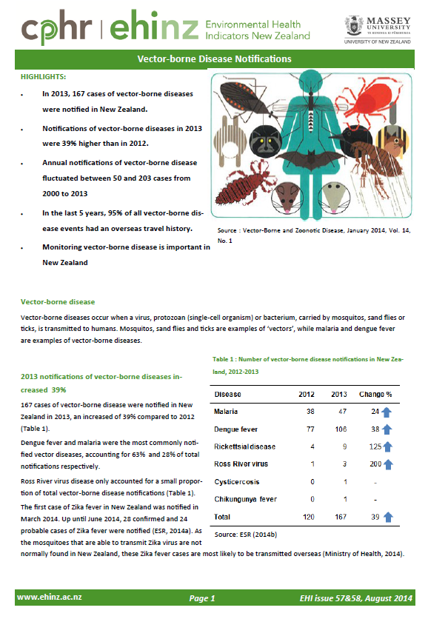
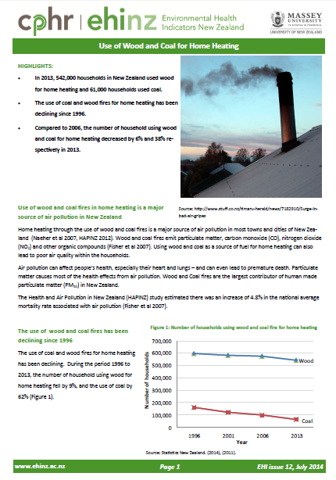
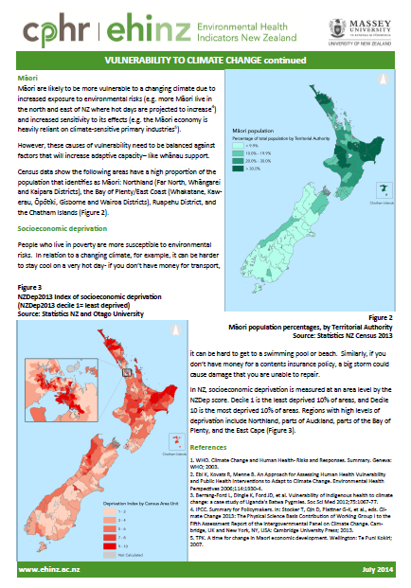
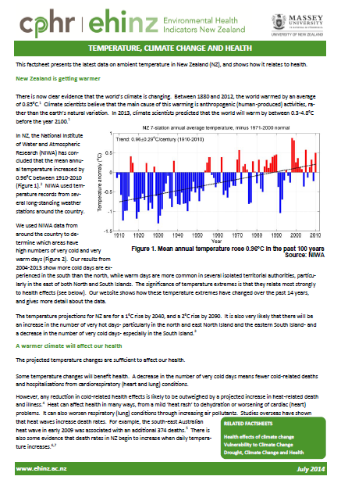
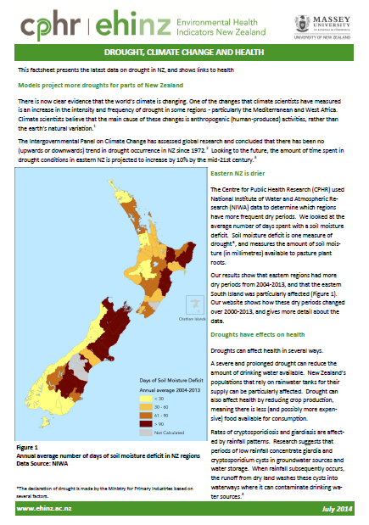
Environmental Health Indicator factsheets
Environmental Health Indicators programme

Slide 3
EHI factsheets released in the past 6 months
Domain | Topic
Air quality | Wood and coal fires
 | Particular matter
Recreational water quality | Livestock
Biosecurity | Vector-borne disease
Indoor environment | Health and household crowding
Climate change | Temperature
 | Rainfall and drought
Population information | Population change
Transport | Energy consumption
EHI FACTSHEET UPDATE

Slide 4
EHI factsheets released in the past 6 months
Domain | Topic | Factsheets
Air quality | Wood and coal fires | Use of wood and coal as a source of home heating (1996–2013)
 | Particular matter | Airsheds exceeding the PM₁₀ daily level on two or more days (2006–2012)
 |  | Annual average PM₁₀ levels in air (2006–2012)
Recreational water quality | Livestock | Number of livestock by type in New Zealand (2002–2013)
Biosecurity | Vector-borne disease | Vector-borne disease notifications by risk factor (2000–2013)
 |  | Notifications of dengue fever and malaria (2009–2013)
Indoor environment | Health and household crowding | Notifications of meningococcal disease (1997–2013)
 |  | Notifications of rheumatic fever (2004–2013)
Climate change | Temperature | Number of days over 25 degrees (2000–2013)
 |  | Number of days below 0 degrees (2000–2013)
 | Rainfall and drought | Number of days of soil moisture deficit (2000–2013)
Population information | Population change | Population change in New Zealand (1964–2013)
 |  | Population density by territorial authority (2001–2013)
Transport | Energy consumption | Total energy consumed in New Zealand by fuel type (2000–2013)
 |  | Total energy consumed in New Zealand by sector (2000–2013)
EHI FACTSHEET UPDATE

Slide 5
Key findings of the EHI factsheets
Topic | Highlights
Wood and coal fires | In 2013, 542,000 households in NZ used wood for home heating and 61,000 households used coal. The use of coal and wood fires for home heating has been declining since 1996. South Island homes are more likely to use wood or coal fires
Vector-borne disease | In 2013, 167 cases of vector-borne diseases were notified in NZ, 39% higher than 2012 In the past 5 years, 95% of all vector-borne disease events had an overseas travel history
Temperature | Mean annual temperature in NZ has risen by 0.96°C over the past 100 years Warm days more common in northern and eastern NZ
Rainfall and drought | Models project more droughts for parts of NZ Eastern areas of NZ have been most affected by a lack of rainfall over recent years.
Data sources:
New Zealand Census (1996, 2001, 2006, 2013) – Statistics New Zealand
Ministry for the Environment and Statistics New Zealand. 2014. New Zealand's Environmental Reporting Series: 2014 Air domain report. Wellington: Ministry for the Environment.
ESR. 2014. Notifiable and Other Diseases in New Zealand: Annual Report 2013. Porirua: The Institute of Environmental Science and Research Ltd
NIWA. 2010. 'Seven-station' series temperature data.
Ministry of Business, Innovative & Employment (MBIE). (2014). Energy in New Zealand 2014

Slide 6
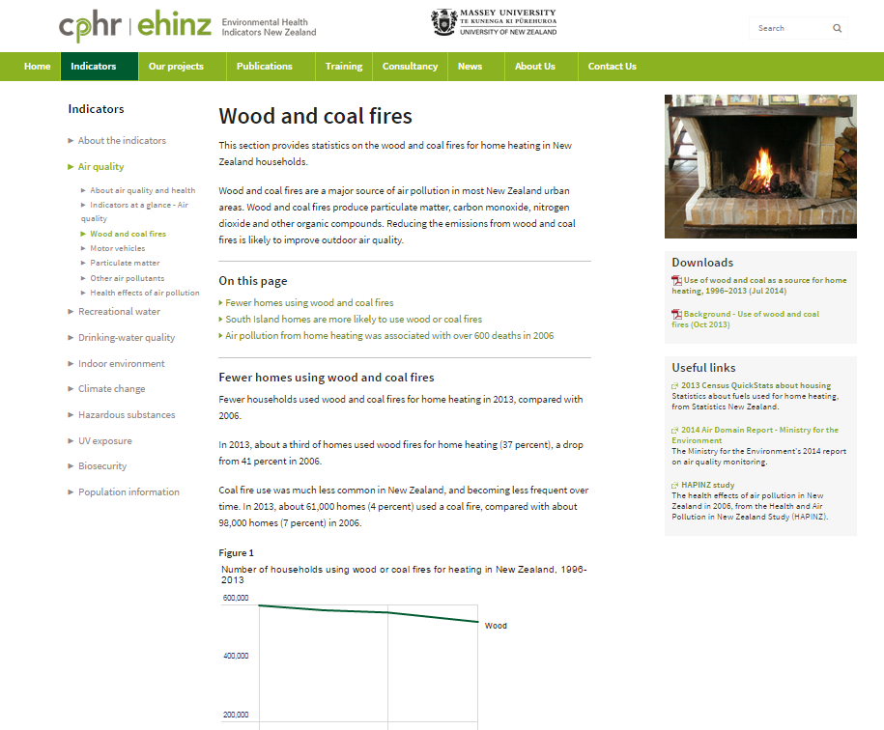
Factsheets live on the EHI web
EHI FACTSHEET UPDATE

Slide 7
Coming EHI factsheets
Domain | Topic | Factsheets
Air quality | Wood and coal fires | Proportion of households using wood and coal as a source of home heating (2001-2013)
 | Vehicle | Number of vehicles in New Zealand (2000-2014) Average age of vehicles in New Zealand (2000-2014)
Drinking-water | Safe drinking water supplies Water-borne disease | Population with access to safe drinking-water (2012-2013) Notifications of water-borne diseases (2001-2013) Notifications of water-borne diseases with untreated drinking-water as a risk factor (2001-2013)
Recreational water | Livestock | Livestock by type in New Zealand (2002-2014)
Population information | Population size | Population change in New Zealand (1964-2014)
And more….
EHI FACTSHEET UPDATE

Slide 8
Thanks
Thank you
EHI FACTSHEET UPDATE

