Slide 1
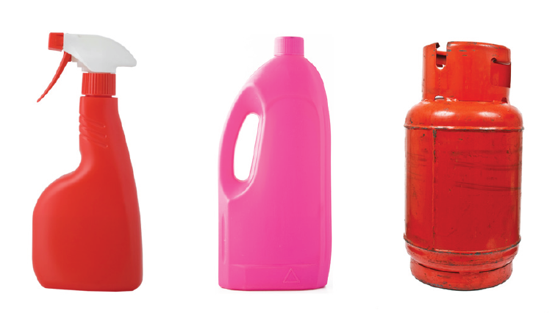
Hazardous Substances Surveillance Update
Helene Marsters
TAG Meeting: 24 November 2014

Slide 2
Two new data sources
Existing
Mortality
Coronial reports
Hospital discharges
Poison calls
New
Primary care notifications
Hazardous substances incidents
Hazardous substances

Slide 3
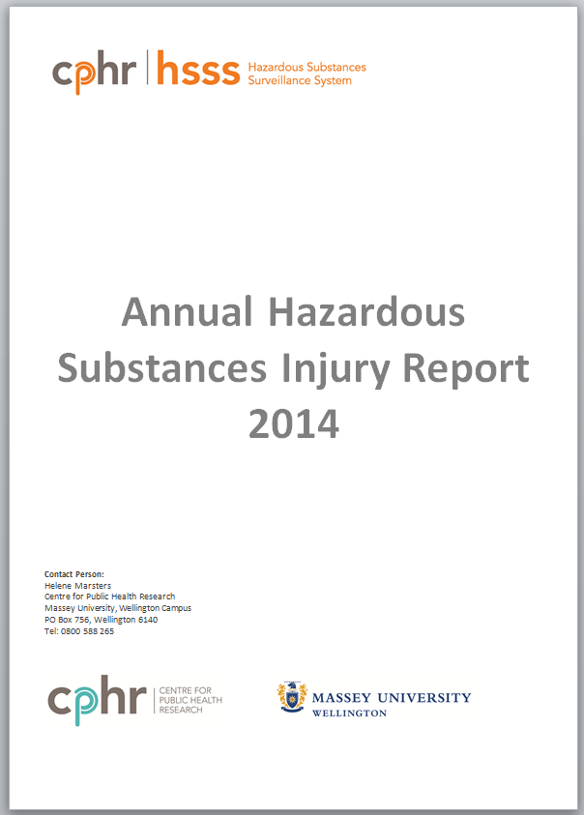
Hazardous Substances Injury Report 2014
Key Findings
No deaths of children 0-4 years but they have the highest rates of hospital discharge.
29 deaths from huffing in the 5-14 and 15-24 year age groups.
Māori have higher discharge rates for poisoning than non-Māori.
~ 1000 hazardous substances incidents reported each year.
>50% hazardous substances-related calls were for children 0-4 years old
Hazardous substances

Slide 4
National HSDIRT Report 2014
Key Findings:
180 lead notifications
Most common occupations
  painter/decorator, scrap metal worker, and foundry worker.
Over half were non-occupational lead exposures
  13 were children under 15 years old.
Source of lead exposure
  Lead based paint and indoor rifle range
Hazardous substances

Slide 5
National HSDIRT Report 2014
Hazardous substances

Slide 6
National HSDIRT Report 2014
Hazardous substances

Slide 7
National HSDIRT Report 2014
Key Findings:
63 hazardous substances notifications.
>80% were unintentional poisonings
Most common substance categories
  household and industrial chemicals.
6 cases required hospital admission including a 1 year old
41% occurred in the workplace
Hazardous substances

Slide 8
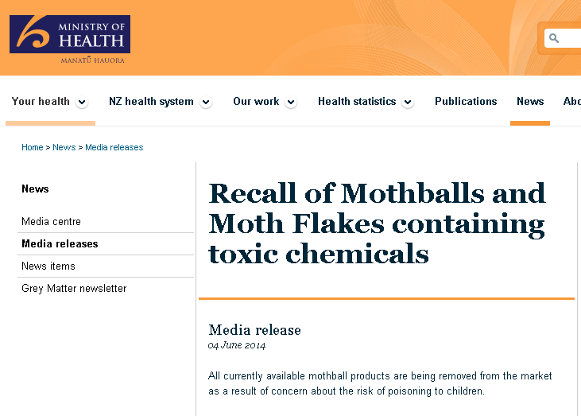

Ad-hoc requests
Mothball poisoning
Lead in toys
Common substances involved in poisoning
Hazardous substances

Slide 9
What’s next?
Report findings (particularly primary care notifications) in various GP-related publications.
Produce factsheets
Association between poisoning injuries and area deprivation
Hazardous substances

