Slide 1

Home Insulation and General Health Status
Project Update – Stage 1
Project Proposal – Stage 2
Caroline Fyfe, Andrew Parnell, 24/11/2014

Slide 2
Home Insulation and General Health Status
Project Update – Stage 1
Descriptive analysis of the EECA Warm Up New Zealand Heat Smart and Warm Up New Zealand – Health Homes insulation retrofit progammes.
The analysis involved mapping 285,005 records and anaylsing these in terms of proportion of homes insulated or heating subsidies provided by:
  District Health Board, Regional Council and Territorial Authority area
  Socioeconomic status of occupants Age of house
  Rural/ Urban location (based on Statistics New Zealand urban area classification)
  Heating type installed
Environmental Health Indicators programme

Slide 3
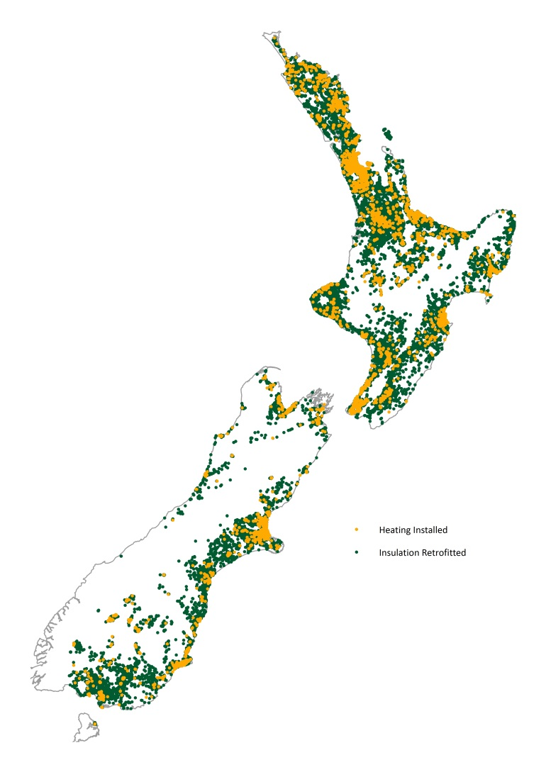
Key findings – Locational analysis
Notes:
Overall distribution of insulation retrofitting and heating grants from the WUNZ-HS programme broadly matched New Zealand’s population distribution.

Slide 4
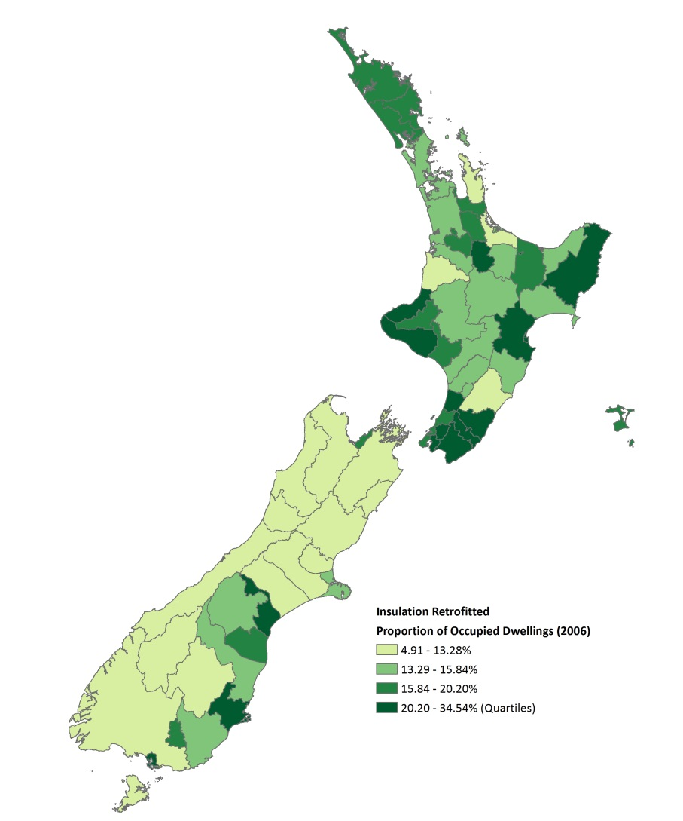
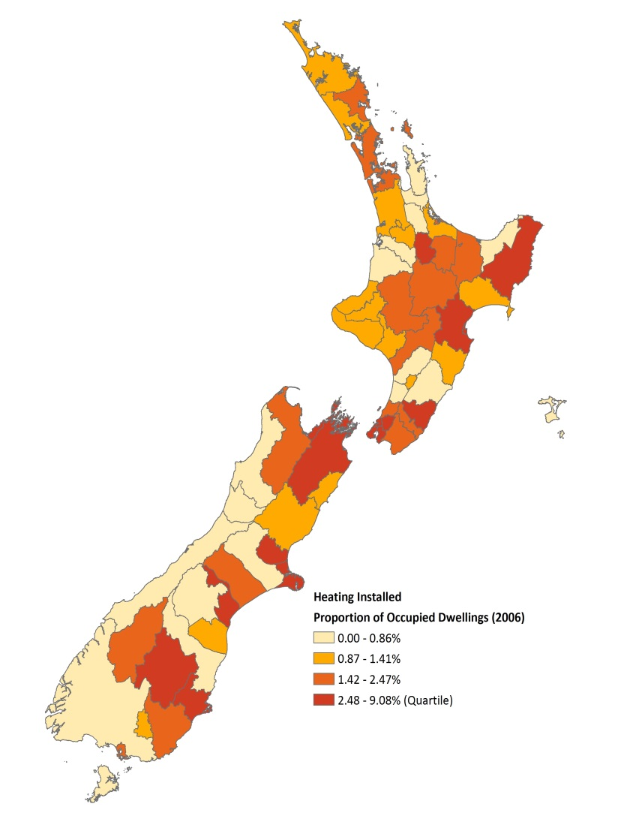
Key findings – Proportion of dwellings insulated and heating subsidy provided by local authority area
Notes:
The areas where the greatest proportion of households benefitted from WUNZ-HS subsidies for insulation were: Gisborne, Hawke’s Bay and Wellington (Hutt Valley and Wairarapa) regions.
The areas where the lowest proportion of households benefitted from WUNZ-HS subsidies for insulation were: the West Coast of the South Island, Tasman and Marlborough (excluding Nelson City).
The areas where the highest proportion of households received grants for heating were: Hawke’s Bay and Canterbury.
The areas where the lowest proportion of households received grants for heating were: the West Coast of the South Island and central North Island - Tarankaki, Wanganui-Manawatu and Waikato regions.
Generally greater uptake of the WUNZ-HS was found in more densely populated Territorial Authorities for example Napier, Hastings District and Nelson City.

Slide 5
Key findings -Proportion of households insulated by socioeconomic status
Dwellings insulated: ‘general income’ 55.23%; ‘low income’ 44.77%
Notes:
Uptake of both heating subsidies and insulation retrofits increased by New Zealand index of deprivation 2013 (NZDep2013) decile, up to decile 7 (for heating) and decile eight (for insulation). Thereafter uptake tailed off with the sharpest fall occurring between deciles nine and ten

Slide 6
Key findings -Proportion of homes where heating subsidies were provided by socioeconomic status
Heating subsidies: ‘general income’ 50.33% ‘low income’ 49.77%
Notes:
Uptake of both heating subsidies and insulation retrofits increased by New Zealand index of deprivation 2013 (NZDep2013) decile, up to decile 7 (for heating) and decile eight (for insulation). Thereafter uptake tailed off with the sharpest fall occurring between deciles nine and ten

Slide 7
Key findings: proportion of homes insulated by house age
Notes:
The majority of houses that benefitted from EECA insulation retrofitting and heating subsidies were built between 1950 and 2000.

Slide 8
Key findings: proportion of homes where heating subsidies were provided by house age
Notes:
The majority of houses that benefitted from EECA insulation retrofitting and heating subsidies were built between 1950 and 2000.

Slide 9
Key findings: proportion of homes insulated and heating subsidies provided by urban area status
Notes:
There was a slight over-representation of households that had insulation retrofitted in the three classes of urban area listed (90.73% of insulation retrofits) compared to the population distribution in these areas (85.90% of the population live in ‘urban’ areas). This was matched by an under-representation of households from rural areas particularly from rural areas including offshore islands. Slightly more than 7% of households taking up grants for insulation retrofits were from these areas which are home to 12% of the New Zealand population.
There was an over-representation of households that received heating subsidies in main urban areas (81.57% of subsidized heating) compared to the population distribution (71.80% of the population live in these areas). For the two other classes of urban area the proportion of heating subsidies broadly reflected the population distribution. Similar to the distribution of subsidies for insulation retrofits, heating subsidies were proportionally much lower (3.08%) in rural areas including offshore island, (where 12.00% of the population reside).

Slide 10
Key findings: type of replacement heating source chosen
Notes:
The majority of households that received a heating subsidy replaced their original heating source with an electric heat pump (77.95%). Approximately one fifth (19.66%) chose an EECA approved wood burner and two percent of households were split evenly between a pellet burner and a flued gas heater.

Slide 11
Proposal for stage 2: Exploratory Analysis: the impact of home insulation retrofits on the health outcomes of residents
A baseline analysis of hospitalization and pharmaceutical data amongst occupants of homes in the three years prior to insulation being installed for the following indoor environment/ housing quality related illnesses:
  acute hospitalization (excluding: maternity and injury related admissions)
  cold and damp related illness:
    upper respiratory tract conditions (total population and children <5 years): J00-06
    lower respiratory tract conditions (total population and children <15 years): J12-16, J18, J20-22
    asthma (children <15 years) J45-46
A follow up analysis of hospitalization and pharmaceutical data listed in ii
A test for statistical significance of any differences between 1 and 2.
Notes:
Agreement with parameters for this stage? –consisdent with EHI indicators for indoor environment (cold/ damp housing). Other potential indicators linked to functional overcrowding (rheumatic fever, meningococcal disease). Also diseases of elderly COPD have been used in other analysis.?
In order to complete Stage 2, the following data would be required from Ministry of Health hospitalization records from 2005-present (1-3 years prior to insulation being installed to 3 years post insulation)
Timing will depent on whether ethics approval is required.
Patient NHI number (or an encrypted version of this)
x,y co-ordinates for the patients address or a street address (to be geocoded)
domicile code
demographic data: age, gender, ethnicity
ICD10 code

