Slide 1
Flood Vulnerabilty
Presentation to TAG
Andrew Parnell
24 November 2014
Notes:
This is an area that we are looking at investigating.

Slide 2
Outline
Populations at risk
Populations at risk to floods
Pilot analysis

Slide 3
Introduction
Risk of natural hazards
Buildings/Assets well documented
Can cause injury and death
Those who are young or old are at more risk

Slide 4
Estimating those at risk
The spatial extent of hazards are difficult to determine
Flood data and analyses well researched and modelled.
Spatial extent is defined by likelihood of a flood event of a certain size.

Slide 5
Estimating those at risk
Estimating a population of an area based on the areas that often do not completely overlap.
Many of the numbers are small and sometimes confidentialised.
This analysis has these difficulties to contend with.

Slide 6
Data
10 and 100-year flood extents from Northland region council. From their Priority Rivers Project.
27 selected water catchments.
2013 meshblock dataset including usual resident population, aged 0-4 and 65 and over.
The larger extent from the 100-year flood data had very few meshblocks completely inside it.
Notes:
These age groups are the lowest and highest age groups available for mesh blocks.

Slide 7
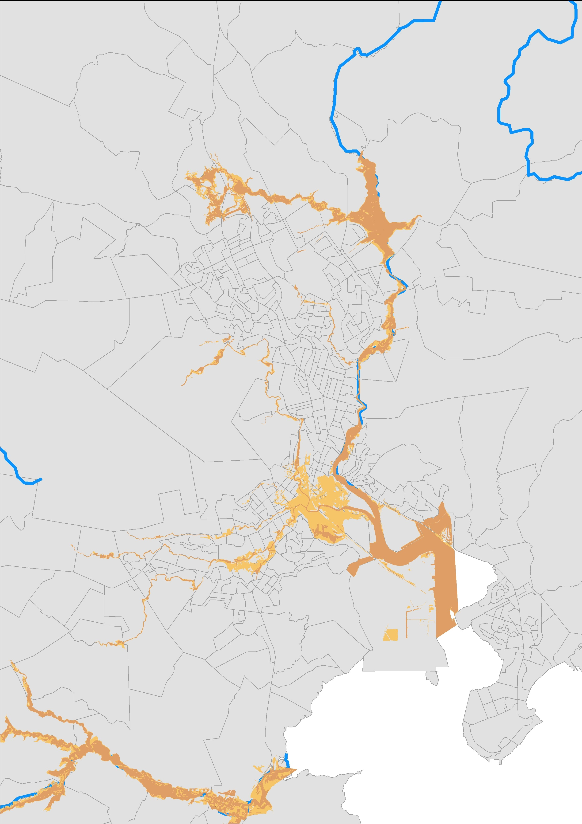
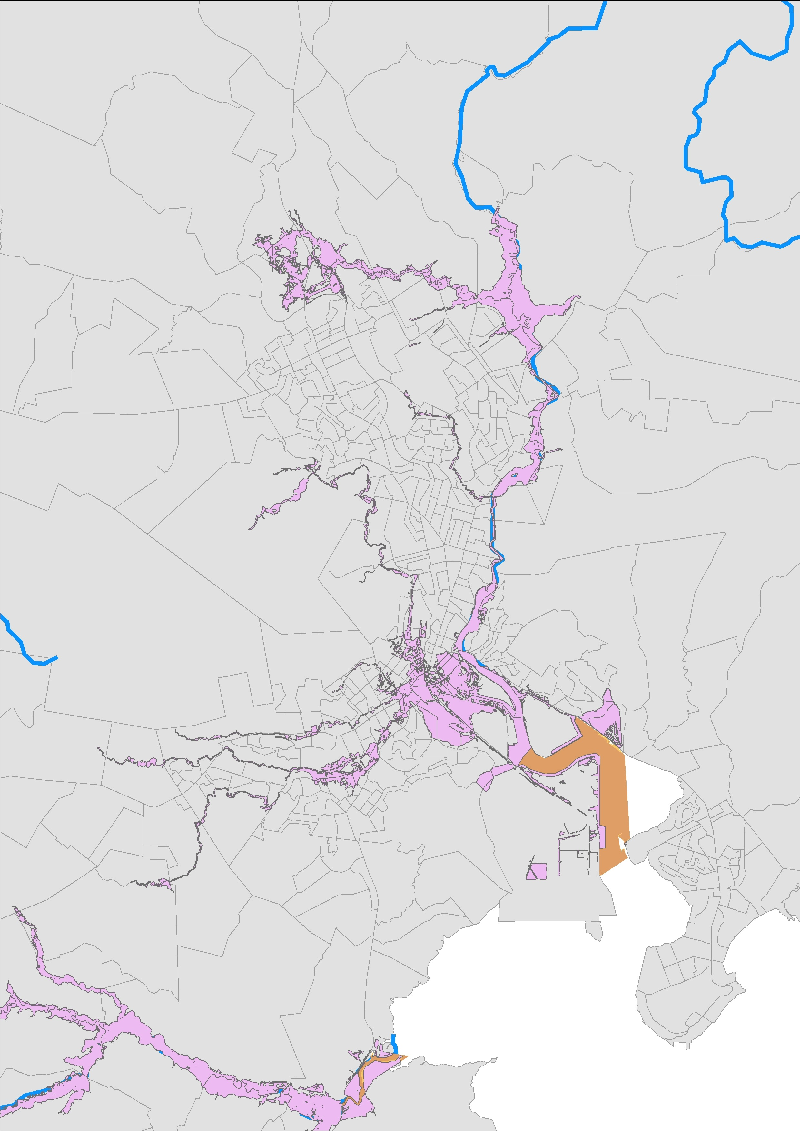
Data
Notes:
These age groups are the lowest and highest age groups available for meshblocks.

Slide 8
Method
A crude method was used for this pilot where proportion of the meshblock was used to determine population affected.
Assumes uniform distribution of the population with each meshblock
Notes:
These age groups are the lowest and highest age groups available for mesh blocks.

Slide 9
Initial results
Inside the 10-year flood extent:
Usual resident population: 190
Population aged 0-4: 12
Population aged 65 and over: 30
Notes:
These age groups are the lowest and highest age groups available for mesh blocks.

Slide 10
Initial results
Inside the 100-year flood extent:
Usual resident population: 5411
Population aged 0-4: 358
Population aged 65 and over: 916
Notes:
These age groups are the lowest and highest age groups available for mesh blocks.

Slide 11
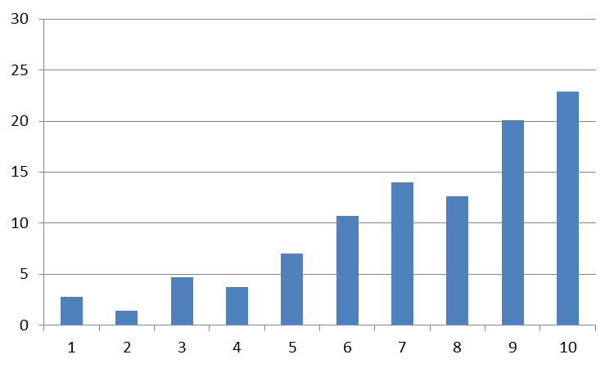
Deprivation
10-year flood extent
%
Deprivation decile

Slide 12
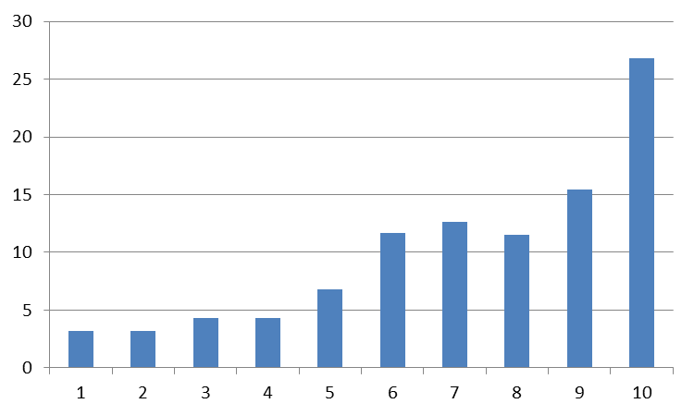
Deprivation
100-year flood extent
%
Deprivation decile

Slide 13
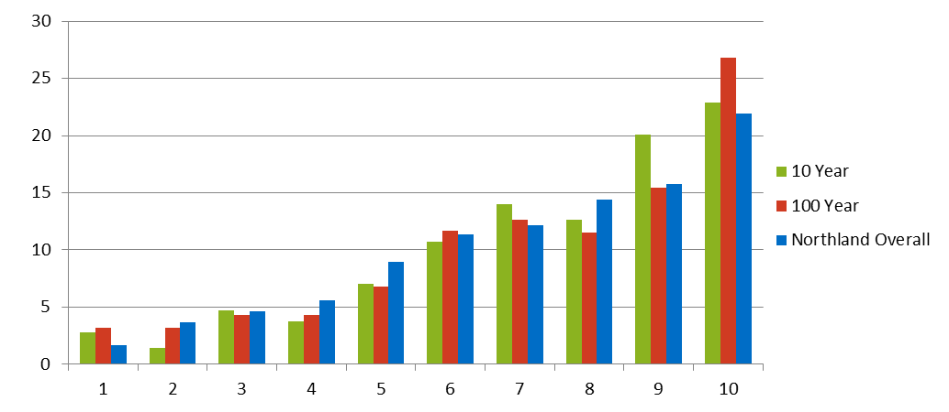
Deprivation
100-year flood extent
%
Deprivation decile

Slide 14
Feedback and other data
Any feedback would be welcomed
Other data:
Location of aged-care facilities
Single person households
Notes:
These age groups are the lowest and highest age groups available for mesh blocks.

