Slide 1
Proposed new indicators for transport
Presentation to TAG
Kylie Mason
24 November 2014
Notes:
So, here’s a basic overview

Slide 2
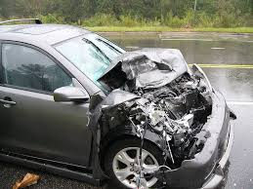
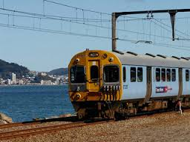


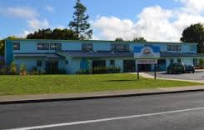

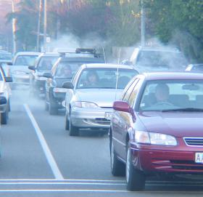
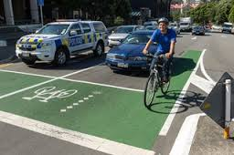
Transport
and health
Notes:
So, here’s a basic overview

Slide 3
Traffic accidents
Public transport
Physical activity
Access issues
Transport
and health
Noise
Fuel
use
Climate change
Cycle safety
Air pollution
Notes:
So, here’s a basic overview

Slide 4
Outline
Proposed environmental health indicators for transport
Other potential topics and indicators
Summarise and prioritise
Notes:
And explain at what regular ‘burden of disease’ studies are
So how does our environmental burden of disease study fit in?

Slide 5
Proposed environmental health indicators for transport
Notes:
We’re proposing the top 4 as being our starting priority.
Now we’ve already started work on SHS – data is relatively easy to source

Slide 6
Rationale for proposed topics
Transport topic | Rationale
Use of public transport, walking and cycling | Good physical activity for individuals Good for the environment Less air pollution Less traffic noise Less greenhouse gas emissions Public transport also has benefits
Traffic injuries | Direct impact on health
Lack of transport | Barrier to accessing services
Proximity to busy roads | Exposure to air pollution and noise pollution
Notes:
Rather than do a comprehensive analysis of all environmental risk factors at the same time
In terms of the environmental risk factors we’ll be looking at

Slide 7
Proposed new indicators for transport
Transport topic | Indicator
Use of public transport, walking and cycling | 1. Main mode of travel to work on Census day 2. Active transport to and from school (children) 3. Mode share of total hours travelled (%) by mode of transport
Traffic injuries | 4. Number of road deaths and hospitalisations, total and for cyclists and pedestrians
Lack of transport | 5. Unmet need for GP due to lack of transport
Proximity to busy roads | 6. Number of people living within certain distance (eg 100 metres) of a busy road
Notes:
Rather than do a comprehensive analysis of all environmental risk factors at the same time
In terms of the environmental risk factors we’ll be looking at

Slide 8
1. Main mode of travel to work
Proposed indicator: Percentage of commuters whose main mode of transport to work was walking, cycling, or public transport on Census day
Census data (2001, 2006, 2013)
Available at various geographic levels, demographics
Only on Census day (early March)
Only main mode (distance)
Notes:
We’re proposing the top 4 as being our starting priority.
Now we’ve already started work on SHS – data is relatively easy to source

Slide 9
1. Main mode of travel to work
Notes:
We’re proposing the top 4 as being our starting priority.
Now we’ve already started work on SHS – data is relatively easy to source

Slide 10
1. Main mode of travel to work
Notes:
We’re proposing the top 4 as being our starting priority.
Now we’ve already started work on SHS – data is relatively easy to source

Slide 11
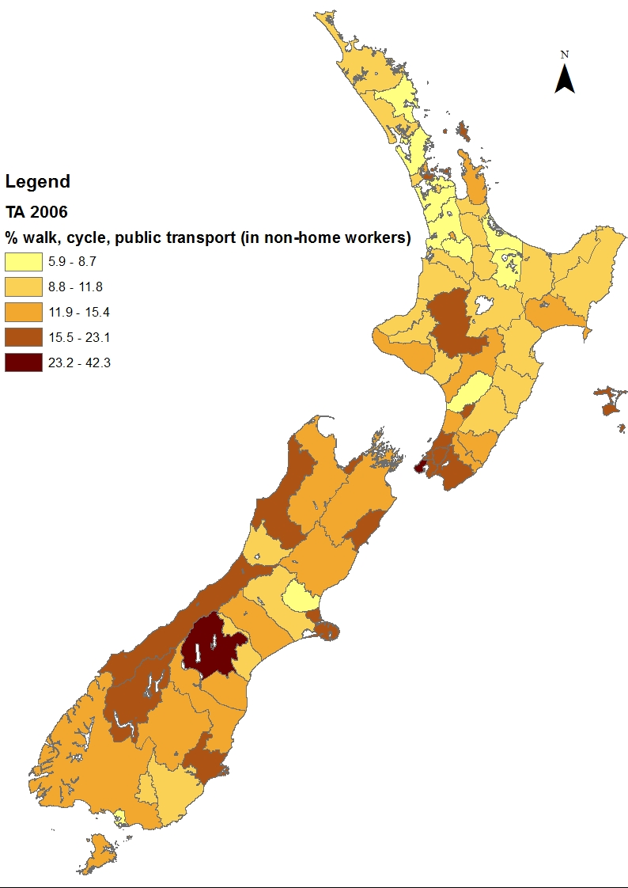
Walking, cycling, public transport
Percentage of commuters who walked, cycled, or used public transport as their main mode of transport to work on Census day (2006)
Notes:
We’re proposing the top 4 as being our starting priority.
Now we’ve already started work on SHS – data is relatively easy to source

Slide 12
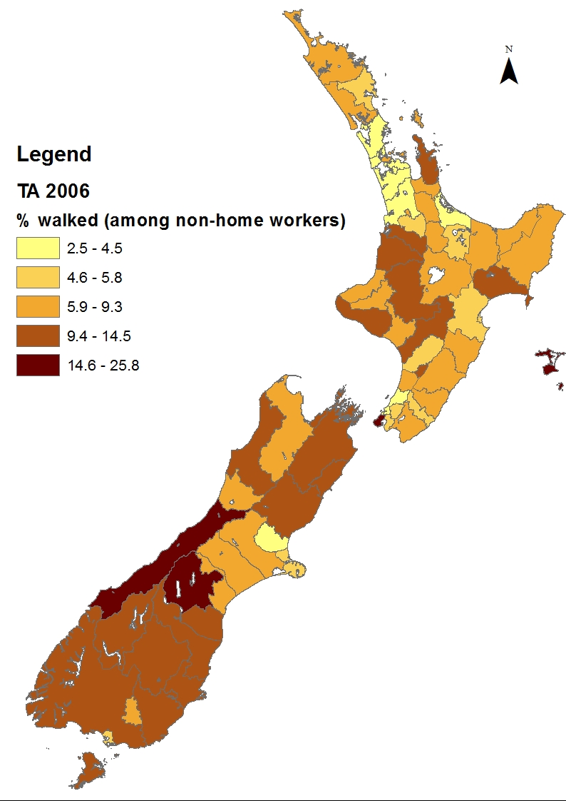
Walking
Percentage of commuters who walked as their main mode of transport to work on Census day (2006)
Notes:
We’re proposing the top 4 as being our starting priority.
Now we’ve already started work on SHS – data is relatively easy to source

Slide 13
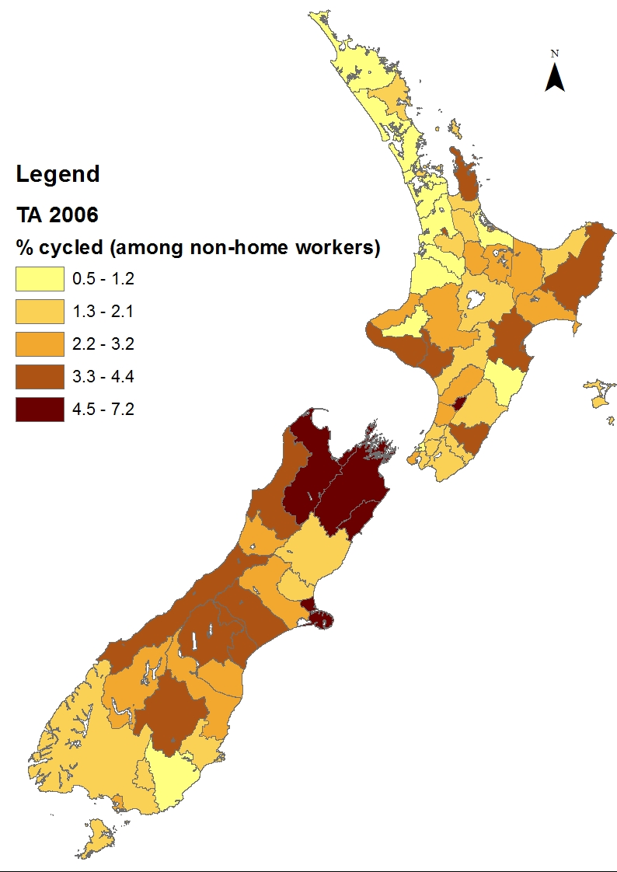
Cycling
Percentage of commuters who cycled as their main mode of transport to work on Census day (2006)
Notes:
We’re proposing the top 4 as being our starting priority.
Now we’ve already started work on SHS – data is relatively easy to source

Slide 14
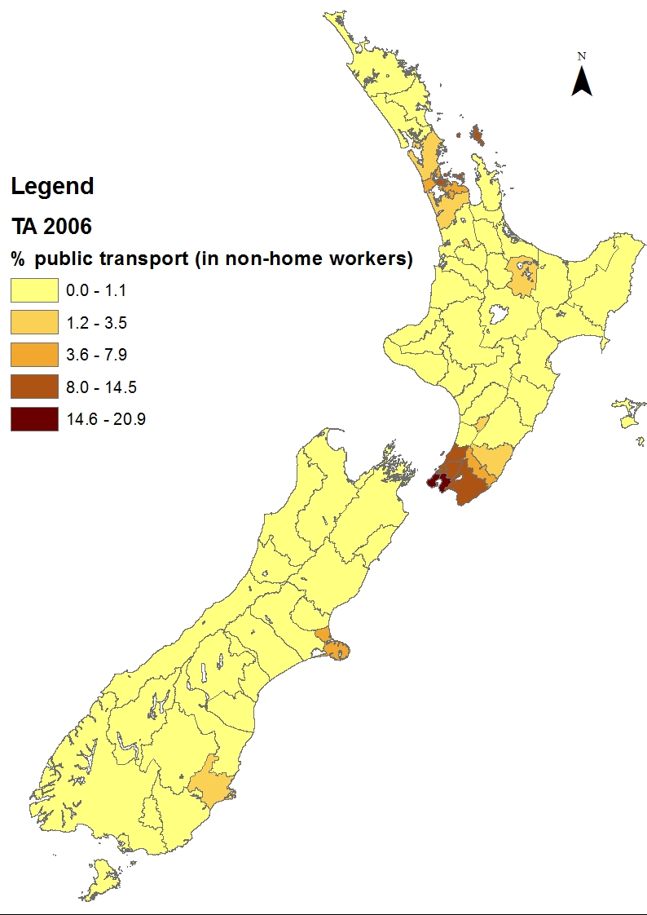
Used public transport
Percentage of commuters who used public transport as their main mode of transport to work on Census day (2006)
Notes:
We’re proposing the top 4 as being our starting priority.
Now we’ve already started work on SHS – data is relatively easy to source

Slide 15
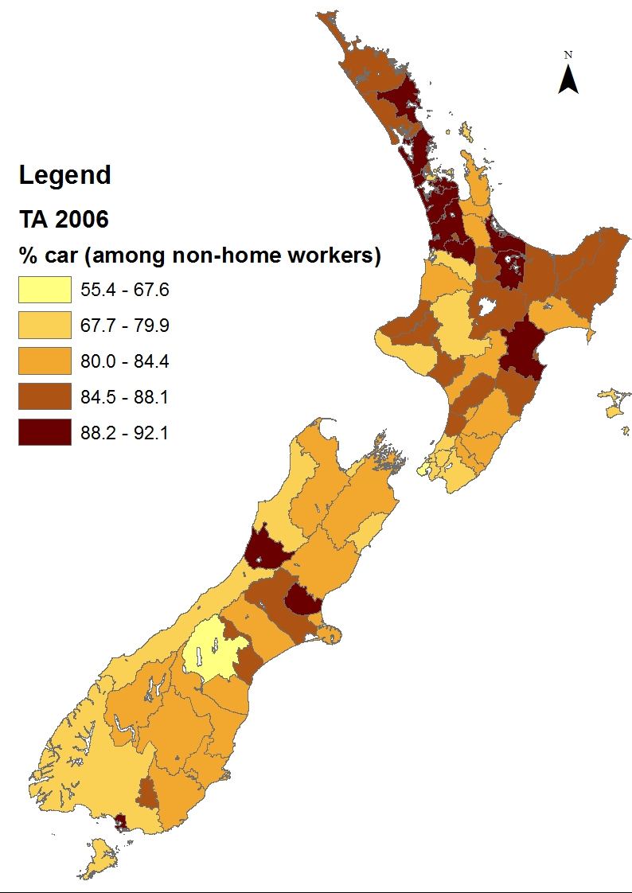
Car
Percentage of commuters who used a car as their main mode of transport to work on Census day (2006)
Notes:
We’re proposing the top 4 as being our starting priority.
Now we’ve already started work on SHS – data is relatively easy to source

Slide 16
2. Active transport to school
Proposed indicator: Percentage of children using physically active transport to school
Option 1: Used active transport to school (NZ Health Survey)
Demographic and socioeconomic data
DHB data possible 2011-2013
Time series only back to 2006/07
Notes:
We’re proposing the top 4 as being our starting priority.
Now we’ve already started work on SHS – data is relatively easy to source

Slide 17
2. Active transport to school
Option 2: Mode of transport to school (NZ Household Travel Survey)
Time series 1989/90 – 2009-2013
By mode of transport
Not available by many other variables
Notes:
We’re proposing the top 4 as being our starting priority.
Now we’ve already started work on SHS – data is relatively easy to source

Slide 18
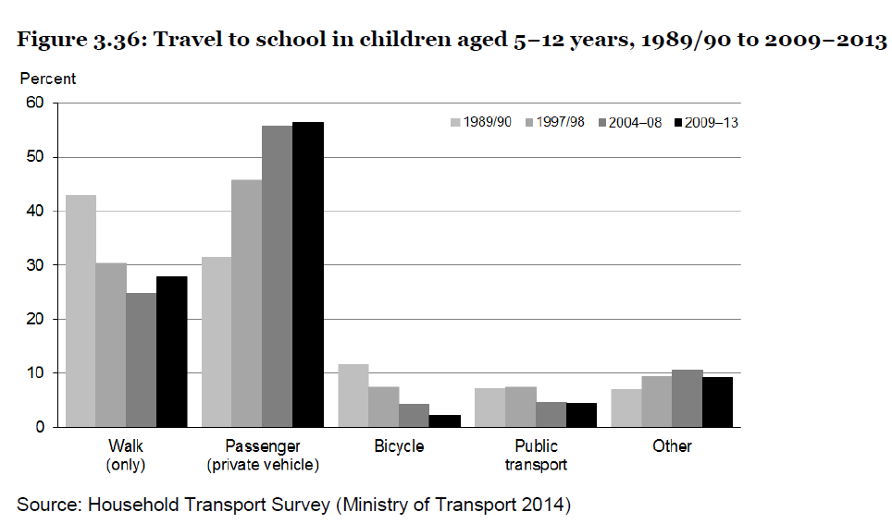
2. Active transport to school
Graph sourced from Ministry of Health
Notes:
We’re proposing the top 4 as being our starting priority.
Now we’ve already started work on SHS – data is relatively easy to source

Slide 19
3. Mode share of total time spent travelling
Proposed indicator: Percentage of total hours travelled, by mode of transport (including walking, cycling, public transport)
Sourced from NZ Household Travel Survey
Available by age group, regional council
Gives more indication of time spent travelling
Notes:
We’re proposing the top 4 as being our starting priority.
Now we’ve already started work on SHS – data is relatively easy to source

Slide 20
3. Mode share of total hours travelled
Source: 2010-2013 New Zealand Household Travel Survey
Notes:
We’re proposing the top 4 as being our starting priority.
Now we’ve already started work on SHS – data is relatively easy to source

Slide 21
4. Road deaths and injuries
Proposed indicator: Number (and rate) of road deaths and hospital admissions
Sourced from National Collections data
Can analyse separately for pedestrians and cyclists
Able to analyse by age group, ethnicity, NZDep, geographic area
Location based on where person lives
Notes:
We’re proposing the top 4 as being our starting priority.
Now we’ve already started work on SHS – data is relatively easy to source

Slide 22
4. Road deaths and injuries
Could also include motor vehicle crash statistics (NZTA)
Includes number of fatalities, injuries, crashes
Annual data (back to 1951)
TA data: Crashes, casualties per 10,000 population
Can map crash sites
Likely to undercount (as based on police reported crash events)
Not many demographic breakdowns available
Notes:
We’re proposing the top 4 as being our starting priority.
Now we’ve already started work on SHS – data is relatively easy to source

Slide 23
5. Lack of transport as a barrier
Proposed indicator: Unmet need for GP services due to lack of transport in the last 12 months
Sourced from NZ Health Survey
Available for adults and children, by age, sex, ethnic group, NZDep
Available by DHB for 2011-13
Could do further analysis (eg urban/rural)
Notes:
We’re proposing the top 4 as being our starting priority.
Now we’ve already started work on SHS – data is relatively easy to source

Slide 24
6. Proximity to a busy road
Indicator needs to be developed
Exposure to air pollution and noise pollution
Linked to health effects, including cardiovascular and respiratory effects
Studies have found adverse health effects for:
Distance from busy road
Volume (vehicles per day)
Notes:
We’re proposing the top 4 as being our starting priority.
Now we’ve already started work on SHS – data is relatively easy to source

Slide 25
6. Proximity to a busy road
Auckland study on separation distances
Recommended separation distances of: - 150m from strategic roads - 70m from regional arterial roads
Study found within these distances in Auckland:
162 early childhood centres
52 schools
2 hospitals
32,000 children resident
Source: Emission Impossible 2012
Notes:
We’re proposing the top 4 as being our starting priority.
Now we’ve already started work on SHS – data is relatively easy to source

Slide 26
6. Proximity to a busy road – issues to consider
How to define ‘busy road’?
Pre-existing definition, eg state highways
Traffic volumes (eg 25,000+ vehicles/day)
What distance to use?
Could use Auckland approach (70 metres)
What population to use for indicator?
Number of people living within zone (all / vulnerable)
Location of early childhood centres
Notes:
We’re proposing the top 4 as being our starting priority.
Now we’ve already started work on SHS – data is relatively easy to source

Slide 27
Other potential topics and indicators
Notes:
We’re proposing the top 4 as being our starting priority.
Now we’ve already started work on SHS – data is relatively easy to source

Slide 28
Environmental noise
An important issue – but not much data
Noise maps
Perceived noise pollution
Airport noise contour maps
Notes:
We’re proposing the top 4 as being our starting priority.
Now we’ve already started work on SHS – data is relatively easy to source

Slide 29
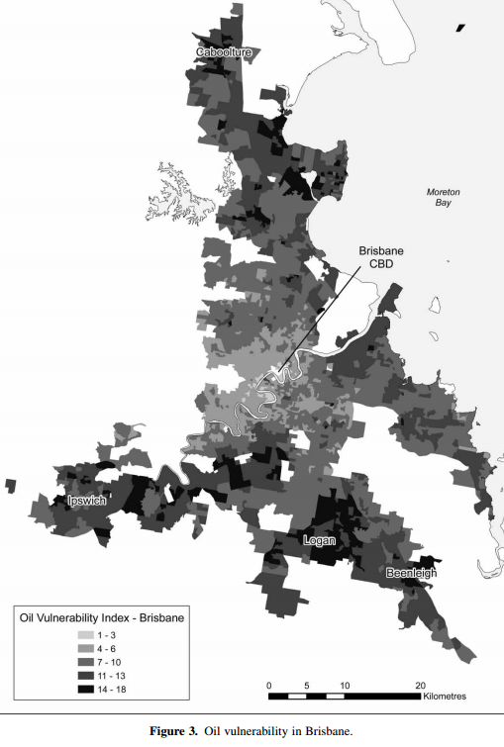
Oil vulnerability index
Measures vulnerability to fuel price increases
Index developed in Australia
Derived from:
Socioeconomic deprivation
Households with 2+ cars
Used car to travel to work
Source: Dodson and Sipe 2007
Notes:
We’re proposing the top 4 as being our starting priority.
Now we’ve already started work on SHS – data is relatively easy to source

Slide 30
Other potential indicators
Potential indicator | Recommendation
Population density in small areas | Could include as contextual info for maps
Households with no car | Hard to interpret – could include as contextual info
Public transport supply and access | Would need to source a lot of data; consider in future
Walkability index | Currently only available for 4 urban areas for 2009, not nationally
Notes:
Rather than do a comprehensive analysis of all environmental risk factors at the same time
In terms of the environmental risk factors we’ll be looking at

Slide 31
Summarise and prioritise
Notes:
We’re proposing the top 4 as being our starting priority.
Now we’ve already started work on SHS – data is relatively easy to source

Slide 32
Final agreement on indicators
Indicator | To check
1. Main mode of travel to work on Census day
2. Active transport to and from school (children) | Source of data
3. Mode share of total hours travelled (%) by mode of transport
Number of road deaths and hospitalisations, total and for cyclists and pedestrians | Whether to include crash statistics
5. Unmet need for GP due to lack of transport
6. Number of people living within certain distance of a busy road | Definition of busy road, distance, population
7. Other ideas – environmental noise, oil vulnerability, population density, households with no car, public transport access, walkability index | Whether to include any
Notes:
Rather than do a comprehensive analysis of all environmental risk factors at the same time
In terms of the environmental risk factors we’ll be looking at

