Slide 1
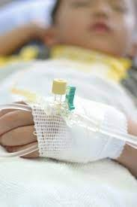
Addressing Health Intelligence Gaps in monitoring and evaluating long-term recovery following childhood injuries
www.trauma.reach.vic.gov.au
Shanthi Ameratunga
Senior Medical Researcher – Population Health Gain, Service Improvement & Innovation, Te Whatu Ora | Health NZ
Honorary Professor – University of Auckland
Public Health Observatory NZ (PHONZ) Conference 24 July 2024
https://www.monash.edu/medicine/sphpm/vstorm/home

Slide 2
Objectives
What’s the problem?
What have we learned so far in Aotearoa?
Evidence from Victoria, Australia
Implications for a model of care that achieves equitable long-term health and social outcomes for injured children in Aotearoa

Slide 3
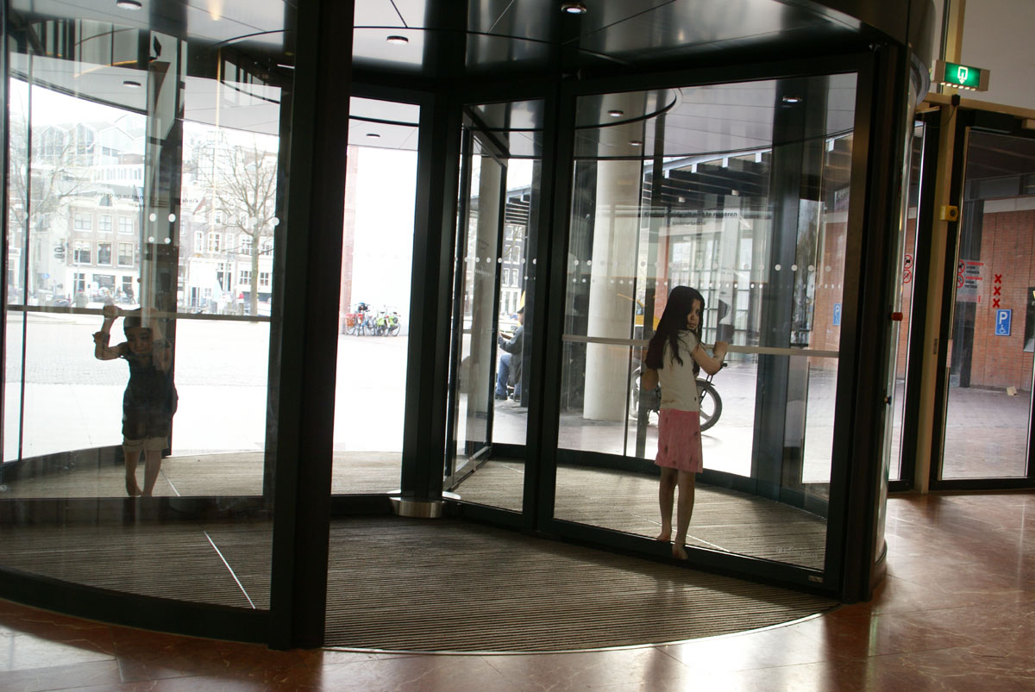

Slide 4
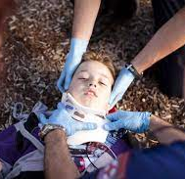
Global mortality trends 1950-2019
Injuries: leading cause of death among 10-24 year olds in most global regions.
In countries with advanced trauma care systems, increasing proportions of children survive life-threatening injuries
Evidence on long-term outcomes is scant
GBD 2019 Mortality Collaborators: Lancet 2021: 398: 1593-1618
S Ameratunga and A George, Lancet 2021; 398: 1546-7 (editorial)
www.trauma.reach.vic.gov.au

Slide 5
The Societal cost of unintentional childhood injuries in Aotearoa
M Young, T Love, M Wilson, M Alatini, M Shepherd
NZ Medical Journal 2021; 13 August 2021, Vol 134 No 1540
Tamariki Maaori and Pacific children had significantly higher rates of in-patient and day-patient admissions compared with other children
Tamariki Maaori had lowest rate of ACC claims
Maaori whaanau experienced highest proportionate loss of discretionary income
Pacific children had lower likelihood of documented post-injury disability

Slide 6
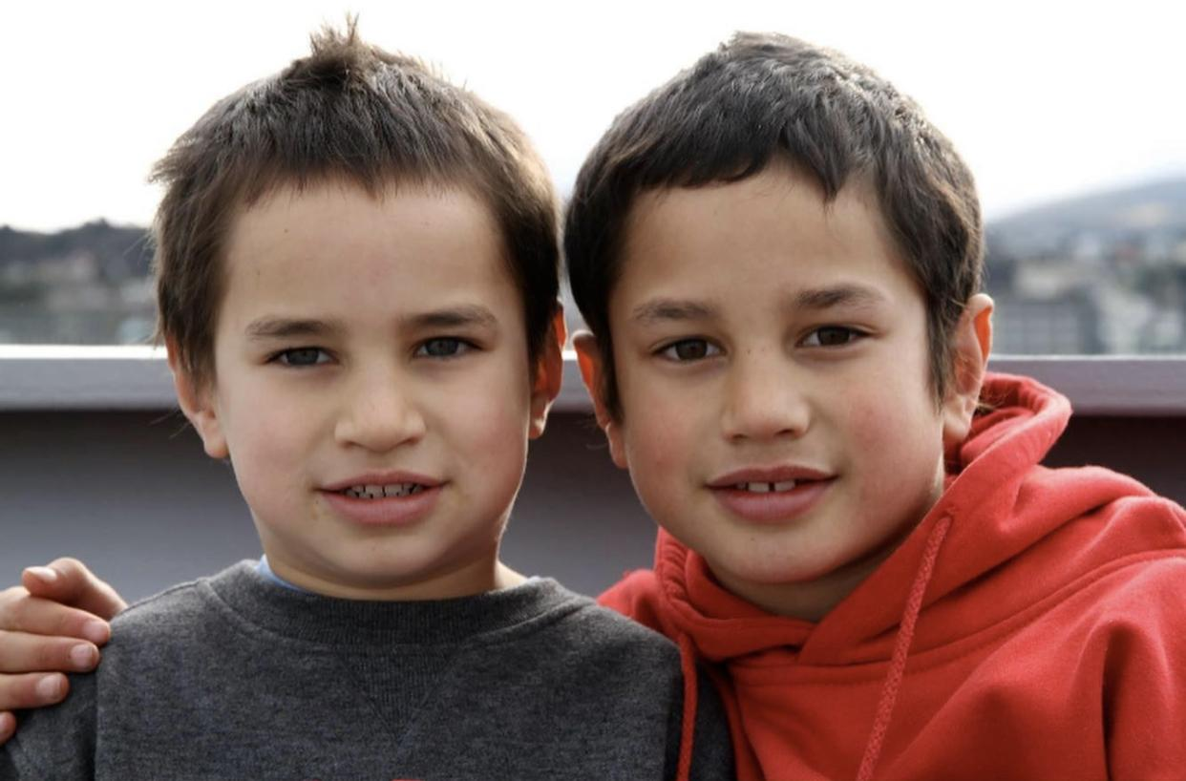
What do we know about longer-term outcomes of injured children in Aotearoa, and how do these outcomes vary across equity groups?
Elaijah Tuivaiti and Hemi Young
Kidz First Hospital Summer Studentship Program 2021-22

Slide 7
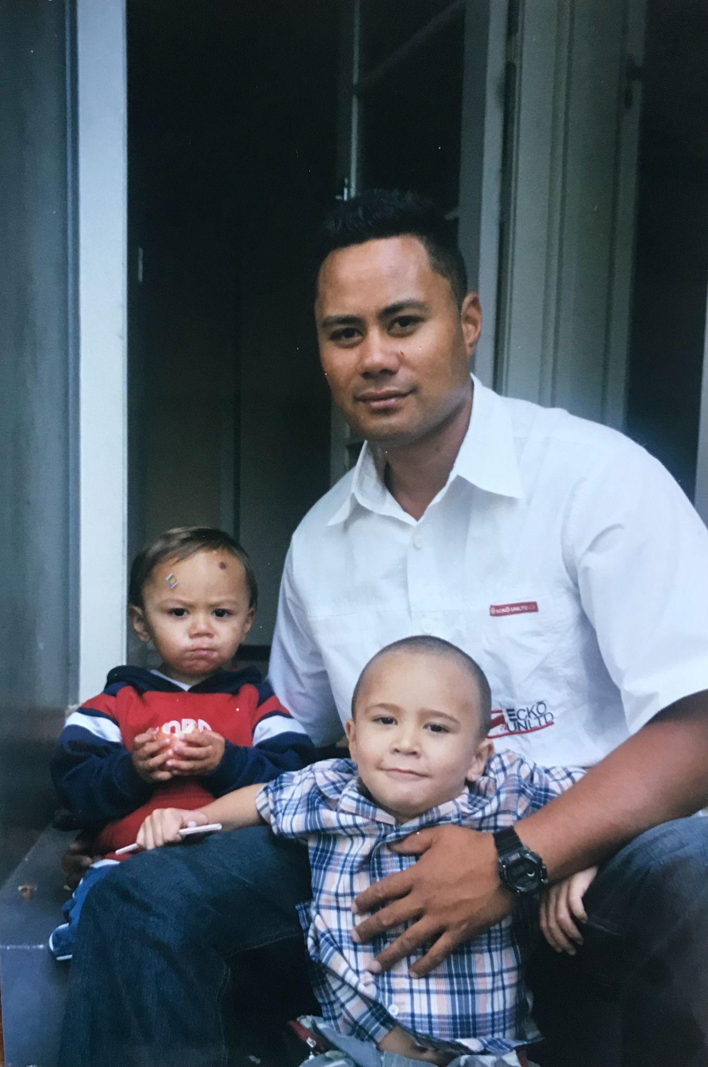
Systematic review of the published literature 2001-2021
14 articles, almost all focused exclusively on head injuries
Christchurch birth cohort study notes significant risks of adverse social, educational and behavioural outcomes in young adults following head injuries in childhood
Minimal information relating to PROGRESS (equity) criteria beyond age and gender.

Slide 8
Experiences of whānau/families when injured children are admitted to hospital
B Arlidge, S Abel, L Asiasiga, S Milne, S Crengle, S Ameratunga
Ethnicity & Health 2009: 14: 169-83
Service providers’ perspectives
S Ameratunga, S Abel, L Asiasiga, S Tin Tin, S Milne, S Crengle
BMC Health Services Research 2010; 10:333
“There was actually no one, they were all busy, they had how many patients to one nurse, they were so busy you couldn’t ask them, is she gonna be ok, all that kind of stuff” (Māori caregiver).
Inadequate communication and information
Difficulty negotiating the hospital environment
Stress of conflicting demands
Issues relating to ethnicity and cultural miscommunication
“I think a lot of children are going home with parents who are still in that traumatic time themselves…I think we’re not assessing. We are not asking how is it going to be for you in terms of managing? We ask the physical ones, like, can you manage this child getting to the toilet and da-da-da… But we don’t do such a good emotional stock take.”
Information needs not met
Children’s needs not met
Stress of the child’s hospitalisation on family
Staff continuity and coordination
Issues for Maori and Pacific family support services
Follow-up problems
This Photo by Unknown Author is licensed under CC BY-NC-ND

Slide 9
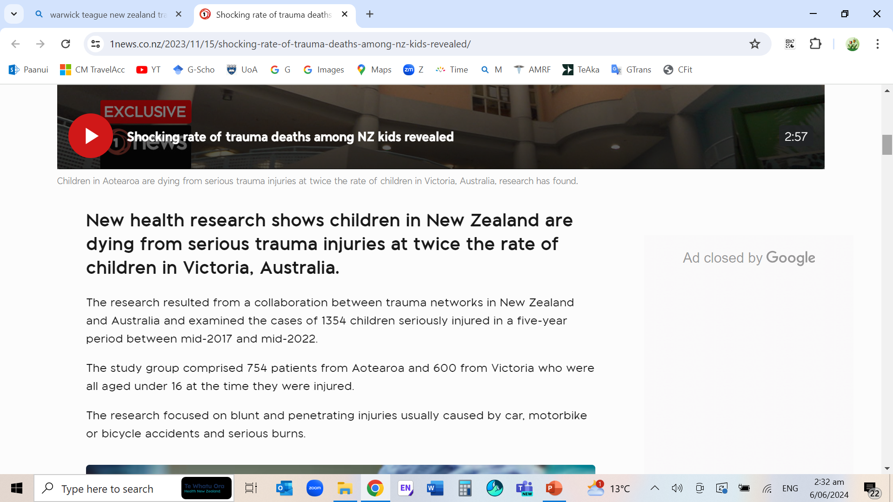
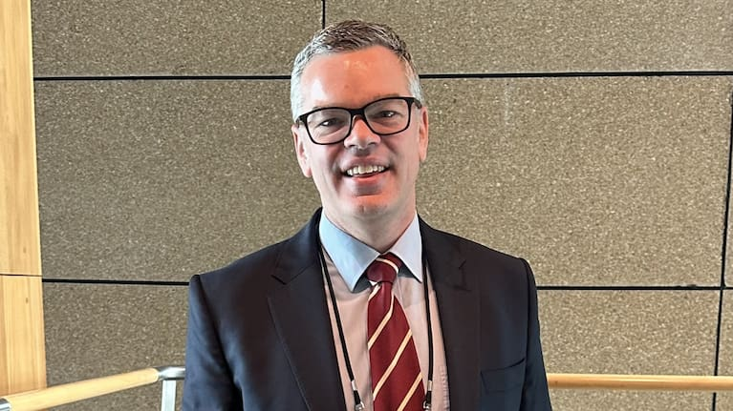
1 NEWS 15 Nov 2023
Associate Prof Warwick Teague

Slide 10
RESTORE Project: 5-year follow-up study of children surviving serious childhood injury in Victoria, Australia
Shanthi Ameratunga, Belinda Gabbe, Peter Cameron, Nicola Christie, James Harrison, Helen Jowett, Ronan Lyons, Andrew Nunn, Jennie Ponsford, Sandra Reeder, Warwick Teague
Monash University, Swansea University, UCL, Flinders University, University of Auckland, Royal Children’s Hospital, Victorian Spinal Cord Service
https://www.monash.edu/medicine/sphpm/vstorm/home

Slide 11
Population-based Prospective cohort study of Major Trauma* patients in Victorian State Trauma Registry
Participants: 199 patients <18 years injured July 2011 – June 2012
Caregiver interviews at 6, 12, 24, 36, 48, 60 months (71% response)
Outcomes: Kings Outcomes Scale for Head Injury (KOSCHI), PedsQL
Covariates: Socio-demographic factors, comorbidities, injury factors
Analyses: Logistic, ordinal, linear regression mixed models w random effects
*Injury Severity Score >12, ICU >24 hrs, ventilation or urgent surgery

Slide 12
KOSCHI categories at follow-up

Slide 13
Health-Related Quality of Life at follow-up

Slide 14
Factors associated*with adverse outcomes at 5yrs
*Adjusted models revealed statistically significant associations
 | KOSCHI (Disability) | PedsQL Total | PedsQL Physical | PedsQL Psychosocial
Female cf. male
Adolescents cf. younger children
Lower socioeconomic status cf. high
Regional/remote regions cf. Major cities
Comorbidities cf. no comorbidities
Compensable injury cf. non-compensable
Intentional injury cf. Unintentional injury
Non-Road Traffic Injury (non-RTI) cf. RTI
Head injury cf. no head injury
Factors showing weak or no associations: Admission to a major trauma service, ISS, subsequent hospital admission, pre-existing mental health or substance use problem

Slide 15
Implications for children surviving major trauma
40% experience moderate to severe disability even 5 years later.
Psychosocial recovery substantially lags physical recovery.
Issues predictive of adverse outcomes are evident early
Limitation: No ethnicity data or indicators on variations in care
Equity-focused tailored injury interventions require extending line of sight of trauma-informed care
www.trauma.reach.vic.gov.au
Strengthen Injury control across continuum of care

Slide 16
Implications for a model of care
Injuries = chronic condition embedded within wider social injustices
Impacts not unlike Adverse Childhood Experiences
Need to understand local needs, contexts, and communities
Long-term whanau-centred approach aligning relationships, services (including ACC & primary care), data and monitoring
Extending concepts of indicators –
Threat to life versus threat to wellbeing and flourishing
Measuring “disability” (people and contexts matter)
Mana-enhancing approaches to assess and respond to needs
Tiriti-responsive equity-focused systems before & beyond ER

Slide 17
Pathways to Healing
HRC-funded Project
using Fa’afaletui Framework
Mixed-methods research project engaging patients and whaanau, providers and communities.
Seini Taufa, Dame Teuila Percival,
Braden Te Ao, Sam ‘Ofanoa,
Josephine Herman, Nicola Kayes,
Shanthi Ameratunga
Ngā mihi nui
Elaijah Tuivaiti and Hemi Young (KF summer students)
Māori Child Health Research Collective in South Auckland (Kidz First)
RESTORE participants, Prof Belinda Gabbe and team at Monash University
NHMRC, Health Research Council of NZ, Fisher & Paykel Healthcare Foundation, Stevenson Trust
Contact Shanthi at:
shanthi.ameratunga@middlemore.co.nz
s.ameratunga@auckland.ac.nz

