Slide 1
An AI-Enabled Framework for Transferable Pandemic Modelling
PHONZ 2024
July 25th, 2024

Slide 2
Assoc Prof Michael O’Sullivan (he/him)
Dept of Engineering Science
University of Auckland (UoA)
Nō Airani me Haina ōku tupuna
Ko O’Sullivan tōku whānau
Ko Te Atatū tōku hāpori
E noho ana au ki ngā whenua me ngā wai tapu o Te Kawerau a Maki
Tēnei ka mihi!
Tēnā koutou!
My ancestors are from Ireland and China
O’Sullivan is my family
Te Atatū is my community
I live on the lands and near the waters of Te Kawerau a Maki
I acknowledge them!
Greetings to you all!
University of Auckland
BSc (Hons), MPhil (Disc)
Stanford University alumni
MS, PhD
President, OR Society of NZ (ORSNZ)
Deputy Director, Te Punaha Matatini
(Complex Systems)
Theme Leader, Precision Driven Health
AI & Pandemic Response Working Group, GPAI
Research/consulting in Operations Research and (Computational) Analytics for Health, Social Investment, Cloud Computing, Infrastructure Planning, Finance

Slide 3
GPAI Members in 2023
The Responsible AI Working Group brings together 45 experts, including two Observers - one representative of the OECD and a second representative of UNESCO.
Argentina
Ireland
Serbia
Australia
Israel
Singapore
Belgium
Italy
Slovenia
Brazil
Japan
Spain
Canada
Republic of Korea
Sweden
Czech Republic
Mexico
Türkiye
Denmark
Netherlands
United Kingdom
France
New Zealand
United States
Germany
Poland
European Union
India
Senegal

Slide 4
Responsible AI
Working Group Projects
Diversity and Gender Equality in AI
Sandbox for responsible AI
Scaling Responsible
AI
Solutions
Social Media
Governance
Pandemic Resilience
Responsible AI Strategy for the
Environment
4

Slide 5
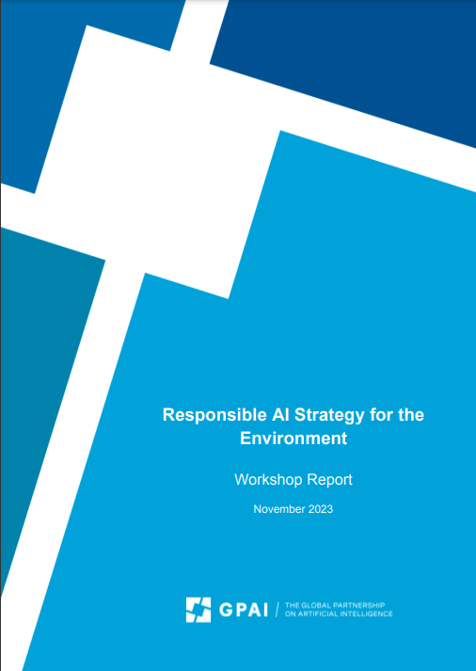
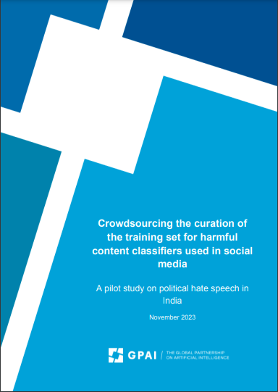
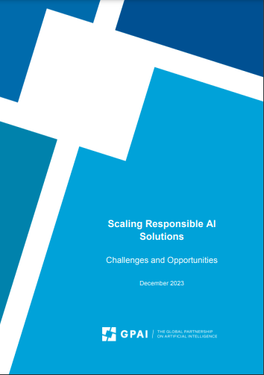
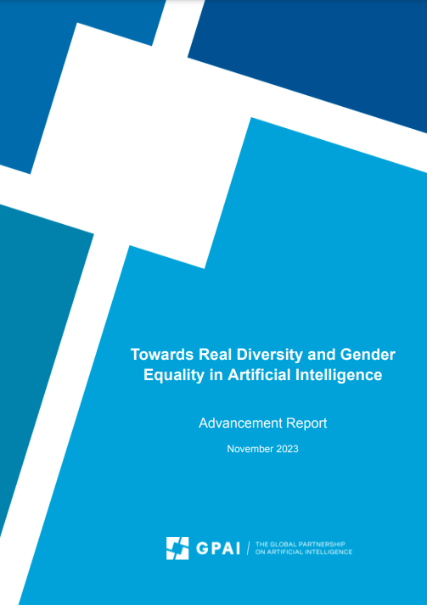
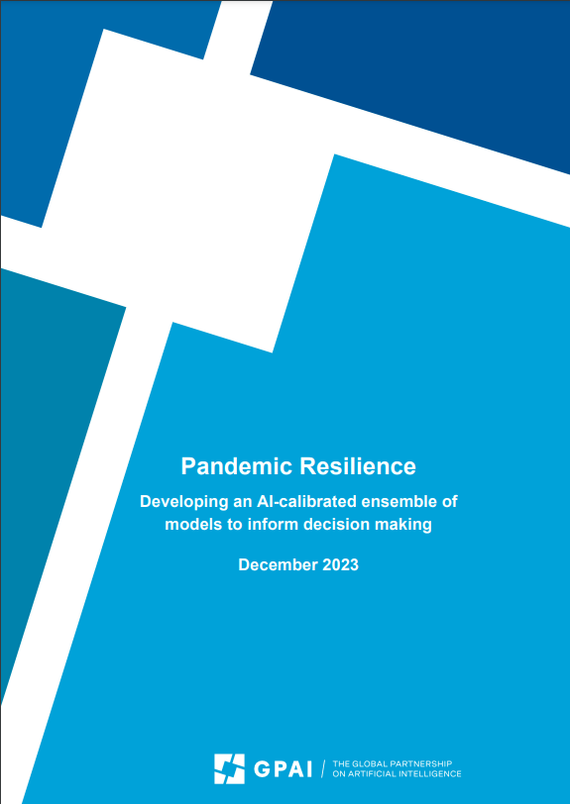
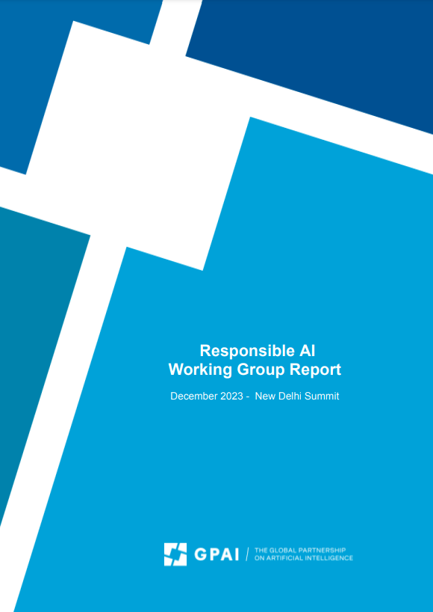
Responsible AI WG 8 Publications in 2023
PHONZ 2024

Slide 6
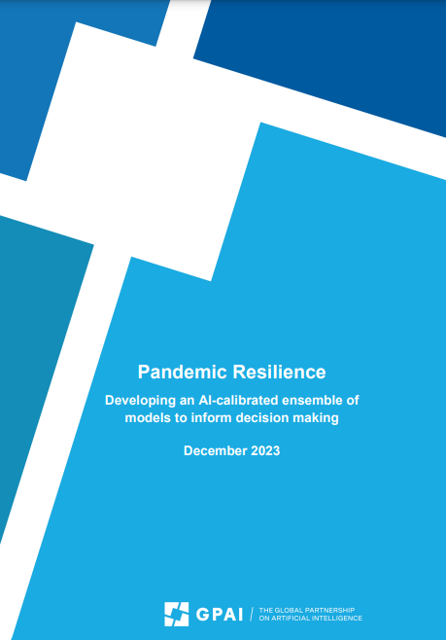
Key Recommendations for Policymakers
Connect decision makers to modelers
Explore opportunities for modeling and leverage the potential of ensembling
Anchor decision support systems in Responsible AI
Build capacity for model-enhanced decision making
Establish policy review and model maintenance mechanisms
Integrate ensemble modeling into pandemic preparedness toolkits
Test the readiness of the models in real-life
Create a standard public data pipeline

Slide 7
Pandemic Resilience
Problem Definition
Addressing uncertainty in complex systems
Interconnected crises create noise
Balancing different objectives
The Solution
Importance of data-driven decisions
Modeling for scenario generation
Benefits of ensemble modeling
Fostering RAI best practices
“AI that is human-centred, fair, equitable, inclusive and respectful of human rights and democracy, and that aims at contributing positively to the public good”
PHONZ 2024

Slide 8
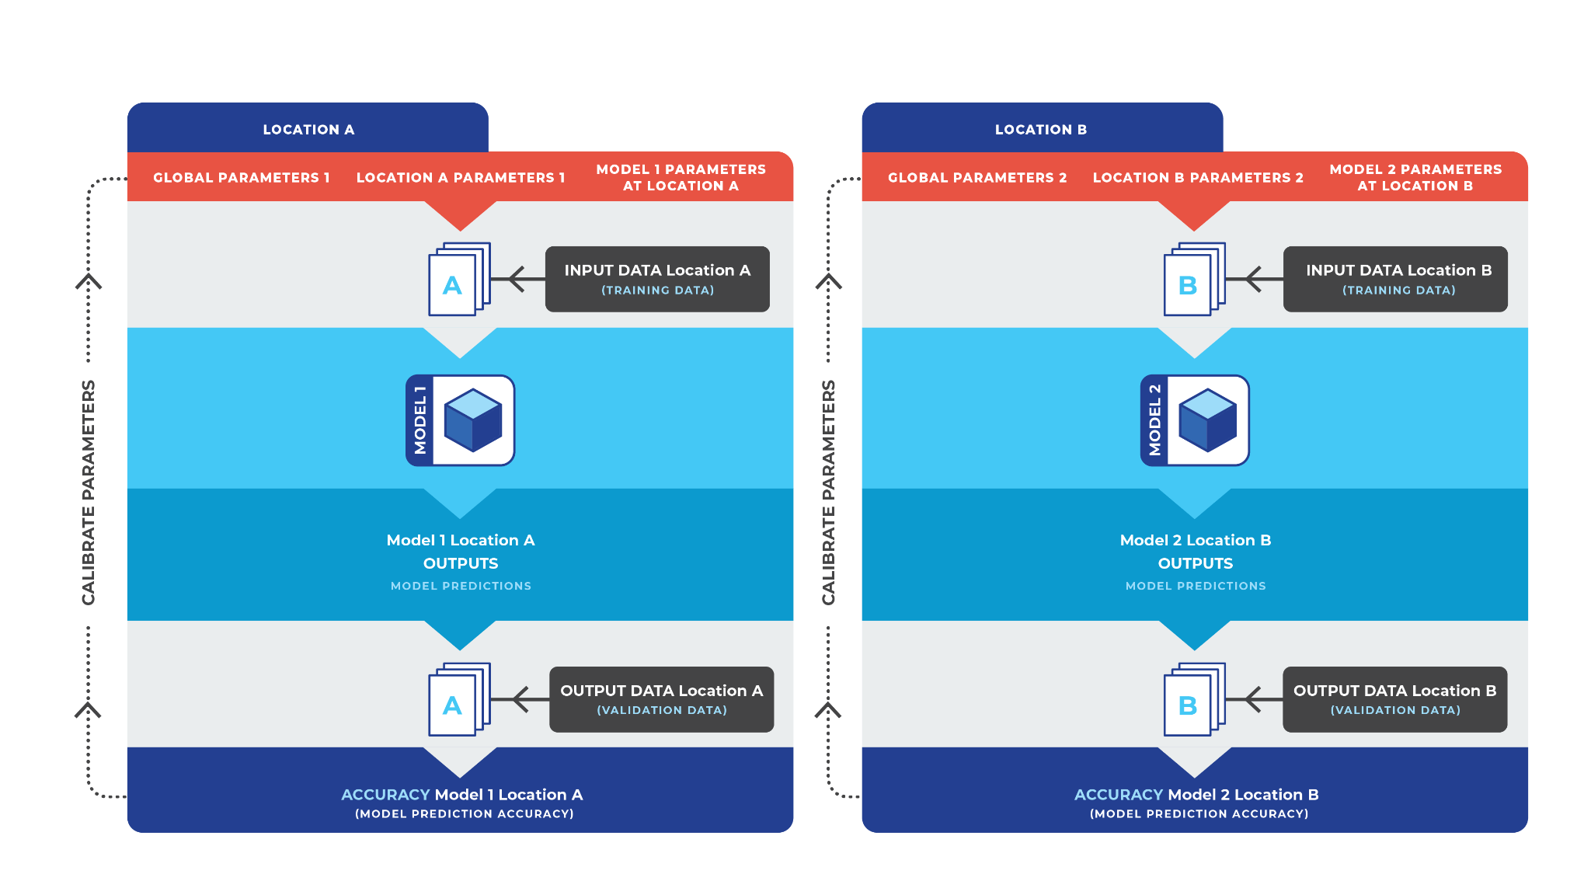
Individual Model Calibration

Slide 9
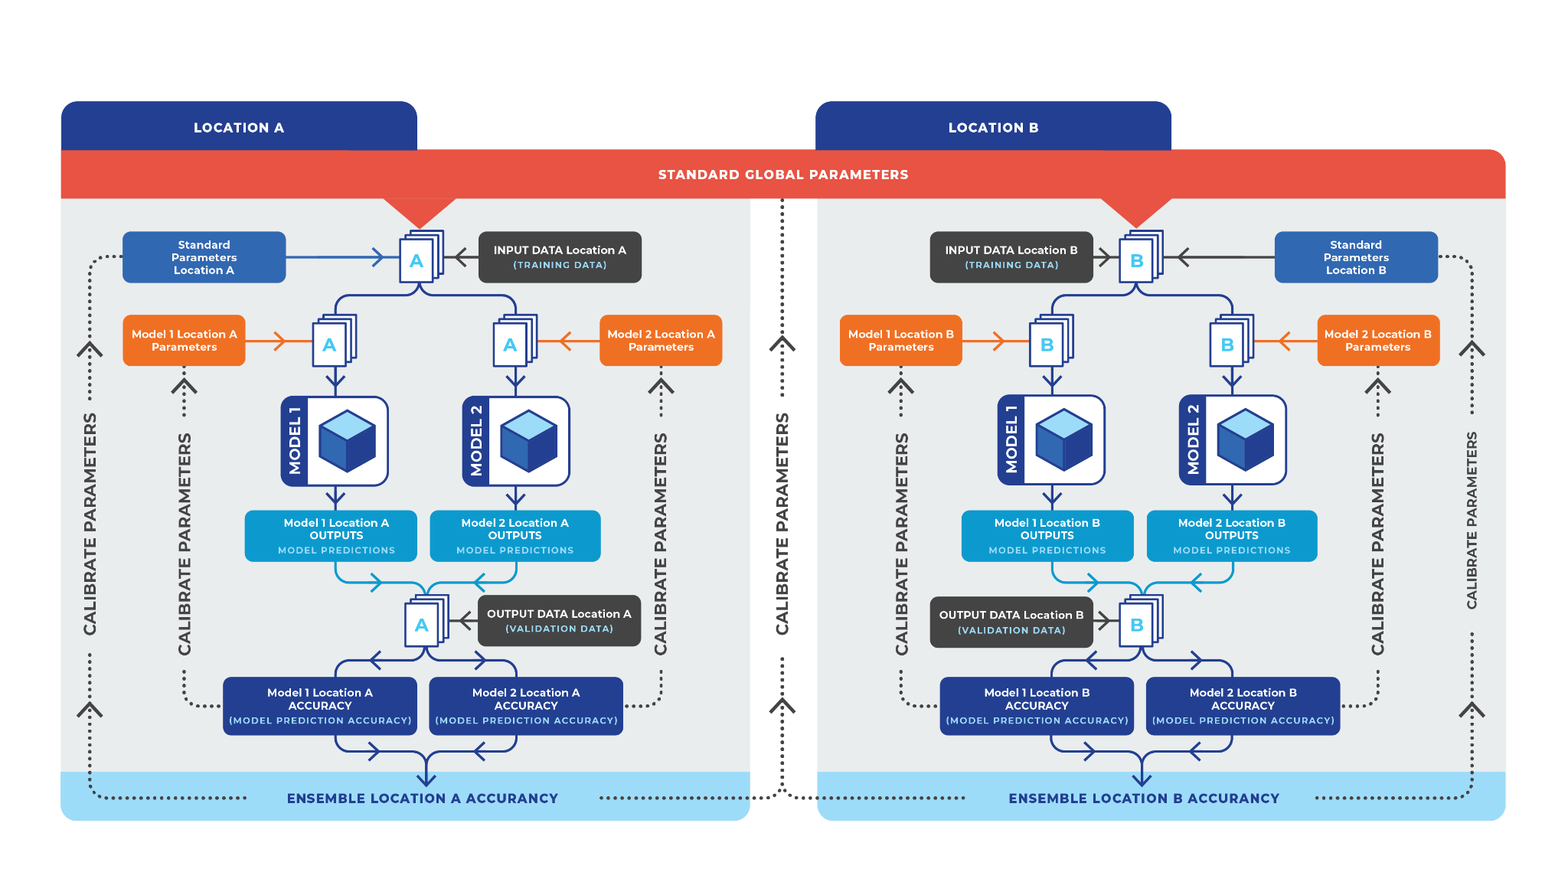
Ensemble of Models Calibration

Slide 10
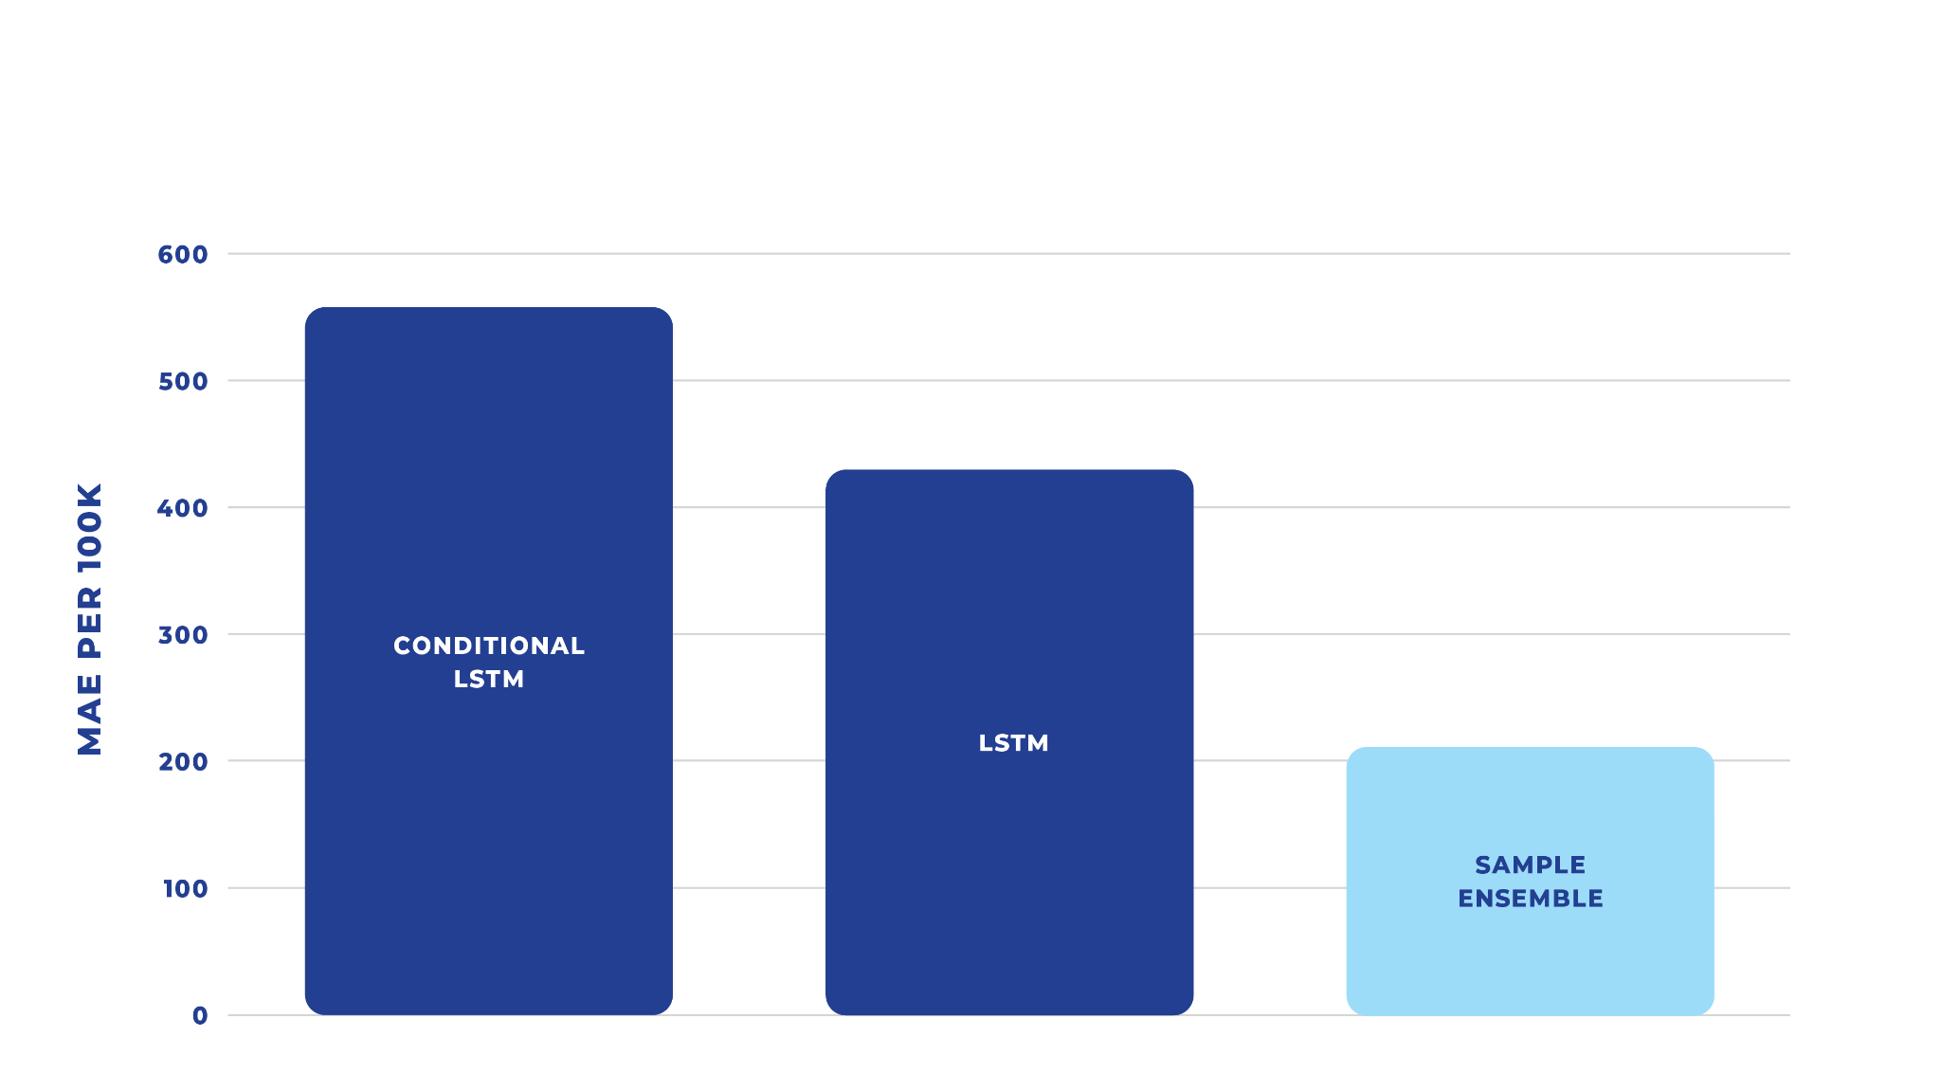
Results
The project proved that collaborative ensemble models enables:
Better model precision and accuracy
Reduced mean average prediction errors by at least 50 percent compared to its individual model components.
Synergies and resilience
Showed potential for giving more weight to different models depending on the stage of epidemic progression
Rapid, Responsible data-based policy development and implementation.
Strengthen the evidence base and permit scenario evaluation under conditions of uncertainty.
The study team speculates that underexplored aspects of model generalizability, lack of computational expertise, and limited funding for modeling collaboratives has led to the underuse of ensemble models in policy laboratories and scenario analysis, despite the higher accuracy and bias reduction demonstrated here.

Slide 11
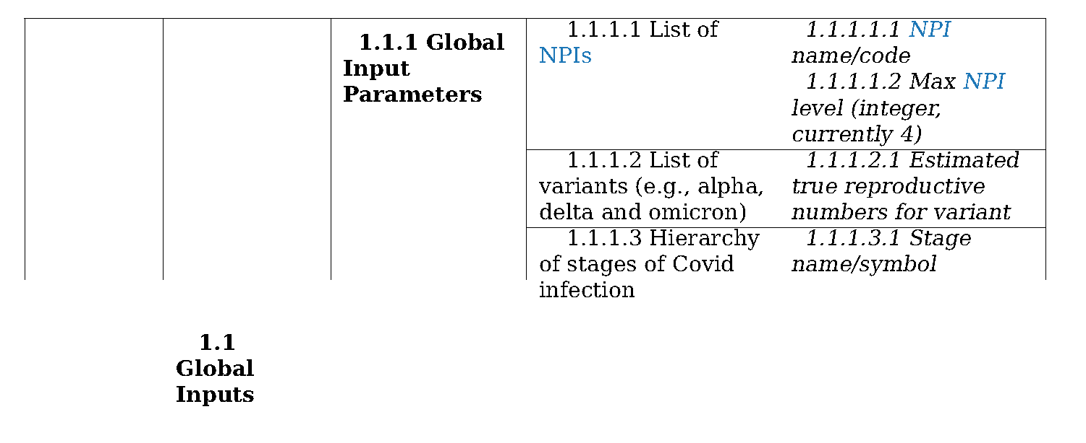
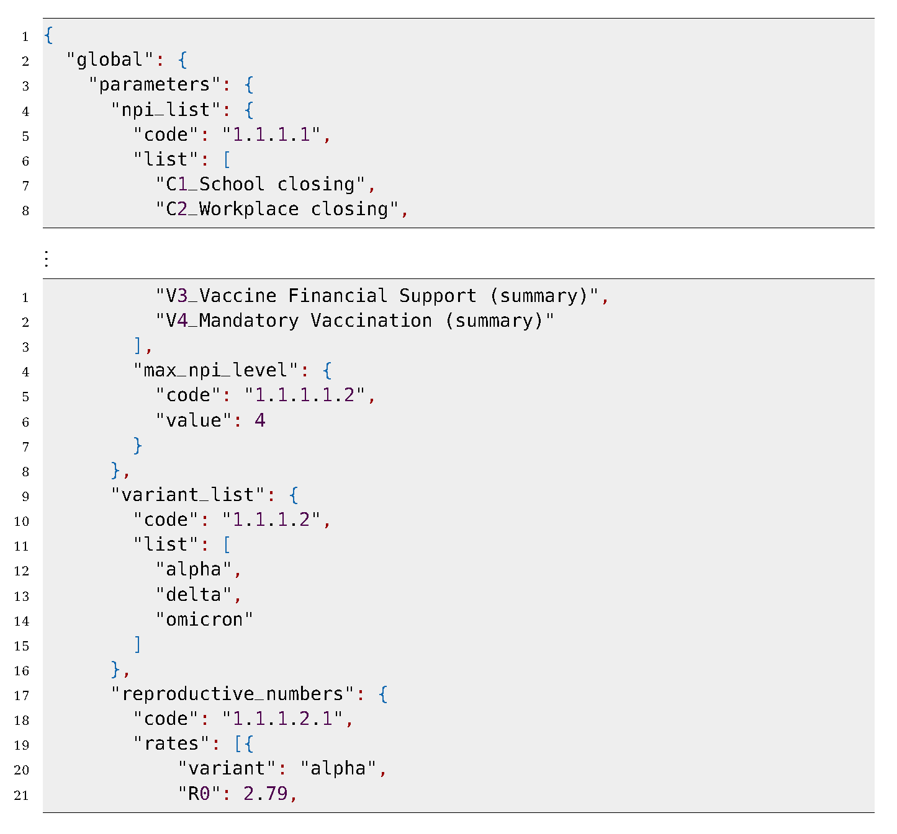
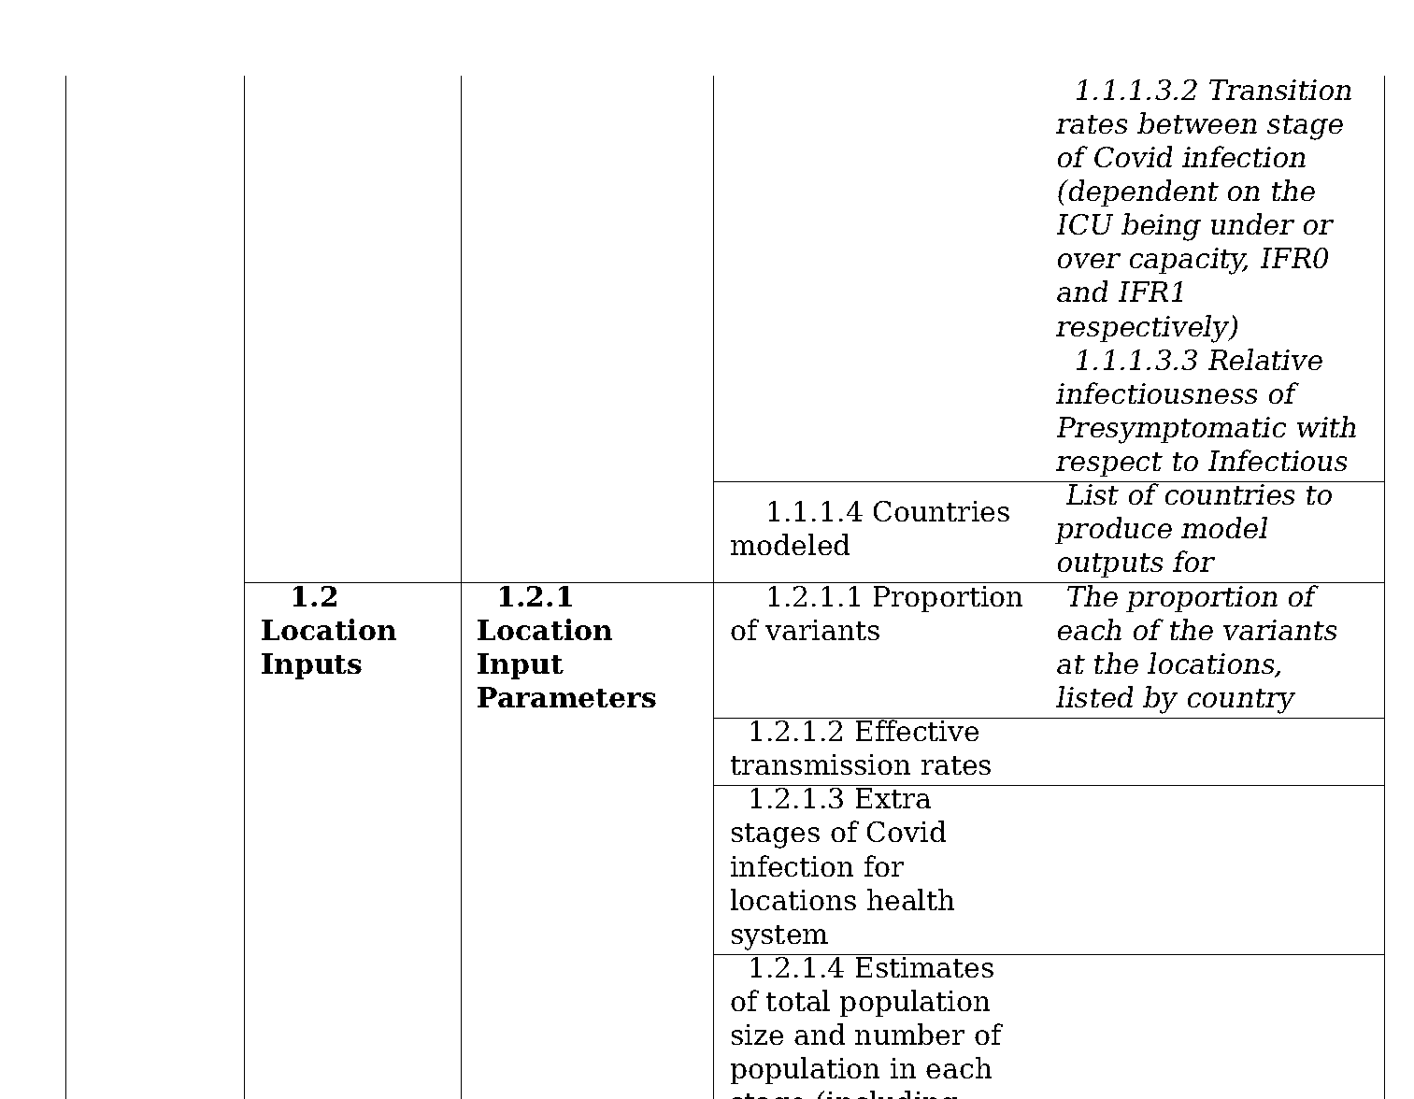
Standard Inputs

Slide 12
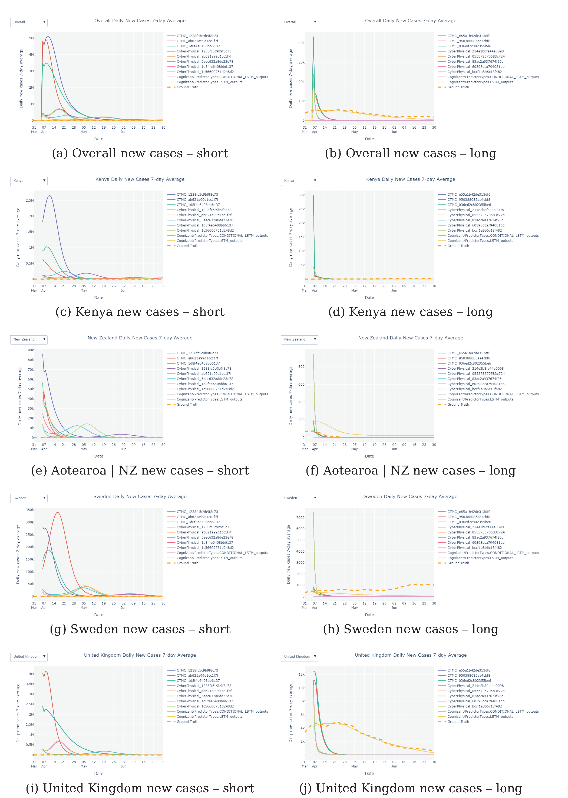
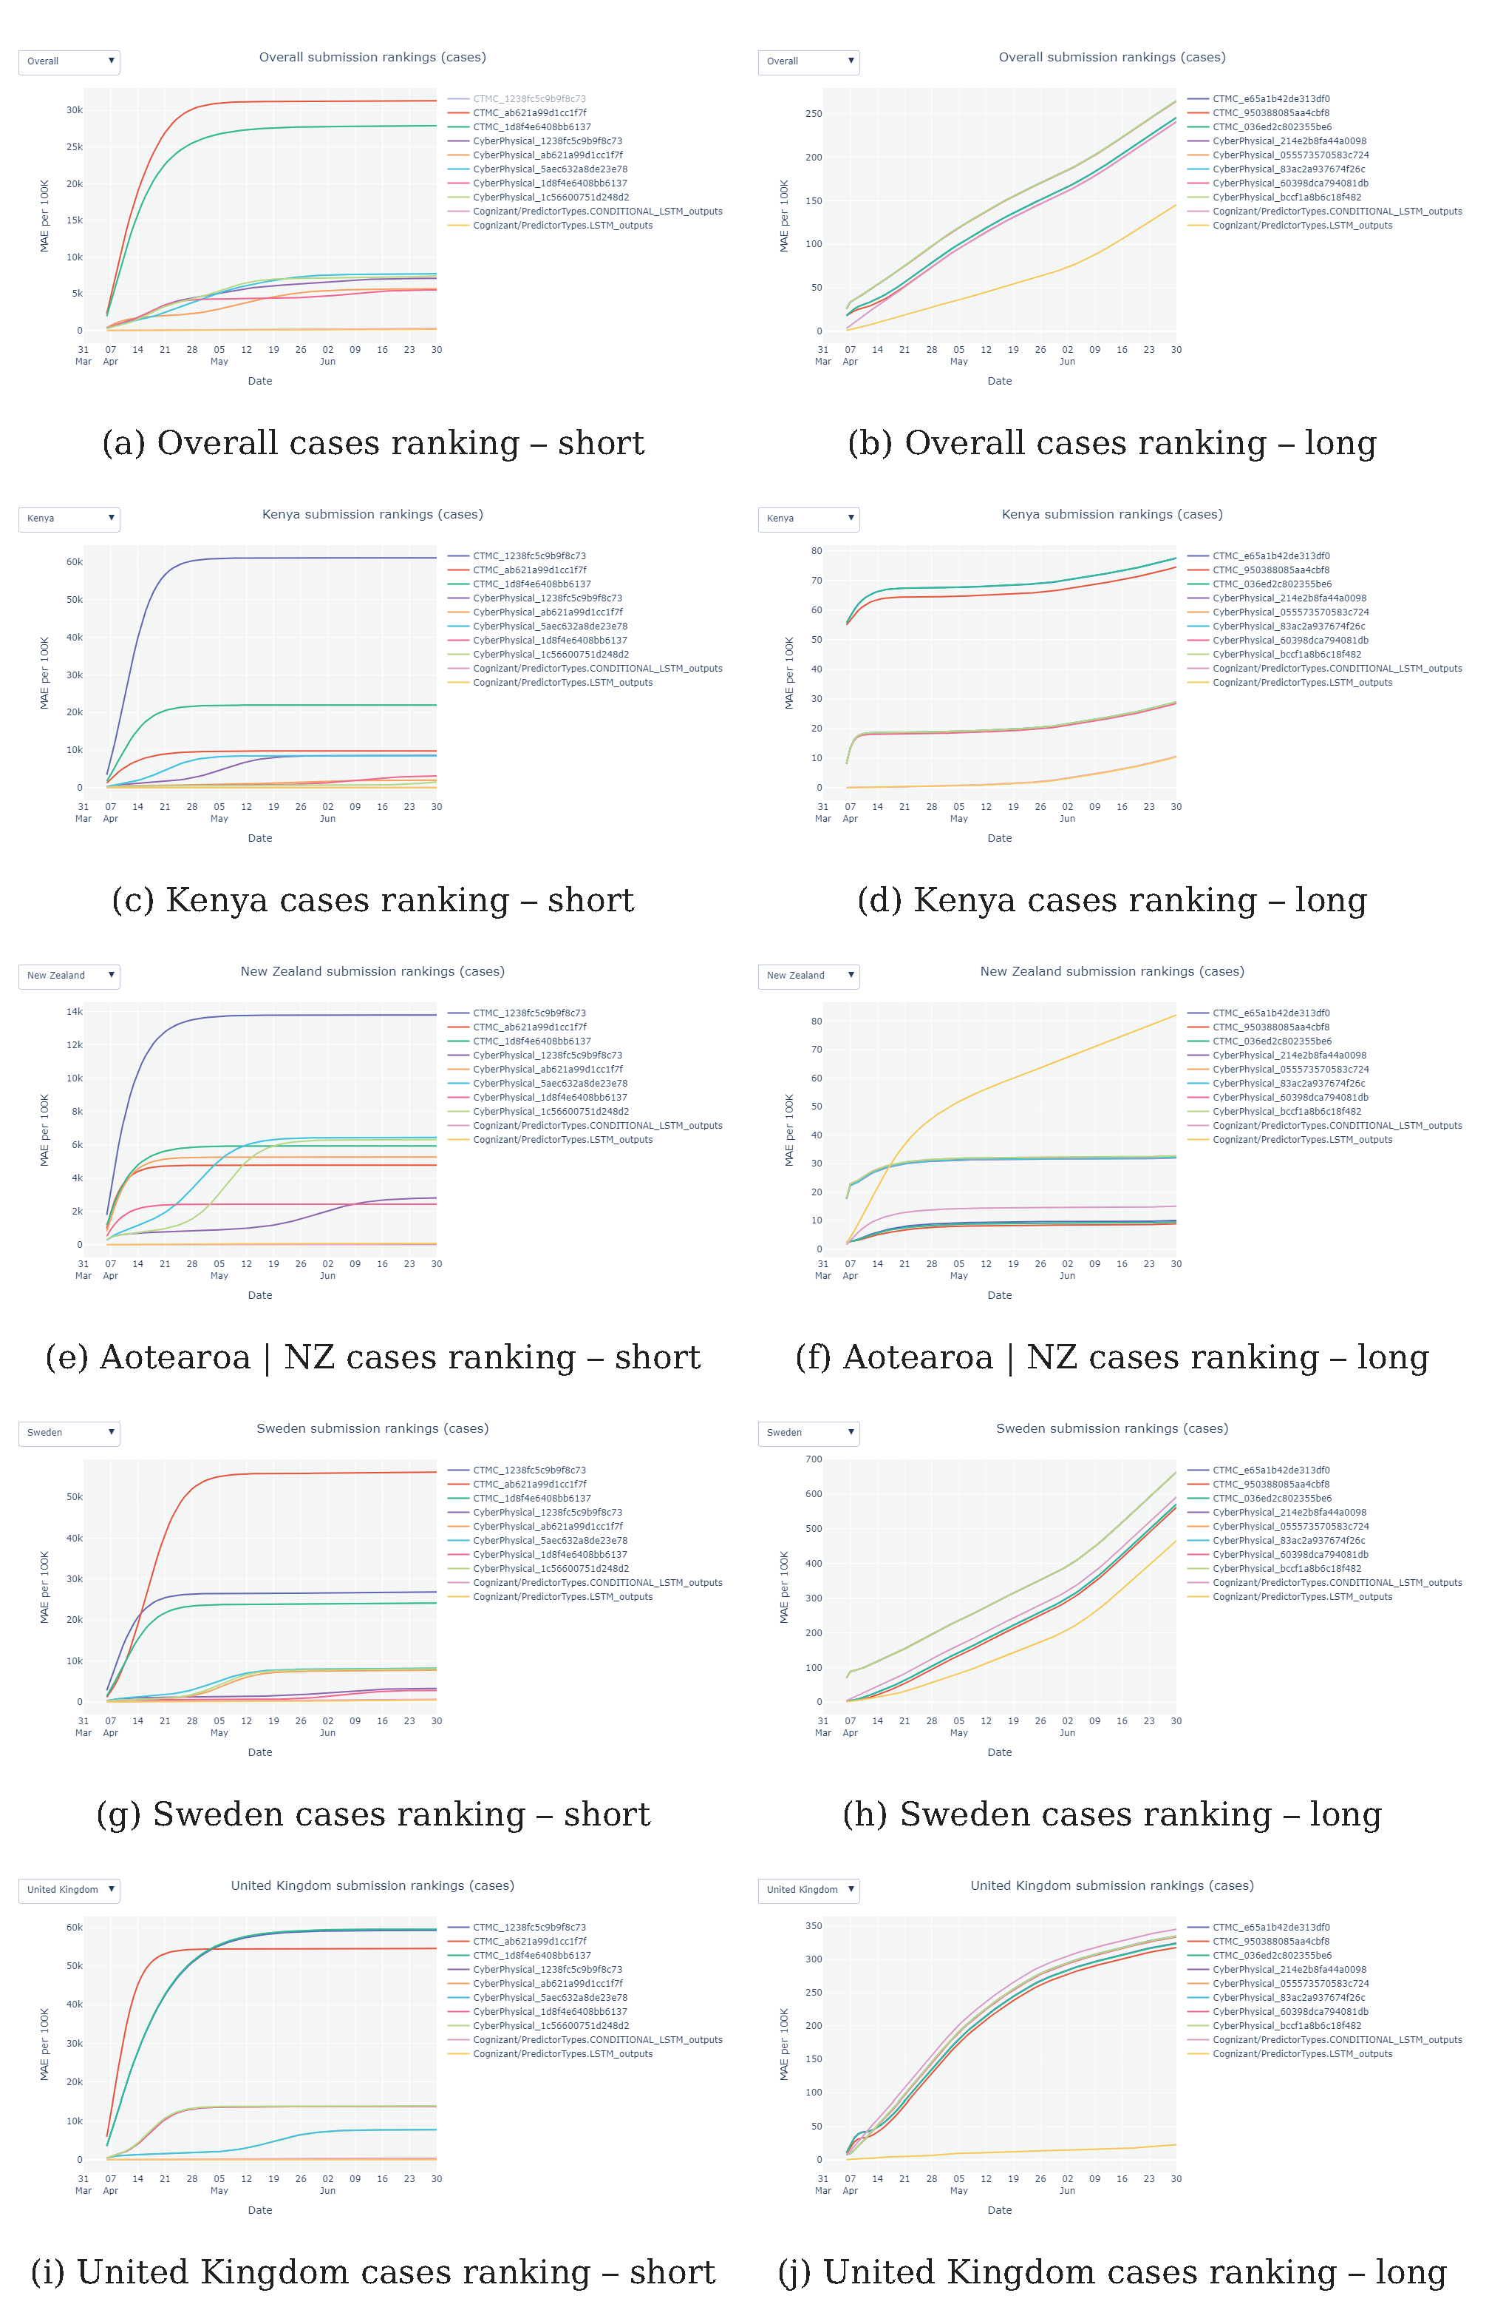
Modelling Case Numbers

Slide 13
Modelling Case Numbers

Slide 14
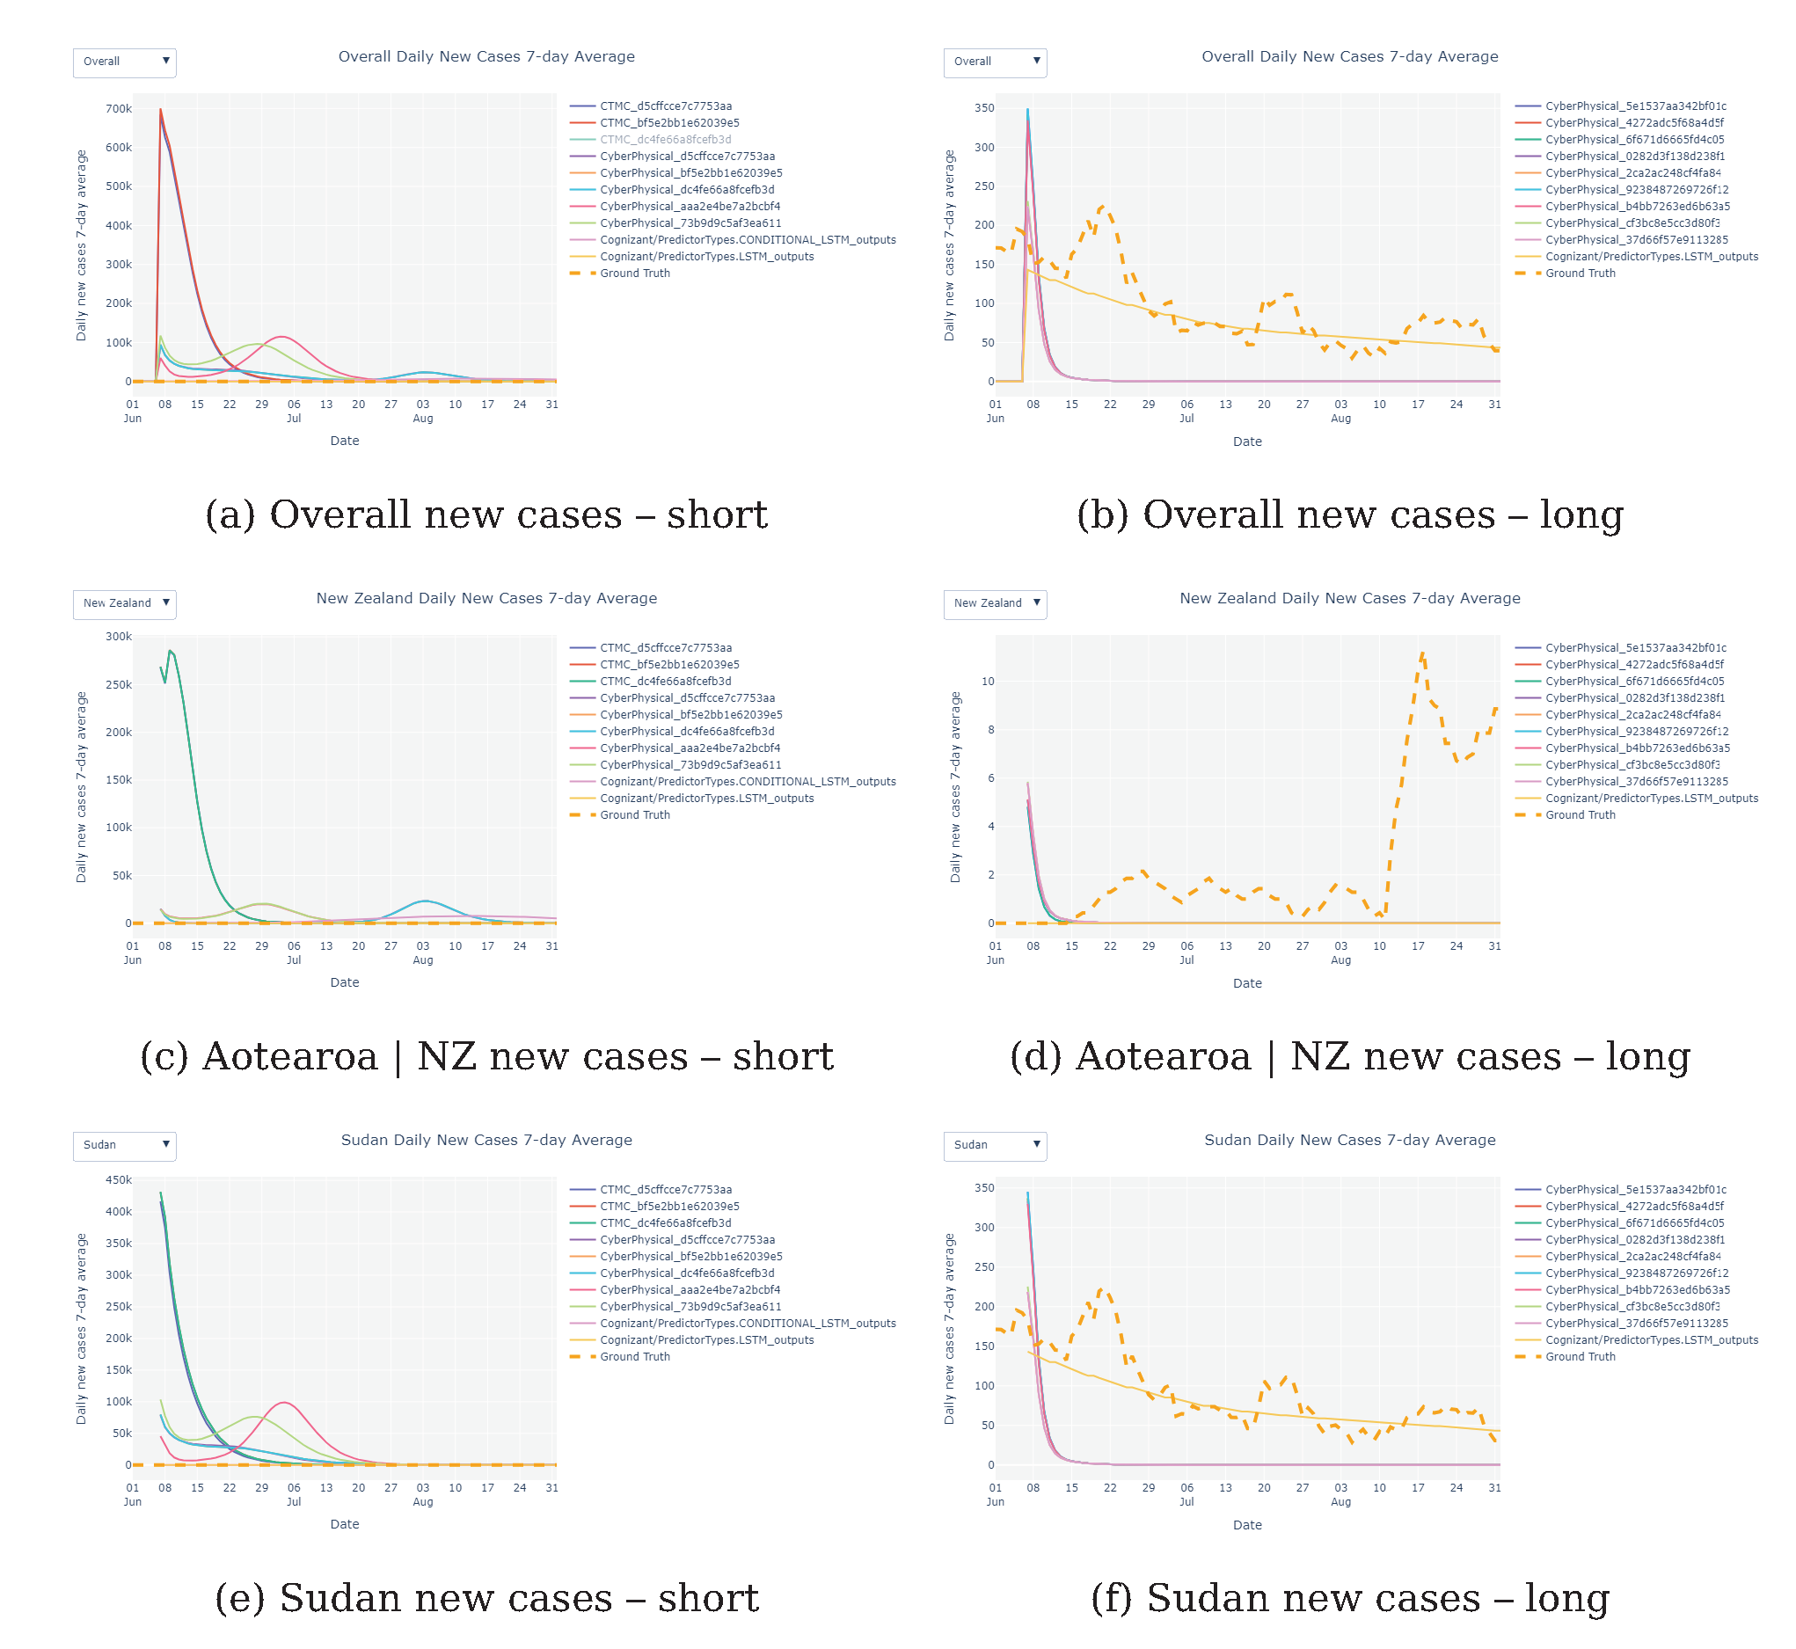
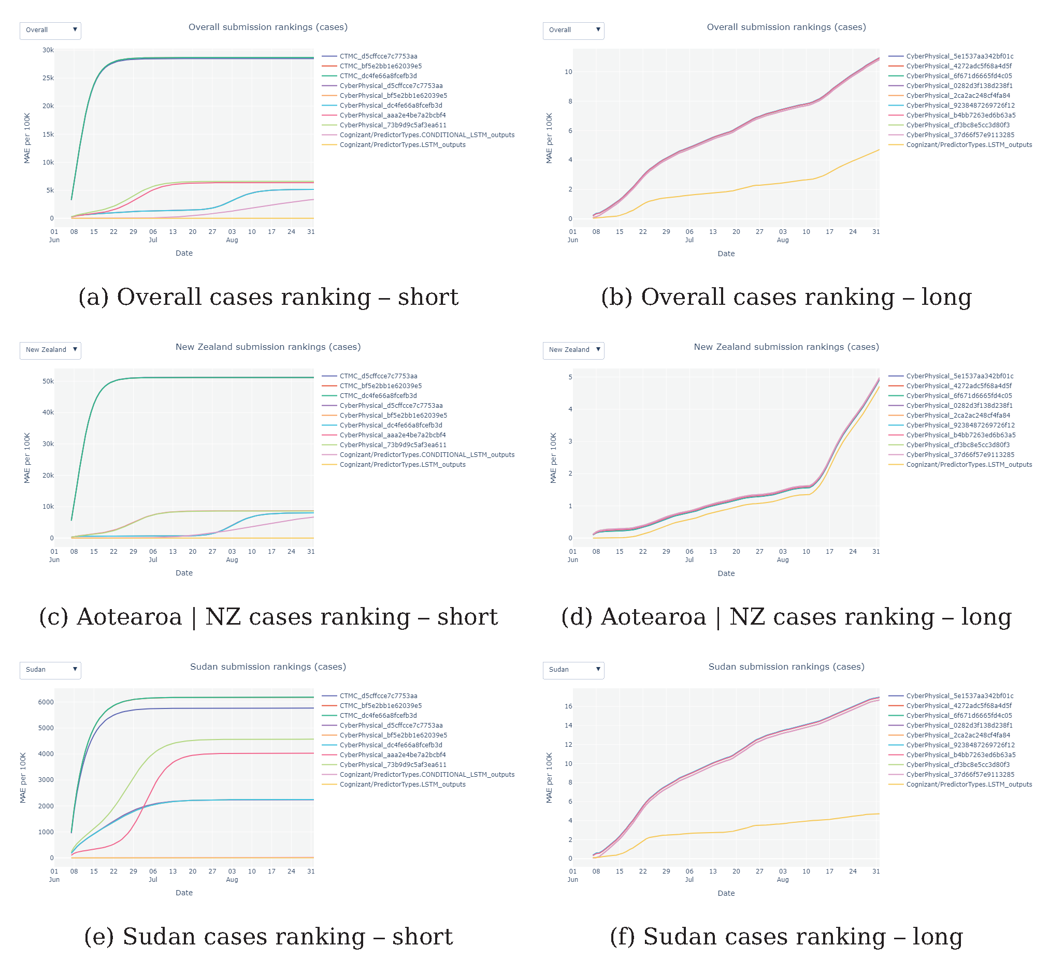
New case study

Slide 15
Comparing Aotearoa | NZ

Slide 16
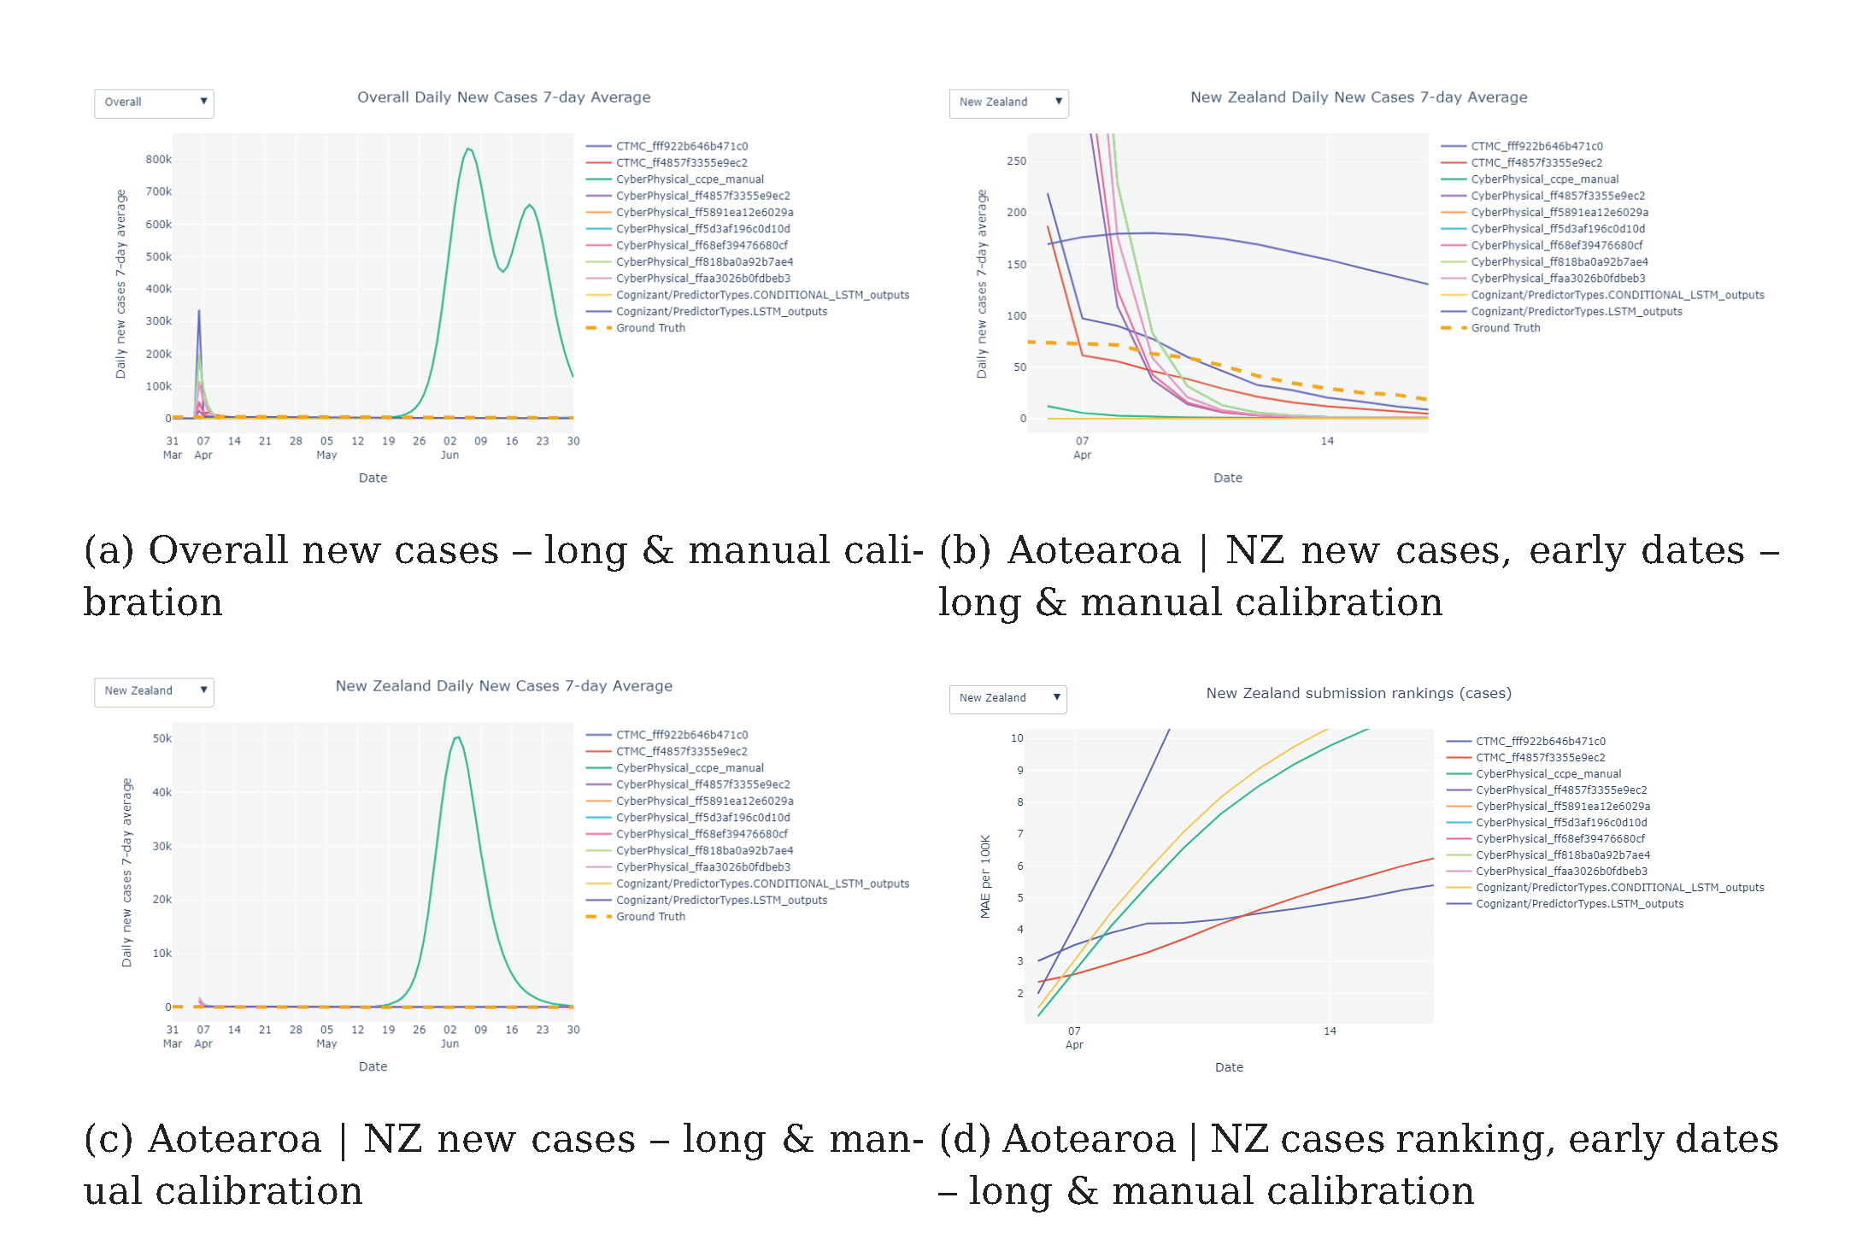
Vs Manual Calibration

Slide 17
Opportunities for governments
What-if simulations
From predictions to prescriptions
Extension to other diseases
Impact on decision-making
https://www.bmj.com/AIcovid19

Slide 18
THANK YOU

