Slide 1
Future of population and Social Statistics Measurement
^{PHONZ July 2024}
^{Vince Galvin}
Notes:
Indicators and data can give a good idea about communities, and trends.
Ultimately, they rely on data collected and shared by, among others, by Stats NZ.
You might have heard that Stats NZ is currently rethinking the way we collect information, but intrinsically connected to this question also what information we provide.

Slide 2
Our Measurement Approach Leaves some unmet information needs
Stats NZ provides population counts, descriptive statistics on key topics such as labour market and income distribution, and “thin profiles” from the census. We do less well on:
Profiles of key interest communities (e.g. disabled, Māori). Reliant on post-censal surveys, which are high-value to communities but infrequent.
Longitudinal information about causes and effects, movement between states (e.g. persistent child poverty).
Slow to respond to emerging policy topics such as social cohesion and mental health of young people.
Adequately covering some of the topics that have limited Census questions. Census has been used as a social survey and is over-burdened with demand for questions.
When the world is changing rapidly, five-yearly updates from the Census may not be frequent enough. With immigration being a more significant driver of population change our historically weak capacity to monitor regional populations has come under challenge.

Slide 3
Some Elements of the current situation
We are struggling to get acceptable population coverage with the traditional Full Field Enumeration Census Model.
We have a considerable amount of administrative data that we have spent the last ten years learning how to construct datasets from;
We have had two Census files (2018 and 2023) that we have matched with our admin files, that have given us very specific information about how the two sources compare.
We have done systematic “variable by variable” work on the administrative data’s alignment with our statistical concept and coverage of standard popualtions
We have constructed experimental Administrative Population Census Files and we have made them available to researchers so they can explore their properties.

Slide 4
Some Elements of the current situation (cont)
We have developed methods for taking an administrative unit record file and adjusting for some of the detectable misclassification.
Under the combined census model the Admin Population listing provides the base population that underpins the census dataset. The Census adds records to this list but the admin list is essentially the reference population.
The IDI provides a rich linked data environment – but there is still work to do to create an environment pose for statistical production and has very limited integration.

Slide 5
Some Directions
Using admin data to supply population counts. The unit record file will be more frequent (annually) and will contain core demographic variables.
Statistical registers for people, places and businesses to enable us to integrate different types of data as a step toward providing more holistic views of “places”.
Data collection targeted at where its most needed.
Using survey vehicles to expand Census questions beyond the scope, which has to be kept “thin” to minimise respondent burden.
Topics will be chosen with the communities, and be explored with a combination of admin data and targeted collections that use community-specific concepts.
Enhanced “community frames” to enable us to explore special topics for each community. Moving away from “one size fits all” statistics.

Slide 6
Census concepts not well covered in admin data
Activity limitations (disability) information that is not captured by the health system
Gender and sexual orientation
Languages spoken
Religious affiliation
Some work and labour force information (‘unemployed/not in the labour force’, occupation, and unpaid work)
Iwi affiliation
Family and household concepts related to dwellings (tenure and crowding)
Familial relationships not captured by admin data (de-facto relationships)
Level 4 ethnicity
Some strategies to mitigate these limitations:
Improved agency collections, and new data sources
Improved methods and statistical mitigations
Combining APC data with surveys
Notes:
Obviously, compared to the census.

Slide 7
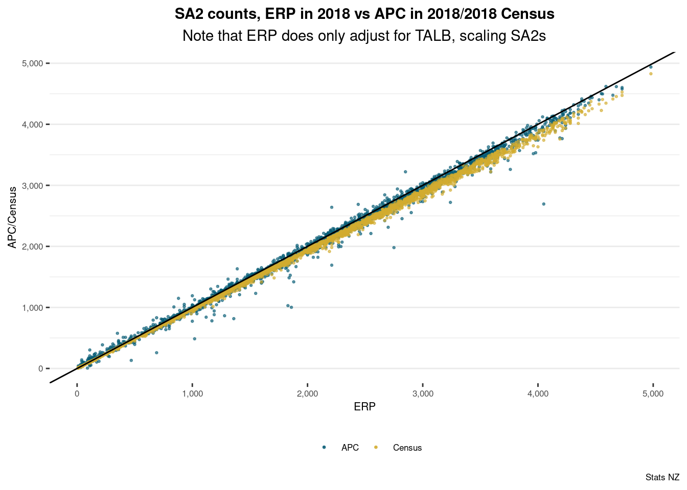
Why we’re confident in admin-based population measures
There are many graphs, this one might be the pick of the litter to sum up the overall picture.
Patterns of differences and extreme outliers here are understood.
Other breakdowns tell a similar story
Notes:
Outliers with undercoverage:
the Chatham Islands,
SA2s that contain prisons or army camps, and
SA2s that are in close proximity to universities.
Outliers with overcoverage:
inner-city business districts,
some SA2s in south Auckland.
These overcounts are potentially due to people using workplace addresses as their mail address

Slide 8
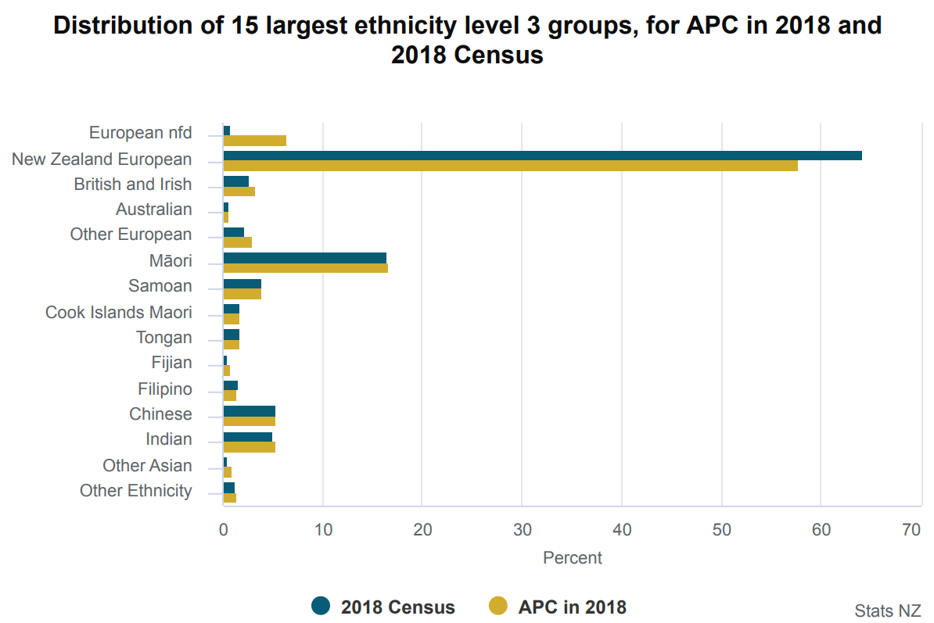
Ethnicity
Ethnicity data is widely collected across government, but at various levels of detail and in a range of circumstances.
Well documented concerns on the quality of ethnicity in Health collection.
The APC is able to mitigate some of these issues and produce high quality Level 1-3 ethnicity data by combining data across collections.
Improvements required to support level 4, in the quality in key source agencies, and in the methods we use for combining information collected in multiple settings.
In the short- and medium-term historic Census data can be relied upon to fill gaps, but that is not sustainable.
Notes:
Source
Level of ethnicity
Accumulated coverage
DIA (birth registrations), level 4, 48%
MoE (tertiary) Level 3 27%
MoH Level 2 - 24%
MoE (primary & secondary) Level 3 <1%
MSD Level 2 <1%
2013 Census Level 4 <1%

Slide 9
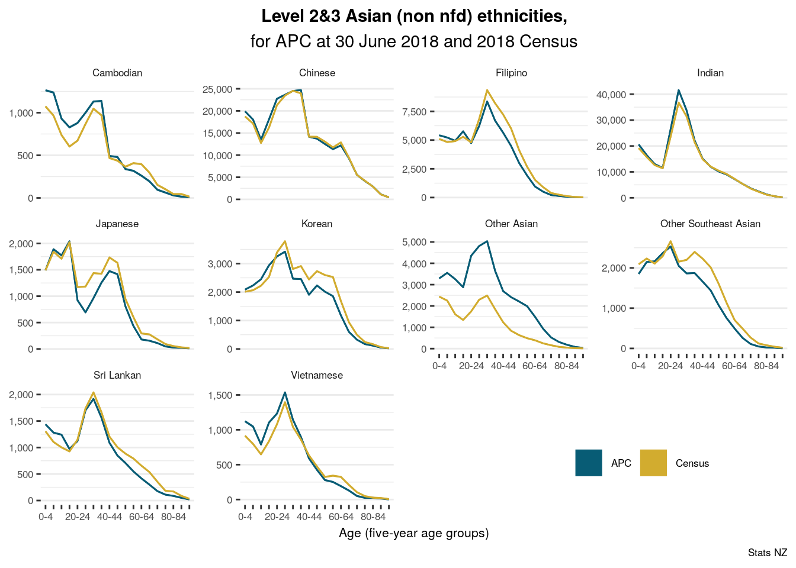
The APC is using administrative data only* and no statistical imputation.
Notes:
Many, many plots we could show. This one illustrates a nice mix of overall good agreement with showing that there is scope for further improvement. Eg admin data likely over-estimates “Other Asian” at the “cost” of underestimating others.
The APC is using admin data only* and no statistical imputation (it does use C13 as a last-resort to compensate for absence of admin data pre-2000). A future census would still include all historic admin data available to fill in gaps, additional survey responses, and improved admin source collections and methodologies, which is a nice segue to the next slide

Slide 10
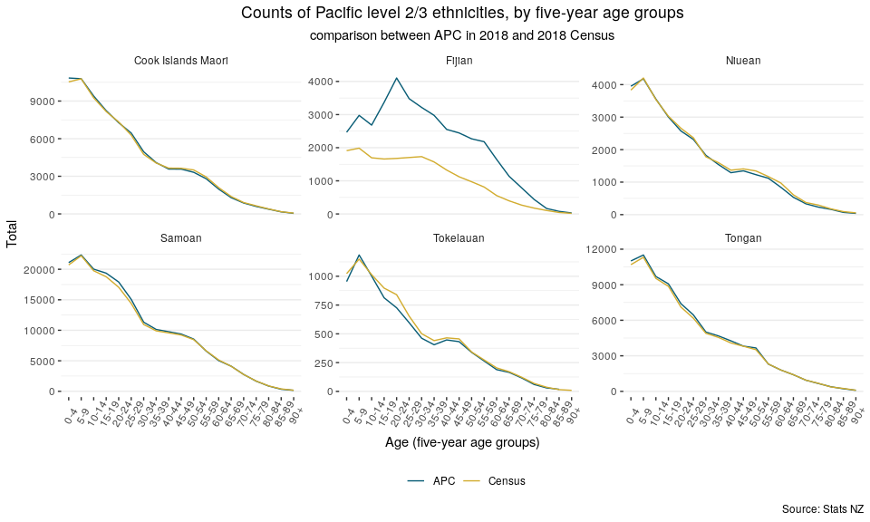
Age distributions for some Pacific ethnicities, APC and 2018 Census

Slide 11
Conceptual alignment in population measurement
 | Field-enumeration-based census | Admin-based population | ERP
Target population | CUR | UR | UR
UR measurement | intention-based* | outcome-based | outcome-based
Main reference date | early March | 30 June | 30 June
Lag to second DSE list measurement | 4-6 weeks | 0 | NA
Frequency | five-yearly | annual+ | quarterly
Geographic resolution | Address (de-facto) | Address (de-jure) | TALB/SA2*

Slide 12
Census is more than collecting data
Current: combined census model
Potential future: admin-first model
Field enumeration
Transformed admin data
APC
Historic census data
Historic census data
Survey(s)
Transformed admin data
Editing,
Statistical imputation,
Quality assessment
Editing,
Statistical imputation,
Quality assessment
SDE
Census information
+ DSE
Population estimates (ERP), projections, …
Notes:
Complex lifecycle of all data.
It’s not simple/robust vs cheap and cheerful.
The APC gives us a good idea of the admin core
Fallback options for many ambitions

Slide 13
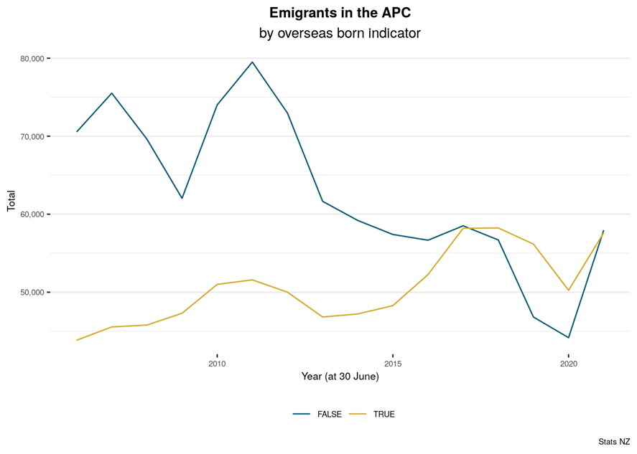
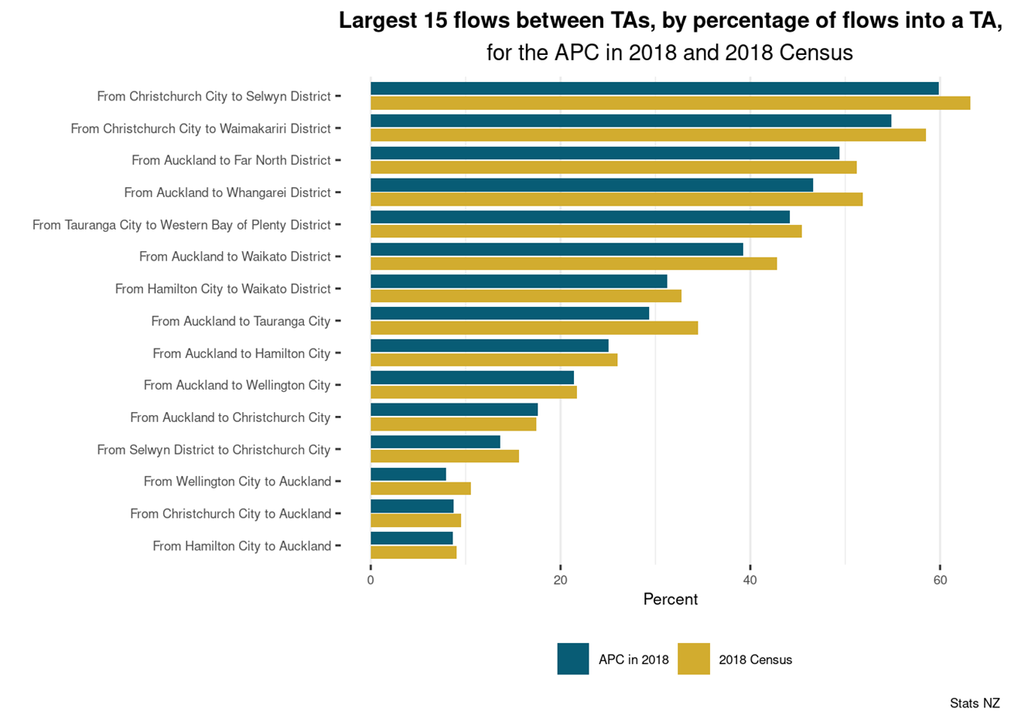
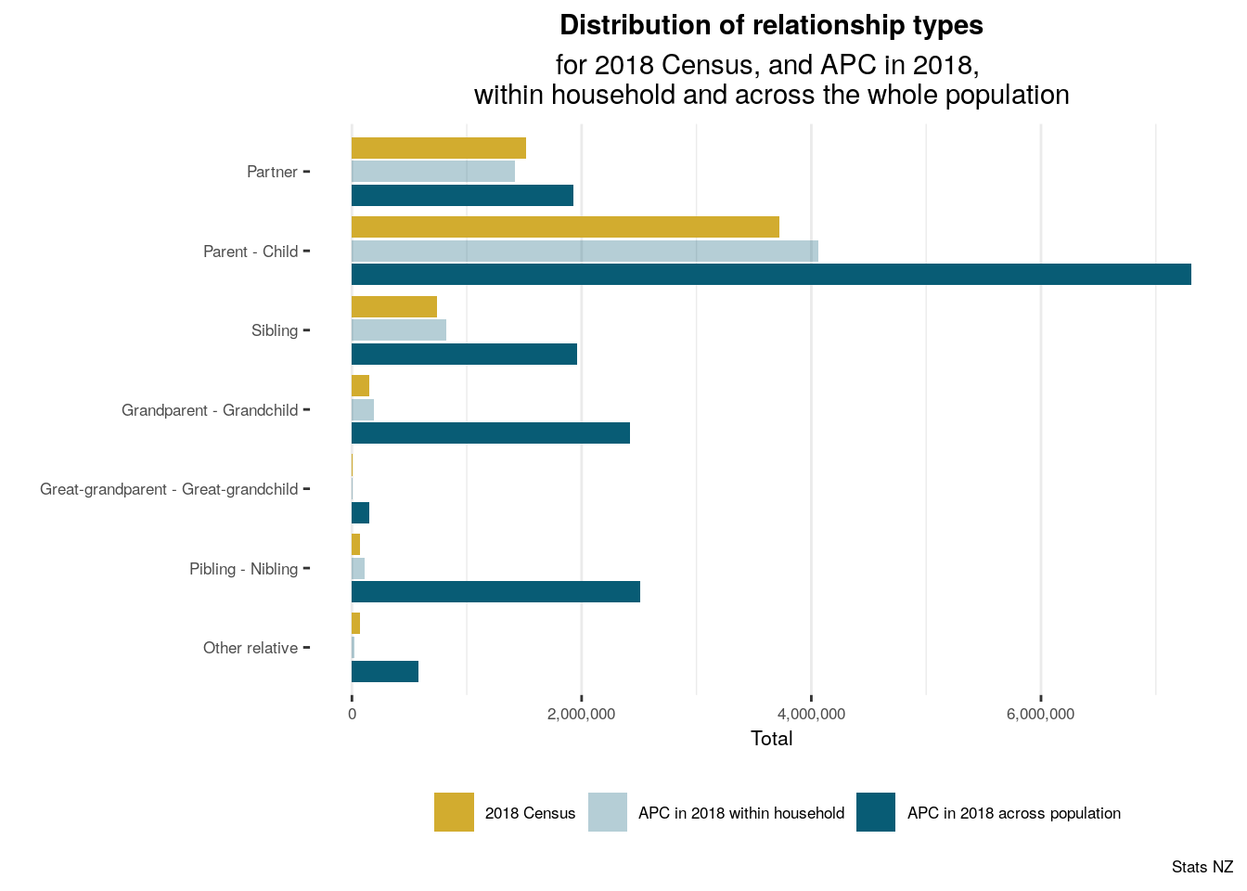
Many opportunities from admin-based population measurement
Longitudinal measurements
Non-standard target populations
More frequent data
(More) variations of concepts

Slide 14
What is needed should drive the data that is collected
If the Concern is that the core measurement of the population with admin data needs to be supported then the focus of collected data programme would be to target the weakness of the admin data. Examples could be;
A collection of data from migrants to compensate for their lack of history in government data systems
A frame verification process to aid the integration of administrative dwelling data with administrative person data. This option could include some minimal collection of data from occupants.
If the key objective is to maintain a comparable set of Census variables at a reasonable level of disaggregation then the emphasis would shift to the idea of a large attributes survey.
If this collection was continuously in the field it would have rotating content modules that would enable topics on the current form to be explored in more useful detail.
It would provide a large enough sample to measure many sub-populations or to provide a frame for sub-samples with more tailored content
If the critical requirement was to break the sense of a “one size fits all” measurement system and provide more tailored information to communities then the data collection effort could shift to a series of collections of more diverse communities
This would depend on what information needs were being targeted but the idea would be to work out how to employ different communities own information about their collections to explore how to use techniques like network sampling.
These collections would develop over time, and under this scenario the communities themselves would be much more involved in the design process.

Slide 15
Future Census: design timeline
Until end of June 2024
Conceptual design
Evaluation
From June –December 2024
High level design on chosen option
Engagement and consultation
From January 2025
Next level design for each element
Engagement and consultation
Co-design & partnership
Refinement of content to meet information needs
Engagement and consultation
Co-design and partnership
Primary focus of engagement and consultation:
manner of taking census
Primary focus of engagement and consultation:
content to meet information needs
Primary focus of engagement and consultation: implementation
and outputs
Notes:
All options under consideration include a survey component!

Slide 16
Other slides

Slide 17
The Contribution the Collected Census Data currently makes to population measurement
In constructing population estimates, we begin with administrative data. The collected Census data makes a contribution to the count of the population. We do have a set of Census forms that are not in the IDI. These appear to be due to the definition of the IDI spine, linking uncertainty and the definitional eligibility differences between the . The admin data will be modified to include this group.
The census file helps identify individual’s location. For those that supply a Census form we clearly get location at single point in time. The address notification lags in the administrative data are more variable, and this weakens the confidence with which we can associate households with addresses.
Despite these location limitations the APC estimates low level geographies (SA2s in the following slide) well when compared to the ERP. This accuracy improves at higher level geographies.
Census is the reference point for constructing households. Work is ongoing to maximise the use of the existing admin data in constructing households– recent work in the context of dynamic poverty measurement has highlighted possible areas of improvements. Where we currently have both we get 72% of households exactly right and 90% of people in the right dwelling.
There are some variables that are high quality but have some coverage limitations. Maori Descent can be improved in this way.
Census is useful for creating sample frames – even with existing response rates a usable frame for disability can be created. Ethnic populations could be adequately targeted from existing administrative data.

Slide 18
There is certainly work to do on some important variables
There are known systematic problems with ethnicity in admin data.
The APC partially mitigates these problems by combining different admin sources.
Admin data-only already provides overall decent counts for ethnicity even include a large part of Level 4. There are problems with some specific ethnicities (eg Fijian), and nfd and other categories.
An admin-first future census can also rely more on historic census data. Going forward the quality from admin sources will increase, which can counteract the relevance of historic census data decreasing.
Exiting admin only quality
Quality
Improved admin data collection
Relevance of historic census data
Time

Slide 19
We have done extensive work to understand the characteristics of admin data.
Our methodologies to transform admin data for statistical purposes and the available admin data has been analysed, documented, and communicated for more than a decade. For our transformation we can build on experience from:
2018 Census combined model (ad-hoc)
2023 Census combined model (by design)
IDI research
The experimental Admin Population Census (APC), the data of which has already been used in:
MoH reporting
SWA small area explorer tool
MEC Cyclone Gabrielle response
…
The IDI has been about 30 years in the making. Probabilistic linking is mature and robust. IDI includes data from government agencies covering a wide range of aspects of life:
Stats NZ
DIA
MoH
MoE
MSD
ACC
IR
WFF
MBIE
HNZ/KO
NZTA
(MoJ/Corrections)
…
Government data is well maintained, curated. The purpose of collection might not align with statistical purposes, and taking the primary purpose into account the data may need transforming.
Notes:
As mentioned, admin data will be at the core of our future data system. (There will be a survey component, but that will be used to build in the gaps in the frame provided by admin data.)
Admin data is of high quality (probably won’t get away with telling IR that your name is John Key),
MOJ/Corrections is bracketed to highlight that this data is available, but we do not use it due to ethical and quality concerns.

Slide 20
Census concepts not well covered in admin data
Ethnicity – APC performs well for level 2-3 but improvements required
Activity limitations (disability) information that is not captured by the health system
Gender and sexual orientation
Languages spoken
Religious affiliation
Some work and labour force information ( ‘unemployed/not in the labour force’, occupation, and unpaid work)
Iwi affiliation
Family and household concepts related to dwellings (tenure and crowding)
Familial relationships not captured by admin data (de-facto relationships)
Some strategies to mitigate these limitations:
Improved agency collections, and new data sources
Improved methods and statistical mitigations
Combining APC data with surveys
Notes:
Obviously, compared to the census.

Slide 21
Ethnicity
Ethnicity data is widely collected across government, but at various levels of detail and in a range of circumstances.
Well documented concerns on the quality of ethnicity in Health collection.
The APC is able to mitigate some of these issues and produce high quality Level 1-3 ethnicity data by combining data across collections.
Improvements required to support level 4, in the quality in key source agencies, and in the methods we use for combining information collected in multiple settings.
In the short and medium term historic Census data can be relied upon to fill gaps, but that is not sustainable.
Notes:
Source
Level of ethnicity
Accumulated coverage
DIA (birth registrations), level 4, 48%
MoE (tertiary) Level 3 27%
MoH Level 2 - 24%
MoE (primary & secondary) Level 3 <1%
MSD Level 2 <1%
2013 Census Level 4 <1%

Slide 22
Possible improvements:
Electoral roll + X
Better address data, methodological improvements,
environment
Better visa data
Methodological improvements
(and better-quality measurement)
Marginal improvements

Slide 23
History of administrative data and the New Zealand Census
2012
Census transformation strategy
2015
Cabinet agreed to actively work towards an admin-based census model supported by surveys
2016, 2017, 2018
Experimental admin population counts released
2018
Short-medium term: modernise current model
Long term: investigate census based on administrative data
2018 Census: combined model as mitigation
2021
1st iteration of APC: 7 variables
2nd iteration of APC: 19 variables
2022
National age*sex, sub-national, by ethnic group
admin data used directly to include people missed by field collection, and for missing characteristics
Data Investment Plan: Priority “More accurate and frequent measurement of the population”
Strategic intentions: less reliance on direct contact; More data and better data for and about Māori.
2023
2023 Census: combined model by design
3rd iteration of APC: 20 individual variables + 5 household variables
2028
???
Population measurement effectively moved to the admin data base.
Notes:
As will be re-iterated later, we are not C23, however we are more than happy to pass on questions and concerns.

Slide 24
Now vs 2028
 | APC | Potential admin-based census
Integrated data system | IDI | ISDS
Statistical imputation | No | Yes
Includes historic census data | 2013 | 2013, 2018, 2023
Additional data sources, eg electoral roll data for Māori Descent | No | Probably
Is combined with survey data to cover non-admin data information needs | No | Yes
DSE coverage estimation | No | Yes
Linked dwelling information | No | Yes

Slide 25
Some areas of research – admin data
Statistical methods and population estimation
Inclusion of Electoral Roll data looks promising
Similar to what occurs in the current census, statistical measures will be required to ensure high degree of representation.
Ethnicity
Improvements in collection and coding of level 4 ethnicity data will be critical for meeting information needs for smaller ethnic populations.
Households and families
Clear improvements possible in models used for assigning address and household to individuals.
It is likely that a mix of admin and survey measures will need to be used with different use cases making use of the different sources.
Details for new migrants
Methodological improvements required to ensure migrants not using a visa are included in population counts.
Survey approaches to support estimation
Geographic location for the young and mobile
This will be a challenge and hard to improve substantially.
Some options include making use of education and employment information to estimate location, survey data to model predictable patterns of errors in location data.
The use of survey data and estimation methods may be required to adjust for systematic errors (e.g. students in university centres)
Improvements in admin-households has potential to add huge value.
Building understanding measuring poverty persistence.
The combination of administrative data and historic census data can provide population measures in the short term, but this is not sustainable
Some potential for increasing data provided on visa (e.g. ethnicity)
The APC currently counts the population but does not use statistical procedures such as imputation
Statistical methods will continue to be required to measure and account for systematic errors (under-coverage, misclassification)
With more frequent census products clearer relationship between population estimates and the APC will be needed
Māori descent
Longer term Improvements across admin data will need to be made e.g. to support information for Māori returning to Aotearoa.
Notes:
The APC is on it’s third iteration – each iteration has included improvements in the methodology and the variables released.
We expect this to continue

Slide 26
What’s in the third APC?
Annual time series: 2006–2022 (reference date 30 June) of Admin New Zealand resident population, households and
20 census individual variables:
Population structure: Age, Sex, Geography (address), usual residence n years ago, number of children born, years at usual residence
Identity and culture: Ethnicity (Level 1–4), Māori descent, birthplace, and years since arrival in NZ
Income: total personal income by income source
Education: highest qualification, field of study, study participation
Work: employment indicator, employment status, industry, sector of ownership
5 census household variables:
Usual residence address for households
Household size: number of usual residents in household
Household income: total household income and household income sources
Familial relationship

Slide 27
Some themes in engagement
Ethnicity – often the safe and independent collection is mentioned
Concern about key population variables not in admin data (iwi, rainbow, level 4 ethnicity).
Appetite for increased timeliness.
Wary of losing detailed information (e.g. small ethnic populations, health research, multi-dimensions)
Concern about the need to calibrate the system.
Lots of research papers – missed a trick publishing an overview tech paper.

Slide 28
Future Census conceptual models
Survey more of the population
Survey less of the population more frequently
Administrative data-first + full-enumeration survey
Survey is for variables not in administrative data
Administrative data-first + large-scale Census Attributes Survey (CAS)
Very large survey to provide estimates for variables not in administrative data
Administrative data-first + annual Census Attributes Survey (CAS)
Smaller annual sample survey for variables not in administrative data, pooled across five years for small area estimates
Notes:
Key points of consideration:
The administrative data component is the same in all models
The key difference between the models is the survey component
The third element for all options is the components Stats NZ delivers through partnership – for example, this could be working with iwi and Māori partners and priority communities to innovate and deliver new data collections and statistical insights (e.g. iwi-led collection, integration with iwi registers etc.)​
Census Attributes Survey use internationally:​
Canada and the US do not have adequate data yet for administrative data population counts, so use a full enumeration short form to collect this data​
​Canada has a five-yearly census day CAS (25 percent of the population) that covers education, employment, and disability​
Switzerland has an annual census day survey (200k people) to cover education, employment, and mobility​
Italy has an annual CAS (1.4m households) to cover education, employment, and mobility
The US has a continuous CAS (3 percent of households) covering different topics

Slide 29
Cards we can play to improve quality
Access to more admin data sources
Improve data collection in existing admin sources
Methodological improvements (in how we use the data)
Use new and existing survey data

Slide 30
What is the experimental Administrative Population Census?
“A practical demonstration of what can be achieved now with admin
data only* to produce census-type information.”
APC’s purpose:
Gauge technical feasibility of admin first census to enable decision making
Evaluate the data and methods as used in the APC
Enable engagement on whether information needs are met
Use feedback to direct further development
⇒ The APC is a conversation catalyst
⇒ The APC is not 2028 Census, not 2023 Census, nor official statistics
But also: APC’s purpose has and will evolve
Notes:
So, what is the experimental Administrative Population Census? Our tag line is “A practical demonstration of what can be achieved now with admin data only to produce census-type information.” There are three important bolded words in that sentence:
Firstly, practical. The APC is supposed to be as close as possible to the usual census product, which enables engagement and users to evaluate our data. Also, by having to put all the parts together into a working prototype, it’s easier to see problems one didn’t think about when only considering the parts.
Second is now. Meaning what we can do with data available right now, not at some indeterminate point in the future, and not waiting on improved data becoming available.
Finally, only, which has a bit of a caveat. We do use 2013 Census data in some cases, but its use is treated more or less as historical admin data, and as a last resort, to provide information from a time pre-digitisation of the various agencies that we get data from.
The purpose of the APC is many-fold. Firstly, to gauge the technical feasibility of an admin first census to enable decision making. Next is to evaluate the data and methods as used in the APC. Does the data provide sufficient coverage and is it accurate enough? The APC is also used to enable engagement on whether information needs are met. After each iteration release, we go on an engagement tour, both internally and externally, to see what potential data users thought of the process and outputs we created. Finally, we use this feedback to direct further development. APC is an on going project, so we’re always iterating on it, improving the processes and expanding it where possible.
In short, the APC is a conversation catalyst. We have it out there to get people talking about what they might want and need from a future census model that is different to the current one.

Slide 31
What have we learnt so far?
Some census concepts are not well covered in admin data.
Ethnicity information is of overall high quality, but aspects needs more explanation and investigation
There are specific issues (eg Fijian Indian), we need to better understand level 4, nfd-categories
The quality of Māori descent information is not yet sufficient.
Mainly driven by missingness; not the quality of the sources.
Interest was expressed in the potential for inclusion of iwi affiliation in the future.
(Stats NZ is looking at the potential for combining recent census iwi affiliation data with some administrative sources.)
The APC is increasingly used across government and by researchers.
Filling information need gaps that aren’t met by other Stats NZ outputs.
There is an almost universal demand for more frequent, timely, and detailed data.
There is a large interest in household and dwellings data from admin sources

Slide 32
Flows
The underlying data is longitudinally linked. This allows detailed analysis of flows between aggregates.

Slide 33
What does quality mean?
Timeliness
Accessibility
Consistency/coherency
Source data and statistical techniques are sound and statistical outputs sufficiently portray the reality they are designed to represent.
The interpretability of statistical information reflects the availability of supplementary information and metadata necessary to interpret and use it.
The census data and information is consistent and coherent within census datasets and metadata, it can be successfully brought together with other statistical data and information within a broad analytical
Statistics and information about data (metadata) are presented in a clear and understandable way, they are provided in suitable mediums for access, users are aware of their availability, and they are easily obtained and widely disseminated.
Data are released within a time period that permits the information to be of value to users.
Accuracy
Interpretability
Relevance
The relevance of statistical information reflects the degree to which it meets the needs of the users.
Notes:
We consider six key dimensions of quality, as listed.
Being annual, or potentially of higher frequency, the APC is more timely: the latest Census data available is more than five years old fomr 2018, whereas the latest APC data covers 2022.
Accesibility: small innovative approaches like the Shiny app. Other aspects like metadata could be better presented for both Census and the APC (datainfo+)
Relevance: this is a large part of any APC engagement.
Consistency, interpretability: Naturally, we’re using classifications and standards wherever possible. Notice that sometimes standards and categories don’t fully align (eg “not employed vs not in the labour force”).
Accuracy: see next slides

Slide 34
Current limitations and mitigations
Error structures are different from traditional census non-response patterns.
Multiple sources for the same information: we have methods for choosing best values and resolving conflict, especially usual residence address, ethnicity; next step is to extend to models.
Historical data (pre-digitisation): we already use 2013 Census.
Sub-groups: for example, migrants/events occur overseas: look for new sources (for example, visas for overseas qualifications).
Missing categories:
Admin has positive identification only: derive ‘No qualifications’, ‘No children’ as default value at 15 yrs.
Tax data in Stats NZ excludes ‘No income’: ask for zero income data.
No sources for unpaid work on family farm or business: do not measure?
Admin collection issues: for example, ethnicity coding: work with agencies to improve.
Remaining missing data: develop statistical imputation methods.
Using cell phone information

Slide 35
How we measure quality (accuracy) of attributes?
For example: for highest qualification we have data for 87 percent of the 2018 NZ resident population 15 years and over. The level of highest qualification for these 87 percent is consistent with the 2018 Census 85 percent of the time. Combining these two numbers means we have a quality score of 0.75 (=0.87*0.85).
A low-quality score can be caused by data missing or by indications that the data we have is wrong. We know that there are major drivers for both aspects. The biggest ones are:
There is less admin data available for recent migrants, so missingness is higher for topics such as education or family relationship.
Younger people between 15 and 29 years are generally more mobile, which means it is harder to find the right address for them in admin data.
There is less life-time admin data available in digitised form for older people. For example, parent-child relationships are not in DIA data before 1985.
Coverage: what proportion of the population do we have information for?
Non-missing quality: How good is the data that is there?
combined score
87%
0.75
0.85
Notes:
Mention quality framework + six key dimensions.
Accuracy “main” one.

Slide 36
Possible improvements:
Electoral roll + X
Better address data, methodological improvements,
environment
Better visa data
Methodological improvements
(and better-quality measurement)
Marginal improvements

Slide 37
Quality measurement and reporting
In the APC3 publications we also report these scores for
populations of interest,
TALBs, and
five-year age*sex groups:
2018 quality indicators for highest qualification | Coverage (percent) | Missing (percent) | Non-missing quality rating | Output quality
NZ residents 15 years and over | 88 | 12 | 0.85 | 0.75
Māori descent = Yes | 97 | 3 | 0.88 | 0.86
Māori ethnicity | 94 | 6 | 0.88 | 0.83
Pacific ethnic group | 87 | 13 | 0.87 | 0.75
Asian ethnic group | 74 | 26 | 0.80 | 0.59
Overseas born | 75 | 25 | 0.79 | 0.59
Five-year age groups and sex (range) | 72-97 | 3-28 | 0.80-0.91 | 0.66-0.88
TALB (range) | 83-94 | 6-17 | 0.81-0.90 | 0.68-0.83
Derivation of non-missing quality rating score: APC equal or higher than the census Note: TALB = territorial authority and Auckland local board Note: Low outliers not included in the reported range
One row in the previous table
Newly provided information
Newly provided information

Slide 38
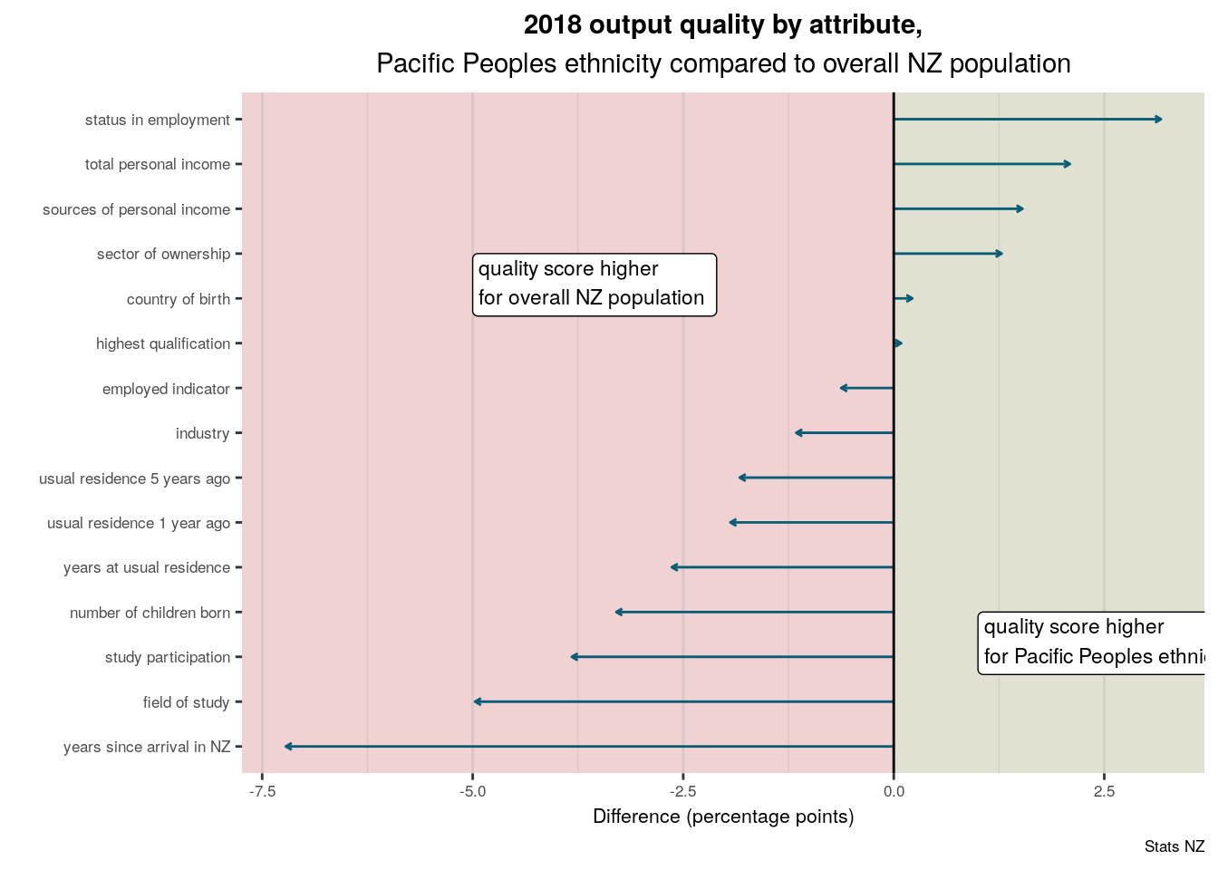
The quality of the attributes for Pacific Peoples

Slide 39
The integrated data infrastructure (IDI)
The integrated data infrastructure (IDI) has been about 30 years in the making.
Grown from initial, discrete linking projects.
IDI would not have been possible without political impetus.
Designed for external researchers.
APC
IDI
The APC is able to rely on IDI for
Data ingestion & (probabilistic) linking & secure computing environment
Confidentiality & ethics framework (Nga Tikanga Paihere)
Social license
These results are not official statistics. They have been created for research purposes from the Integrated Data Infrastructure (IDI) which is carefully managed by Stats NZ. For more information about the IDI please visit https://www.stats.govt.nz/integrated-data/.
These results are based in part on tax data supplied by Inland Revenue to Stats NZ under the Tax Administration Act 1994 for statistical purposes. Any discussion of data limitations or weaknesses is in the context of using the IDI for statistical purposes and is not related the data’s ability to support Inland Revenue’s core operational requirements.
Notes:
There are currently 350 active projects in the IDI, with 815 researchers attached to these projects.
The same iterative build process (start small, add onto, keep improving) that underlies the APC has guided IDI development.
APC would not have been possible without the IDI.

Slide 40
Quality of census attribute data from admin sources
Coverage
Household size
Ethnicity
Status in employment
Age, sex
Usual residence
Study
participation
Number of vehicles
`
Income
Birthplace
High
Work and labour force status*
Years at address
Years since
arrival in NZ
Partnership status
Family type
Highest qualification
Legal relationship status
Māori descent
Occupation
Number children born
Metadata
Partial
Workplace address
Industry
Age of dwelling
Cigarette smoking
Disability
Floor area
Sector of landlord
Detailed analysis
Iwi
Weekly rent
Part of APC
Access to telecommunications
Sexual identity
Hours worked
Travel to work
Access to amenities
Low
Unpaid activities
Language
Gender
Number bedrooms
Tenure of
household
Religious affiliation
Fuel types used to heat dwelling
Damp or mould
Number of rooms
Poor
Moderate
Very close
Measurement
As of Dec 2023, subject to change
Notes:
This version: Updates mainly based on APC 2022. Is assuming 2013 Census used where possible, not highlighted in graph.
Also includes upcoming AHC ADC experimental series
Guidelines for vertical position: locate on top row (High coverage) when coverage is 90% or higher. ‘Low’ coverage is under 50%.
Guidelines for horizontal position: locate right (very close) when 90% or higher accuracy; for variables with 80-90% accuracy we have to justify the location either on the ‘moderate’ or ‘very close’ area; anything lower than 50% is ‘poor accuracy’
A possible justification: We can allow bit leniency if we have knowledge of admin data, eg over time accuracy would increase; or if census responses are are less accurate.
Possible footnotes to consider when using this chart:
The position within a square is more about fitting in the space - not indicative of the relative difference in admin data potential

Slide 41
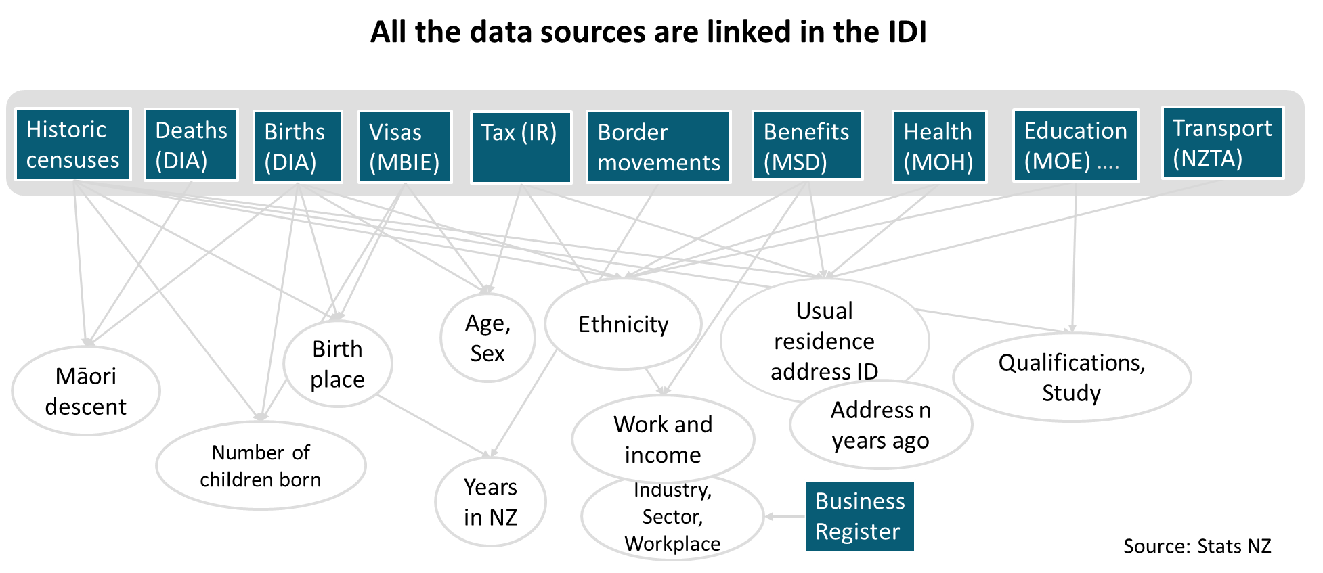
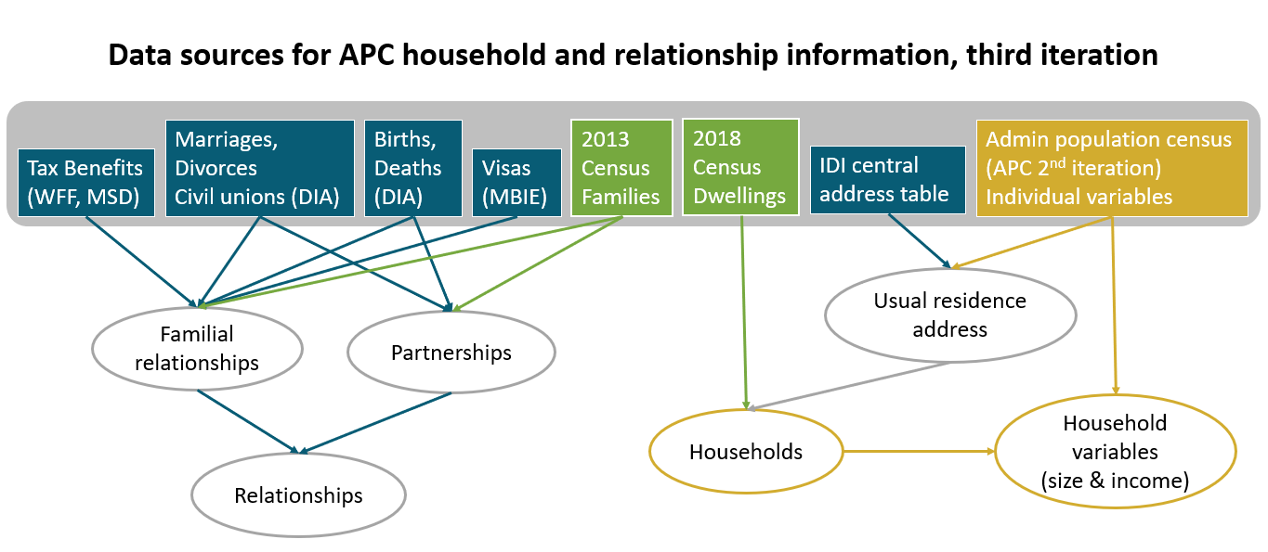
Where does the data come from?
Notes:
Needs polishing/combining. Message is pretty much “it’s complicated, different sources are used for different aspects”

Slide 42
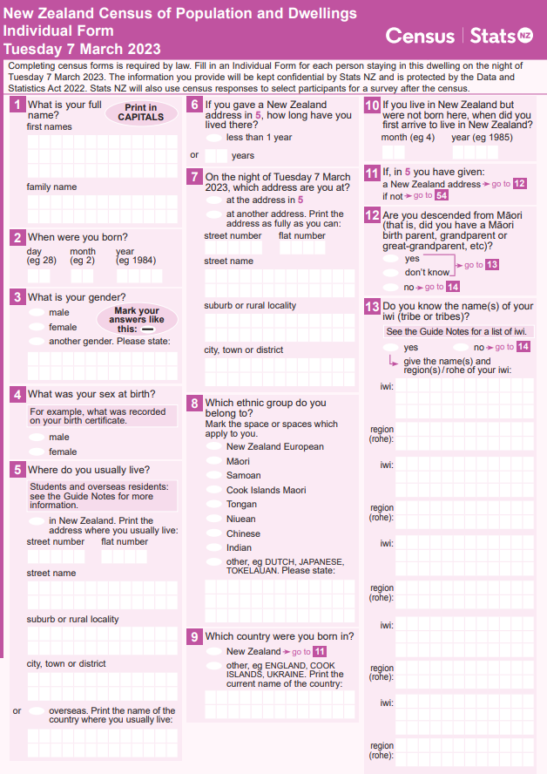
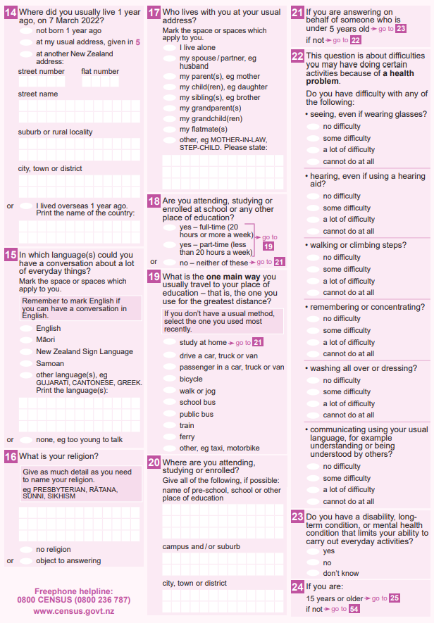
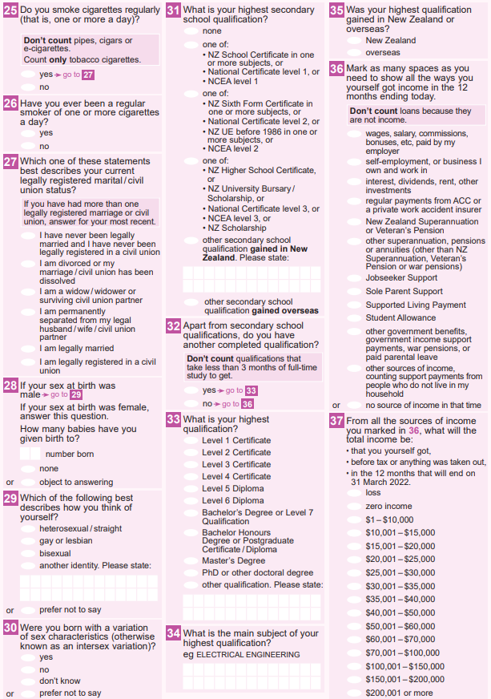
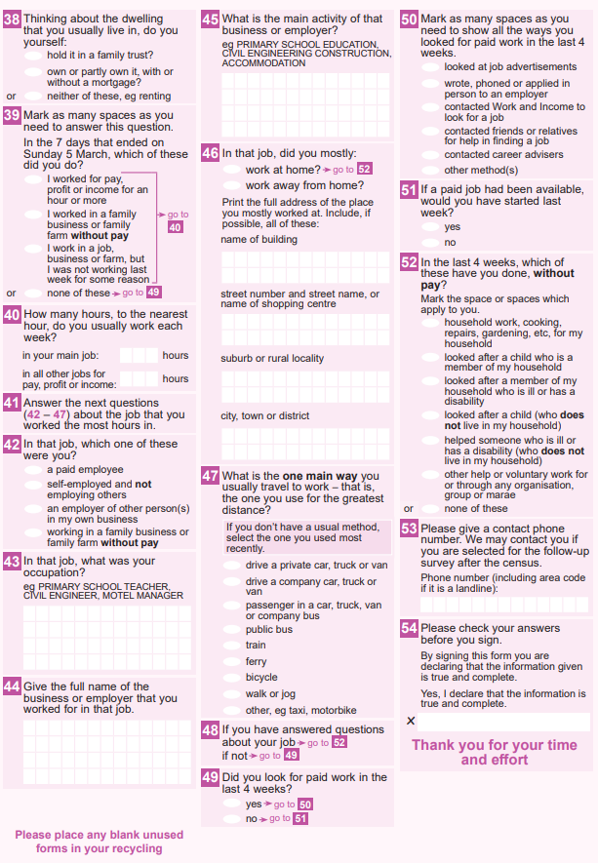
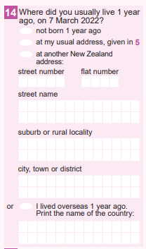
Individual form census questions in APC
Very rough approximation, which does not take into account:
importance of questions,
questions that need to be asked on any survey for linking and operational purposes,
range of the orange category, and
some details within questions.
concept part of APC
concept potentially available from admin data
concept unlikely to be available from admin data
Notes:
Very rough! Also doesn’t include importance.
Iwi work currently ongoing.

Slide 43
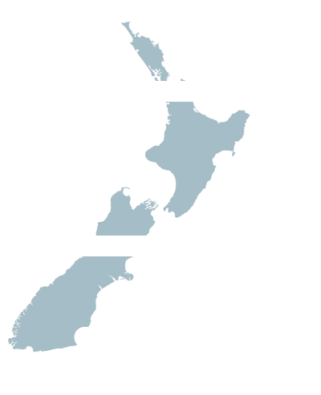
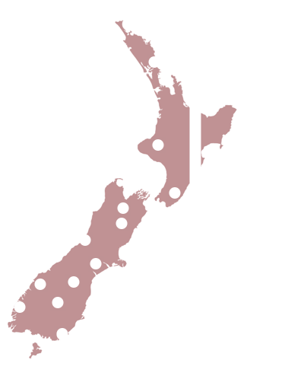
The sum can be greater than its parts
Admin sources by themselves have different levels of coverage and quality.
The combined coverage and quality is potentially better than the individual sources.

Slide 44
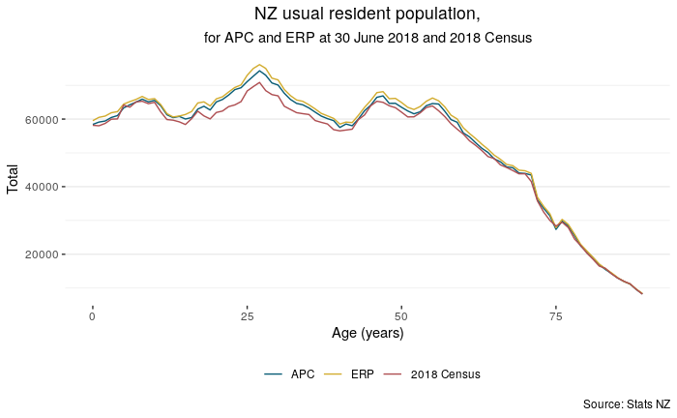
What does the admin population look like?
APC is not quite ready to provide the official estimated resident population
It needs a population estimation adjustment:
for under- and over-coverage
for misclassification and linkage errors
for error bounds

Slide 45
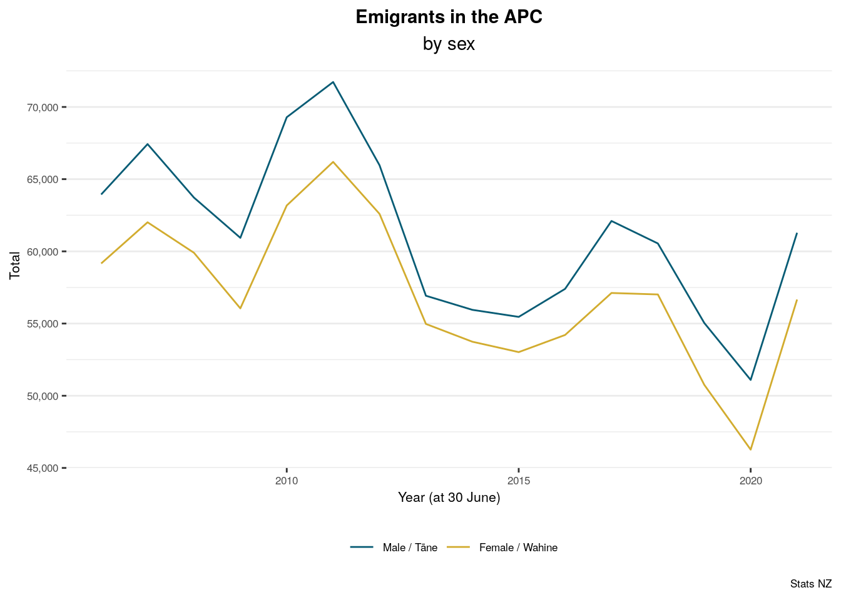
Emigrants
Using admin data opens up new opportunities:
We can get a good understanding of people who have left the APC, because they emigrated.
(Migration based on 12/16 rule).
Other breakdowns and definitions are possible/sensible.
Notes:
We also see the shiny app and our data as a way to make sure that IDI data is accessible by everybody and not just researchers.

Slide 46
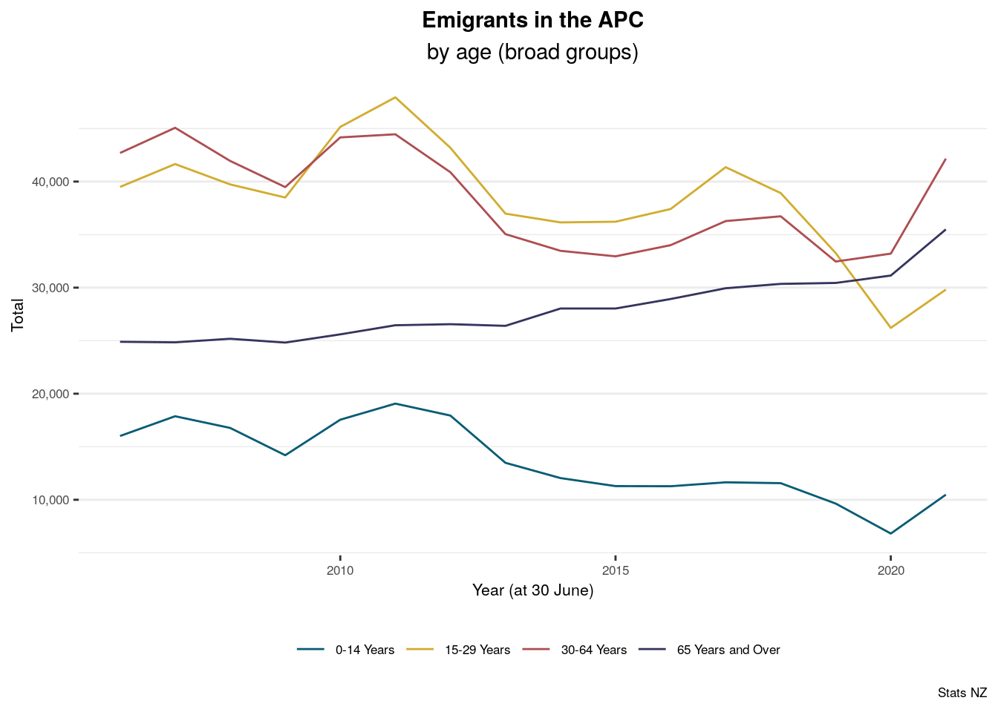
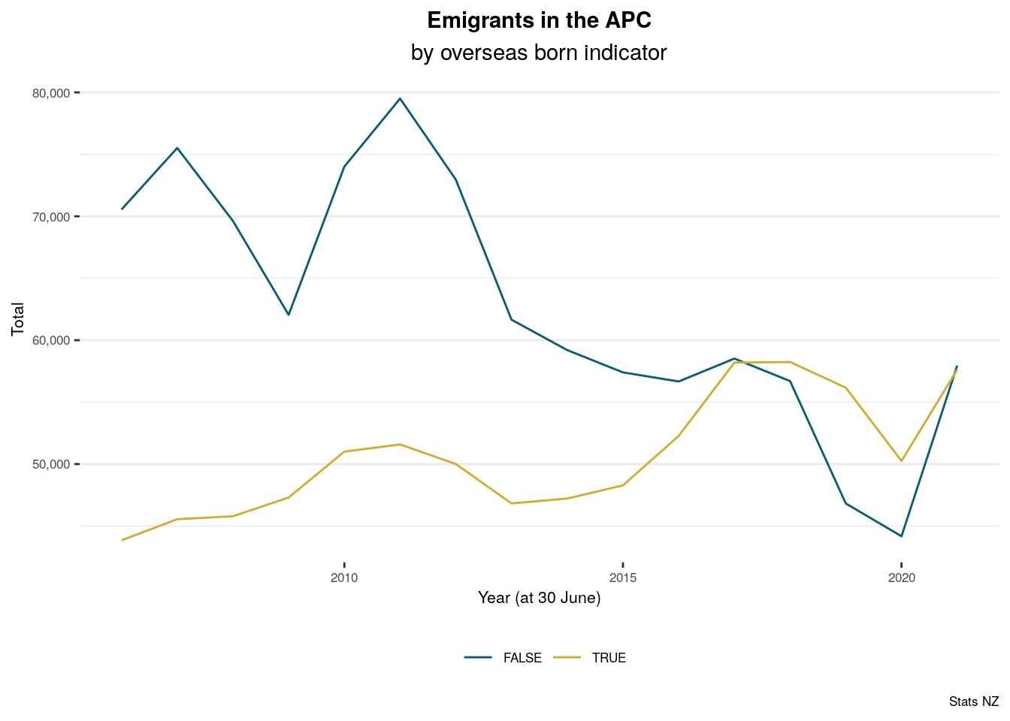
Emigrants
Notes:
We also see the shiny app and our data as a way to make sure that IDI data is accessible by everybody and not just researchers.

Slide 47
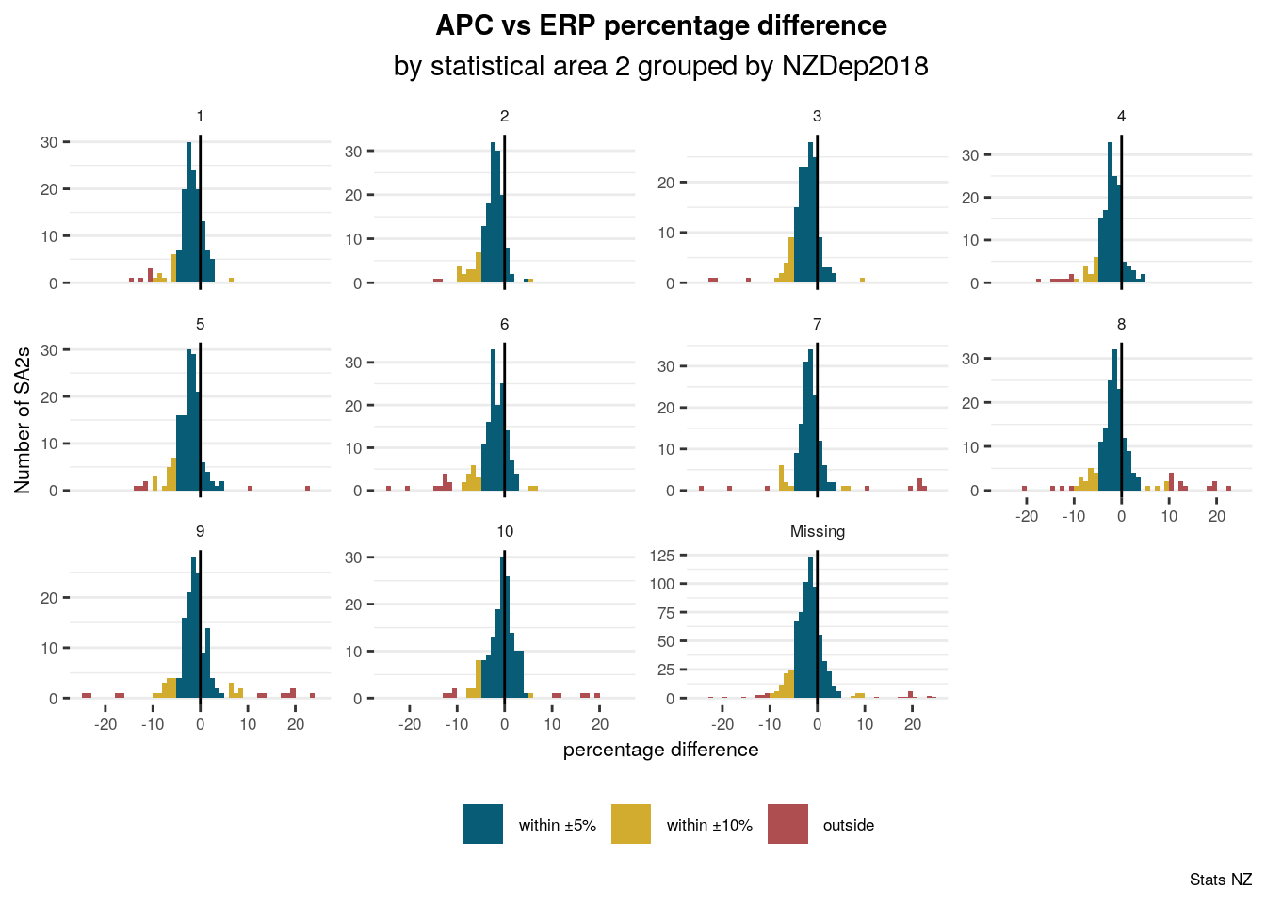
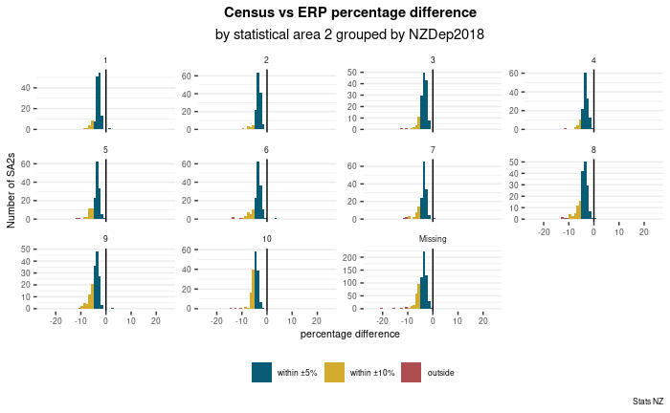
SA2s with missing NZDep2018 score are SA2s that were created since 2018.

Slide 48
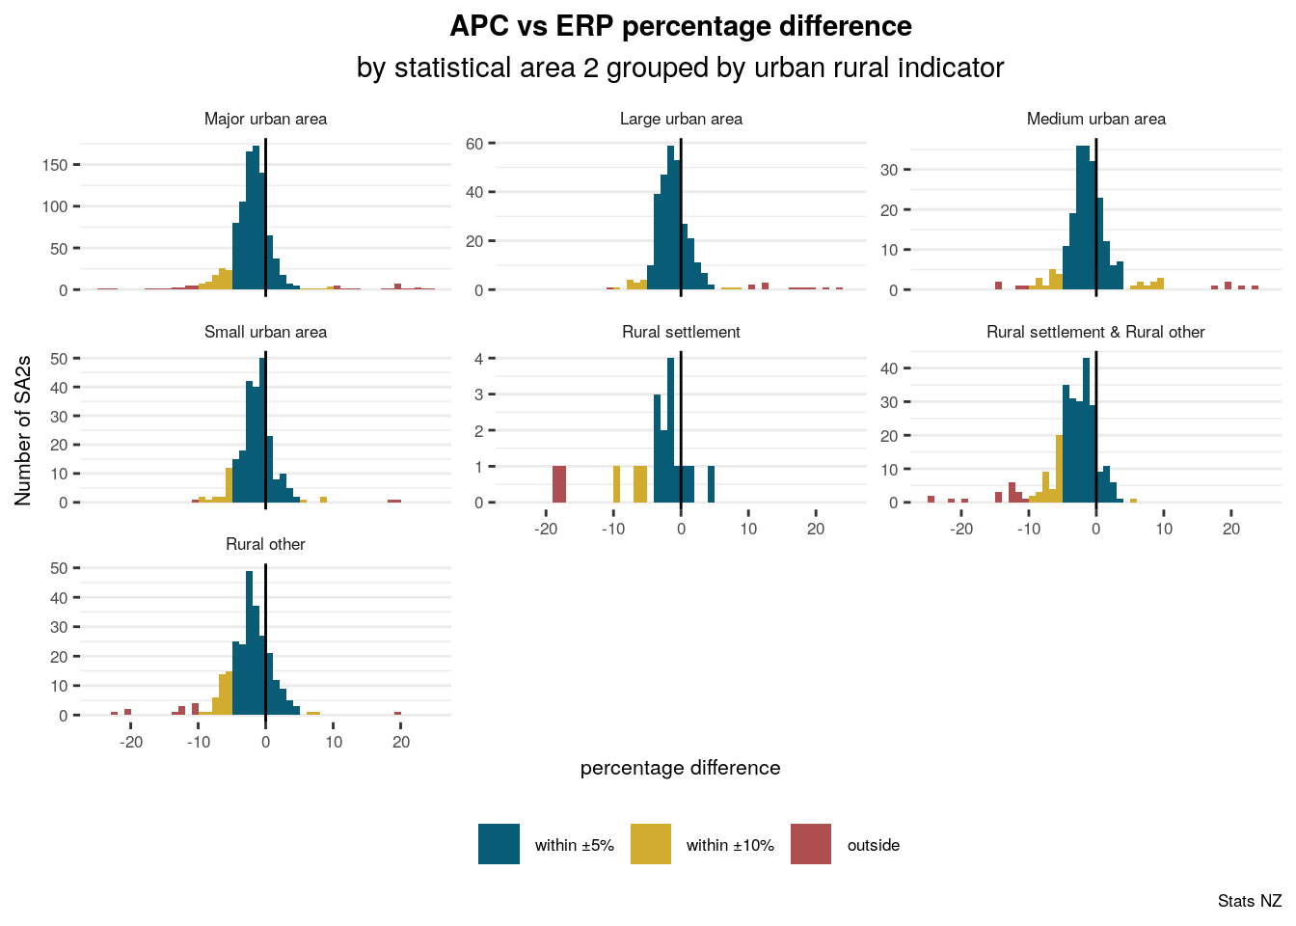

Slide 49
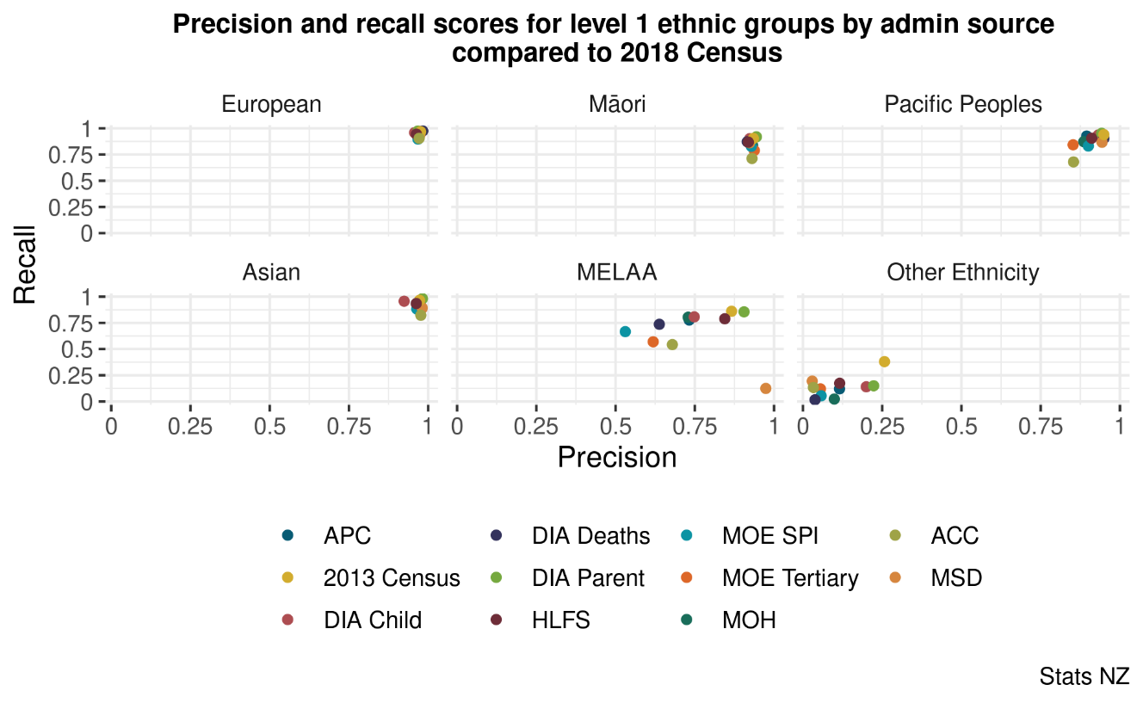
Work in progress

Slide 50
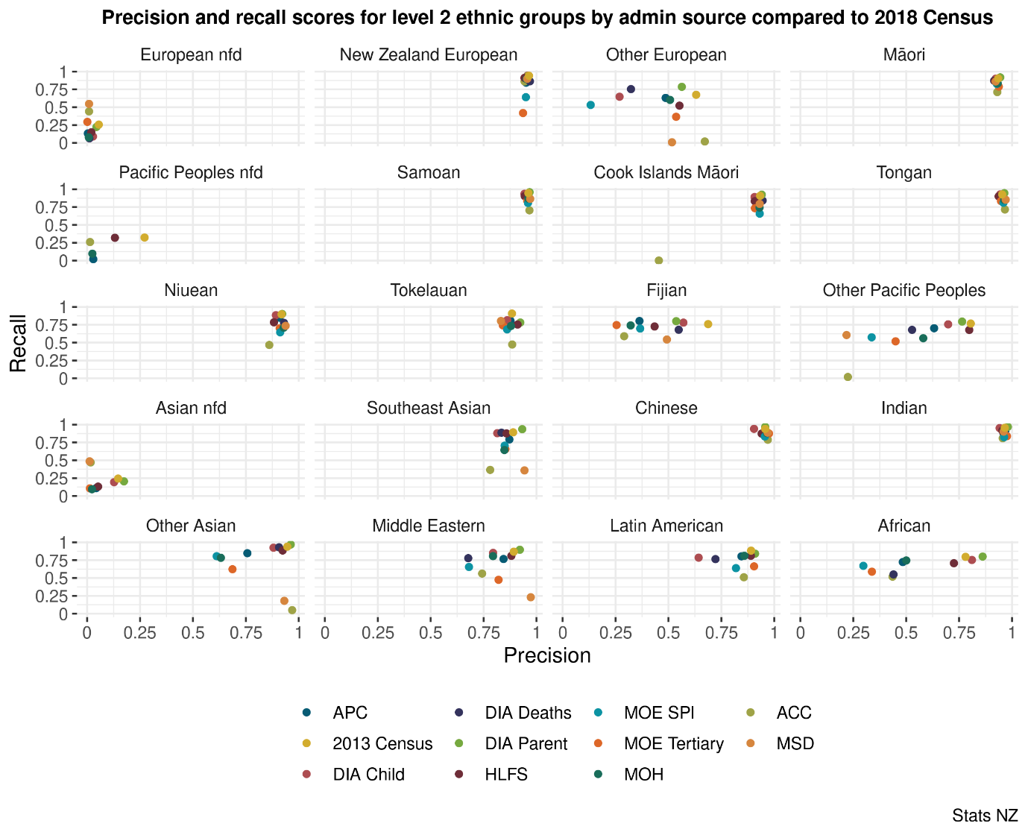
Work in progress

Slide 51
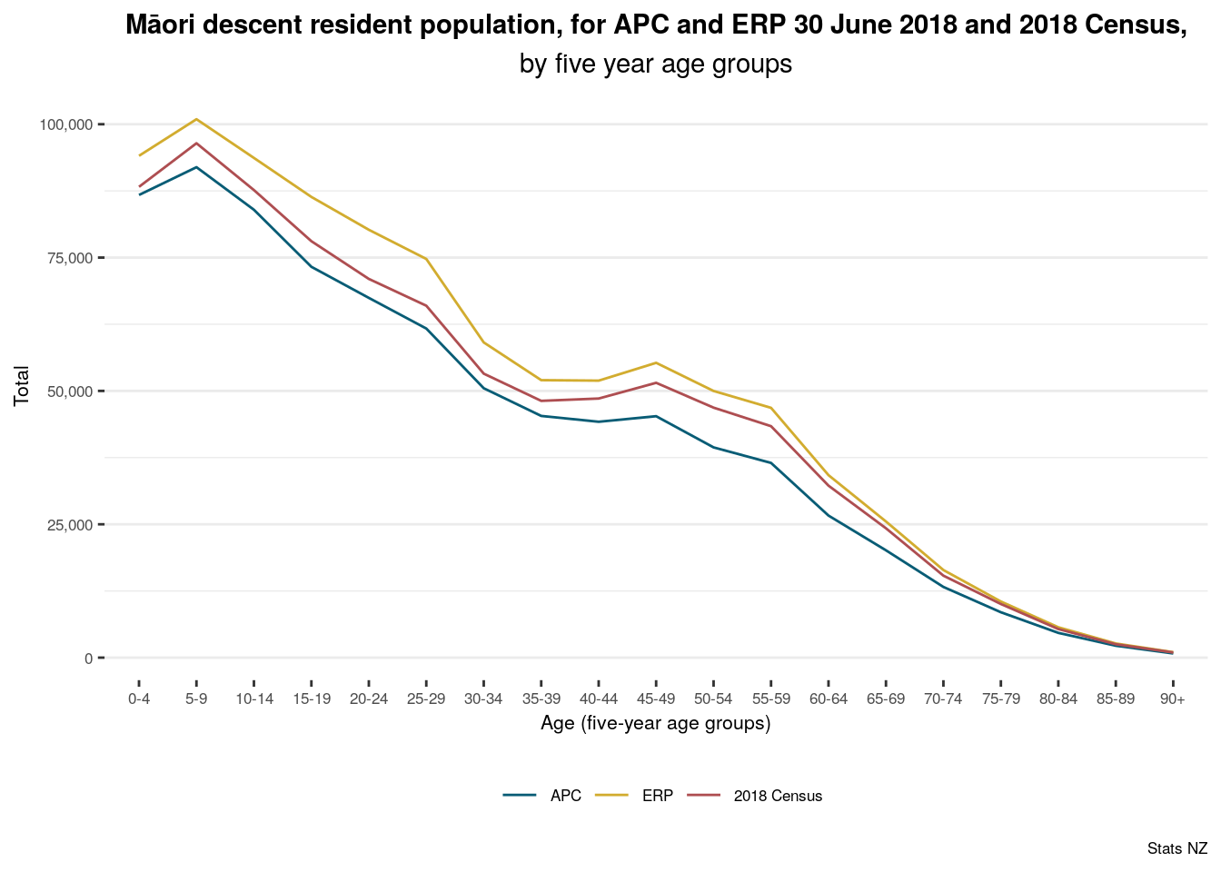
No age bias, but missingness problem visible.

Slide 52
Individuals by dwelling scenario
Dwelling scenario | Count of
 | Dwellings | Census respondents | Admin enumerations (in dwelling) | Admin enumerations (in meshblock) | Admin records not selected
Dwelling under construction | 26,790 | - | - | 1,782 | 747
Multiple dwellings at address | 35,262 | 66,759 | 603 | 17,304 | 10,290
Non-private dwelling | 10,539 | 60,300 | 9,555 | 309 | 7,569
Occupied - non-responding | 108,747 | 6,039 | 176,181 | 30,417 | 7,308
Occupied - responding | 1,619,310 | 4,193,532 | 70,758 | 154,740 | 84,726
Unoccupied - empty | 100,938 | - | - | 8,244 | 3,852
Unoccupied -residents away | 106,302 | 26,790 | 59,385 | 8,409 | 3,255
NA | 10,797 | - | - | 7,002 | 12,747

