Slide 1
Tairāwhiti District Disease Data on
Substack
Public Health Observatory NZ Conference
25 July 2024
Dr Oz (Osman David) Mansoor
Medical Officer Of Health, Tairāwhiti

Slide 2
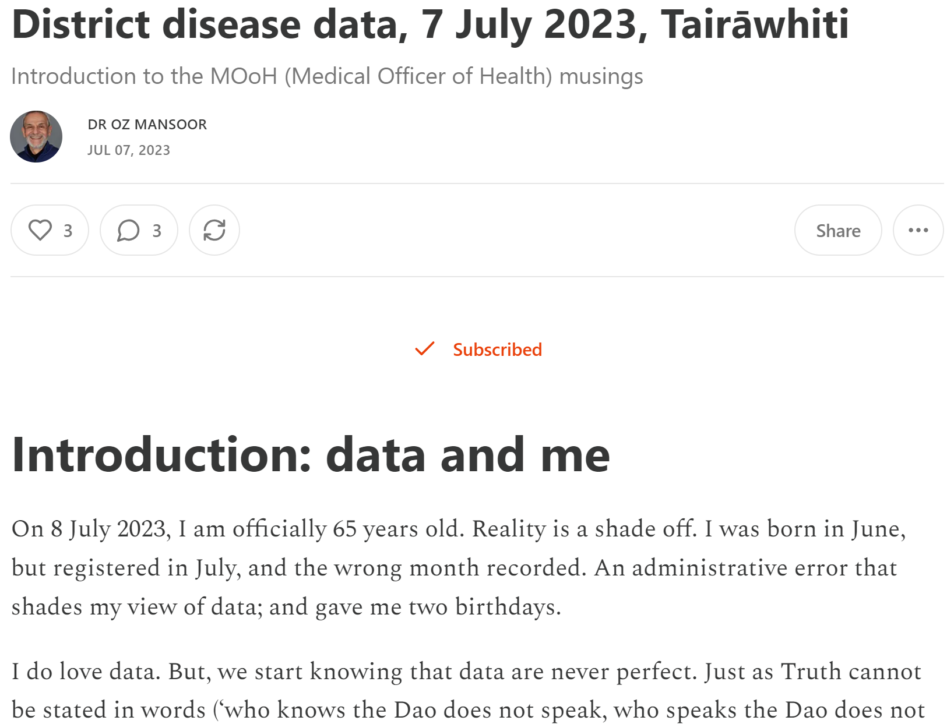
Introduction
My name, Osman David Mansoor, reflects my Muslim father and Jewish mother.
Public Health Medicine (PHM) specialist since 1994; first at the Public Health Commission, then Ministry of Health, World Health Organisation and UNICEF.
Returned to NZ in 2014 to work in local Public Health. Initially in Wellington. Since January 2020, Medical Officer of Health in Gisborne.
Extracted from my Substack; as is nearly all material in this presentation:
https://drozmansoor.substack.com/

Slide 3
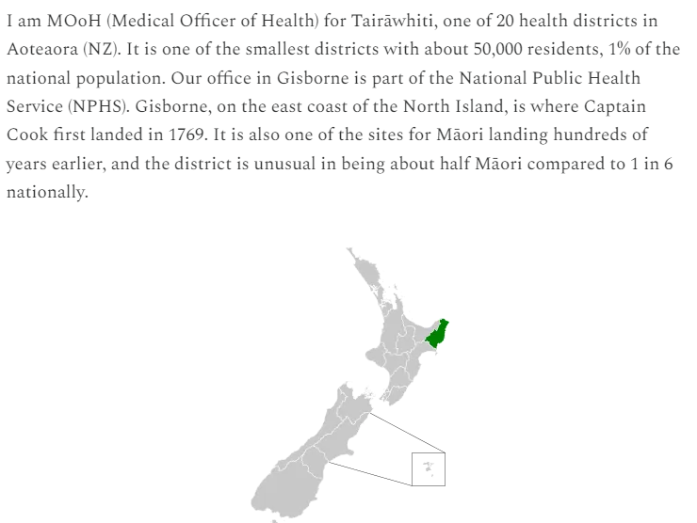
Introduction to district

Slide 4
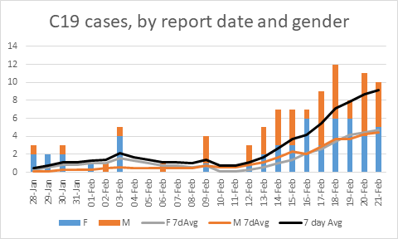
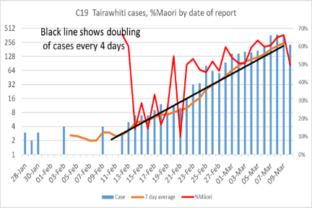
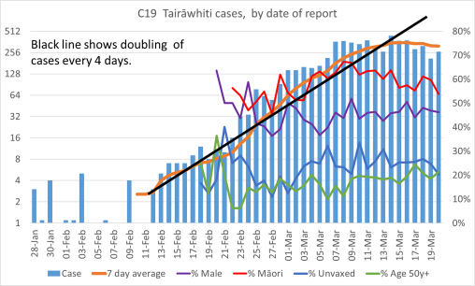
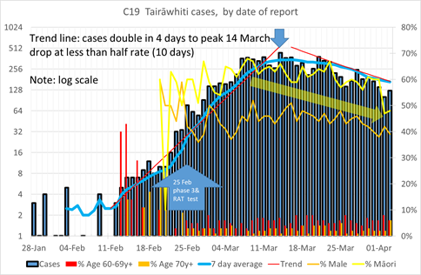
Covid-19 in Tairāwhiti
Only NZ district with no local spread of Covid-19 before Omicron in Jan 2022
4 cases in March 2020
3 cases Xmas 2021

Slide 5
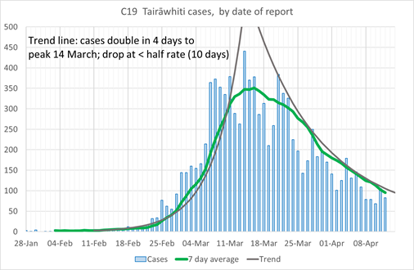
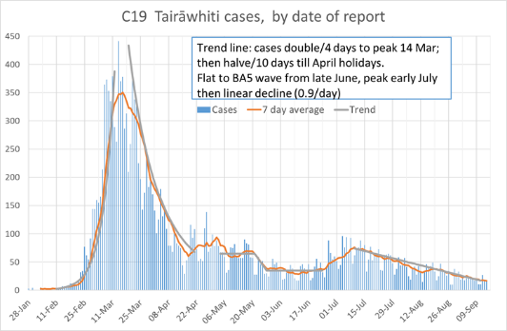

Slide 6
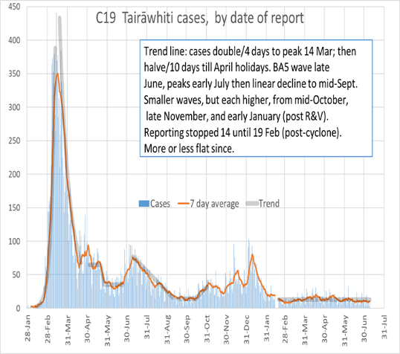
Covid cases on Substack

Slide 7
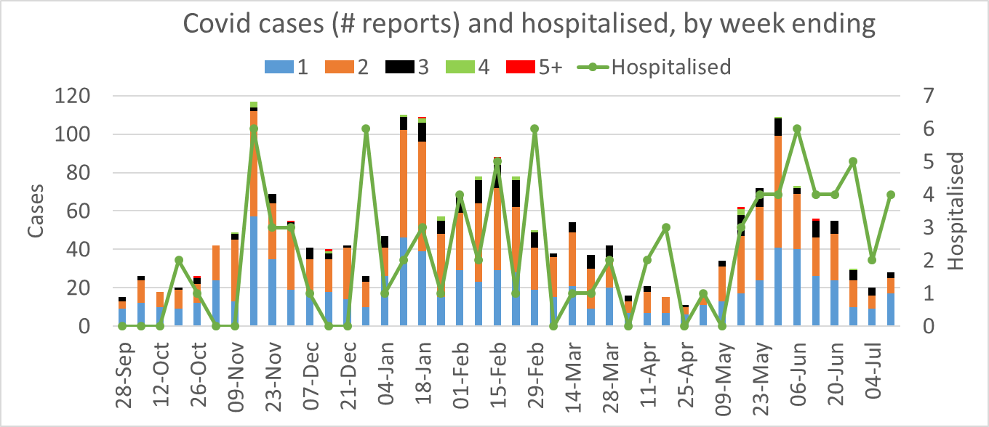
Chart for weeekly update

Slide 8
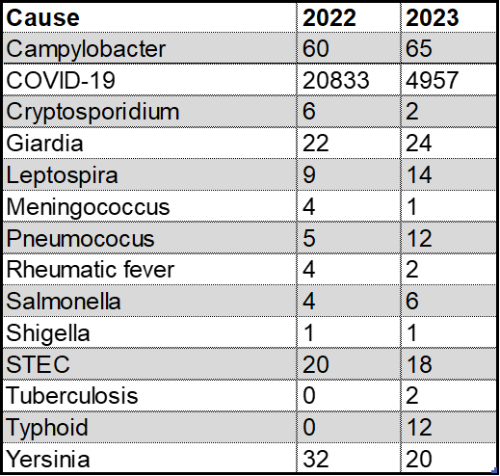
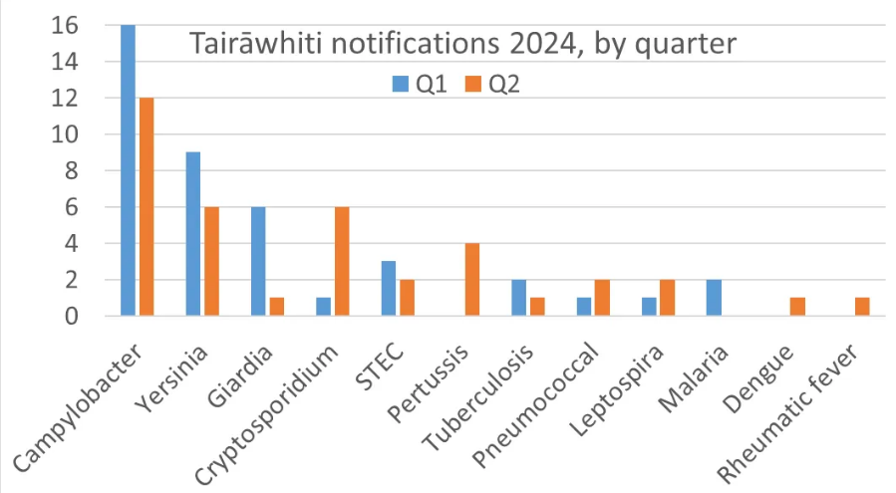
Tairāwhiti notifications

Slide 9
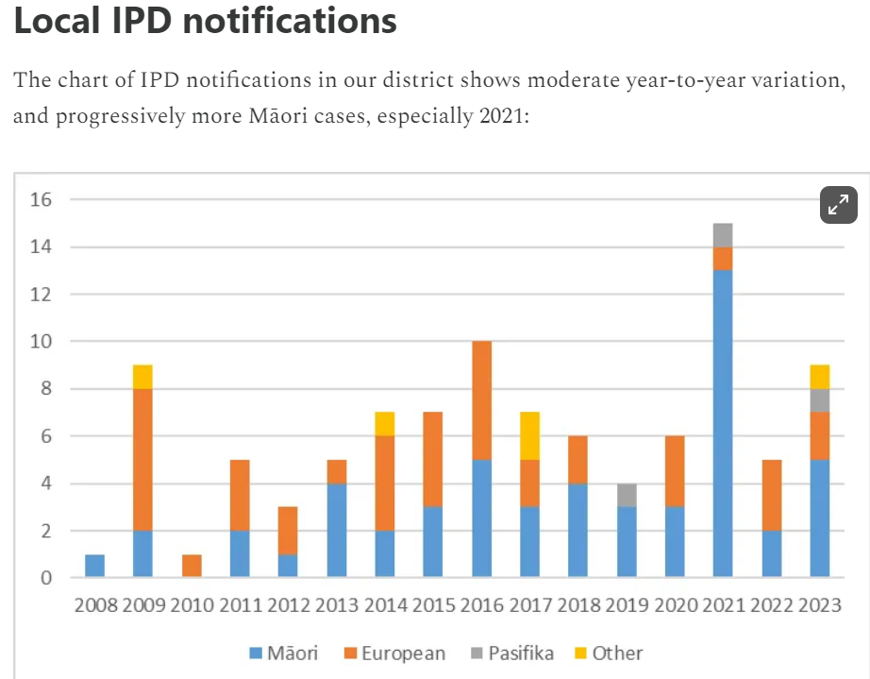
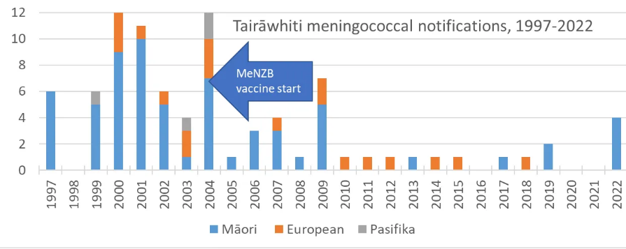

Slide 10
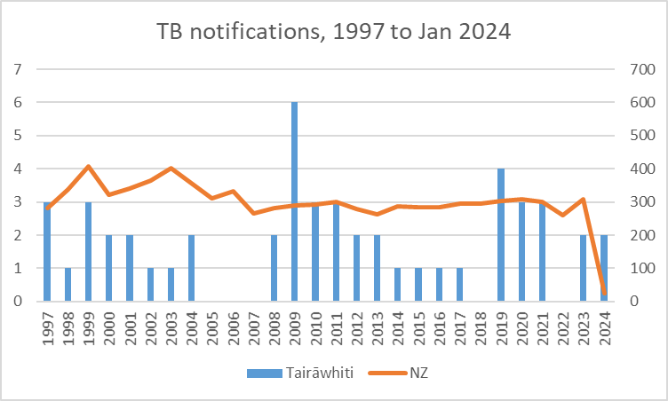
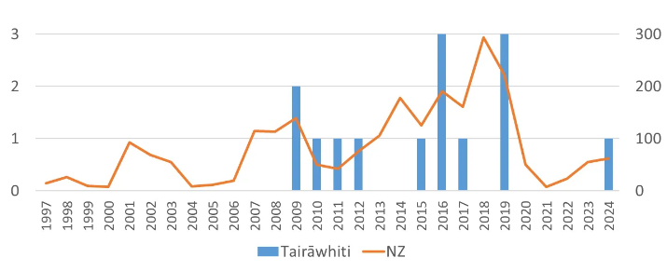
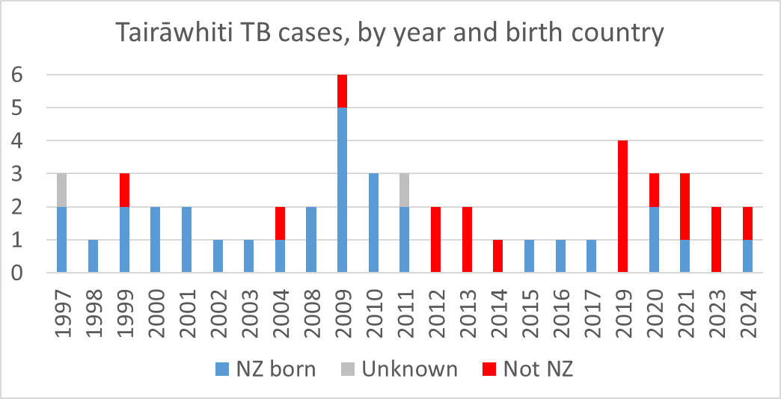
Comparing national and local data
Tairāwhiti has ~ 1% of national population
Chart compares numbers (x100) and crude incidence
Dengue

Slide 11
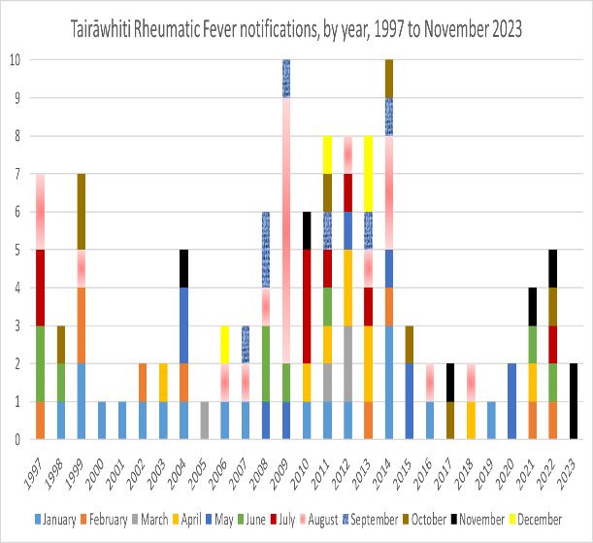
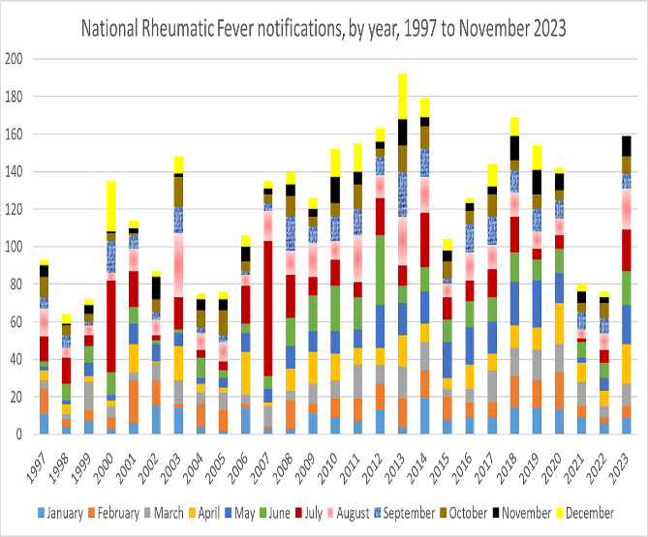
Rheumatic fever

Slide 12
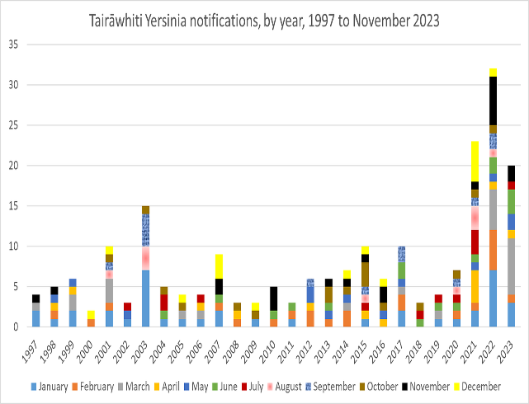
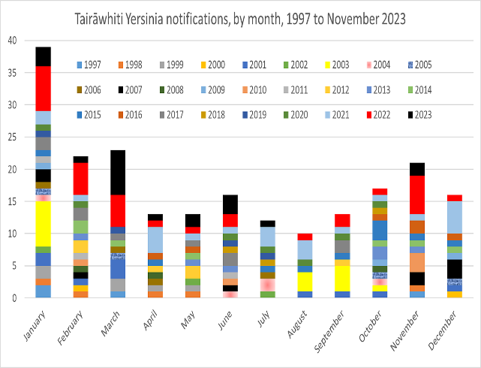
Yersinia

Slide 13
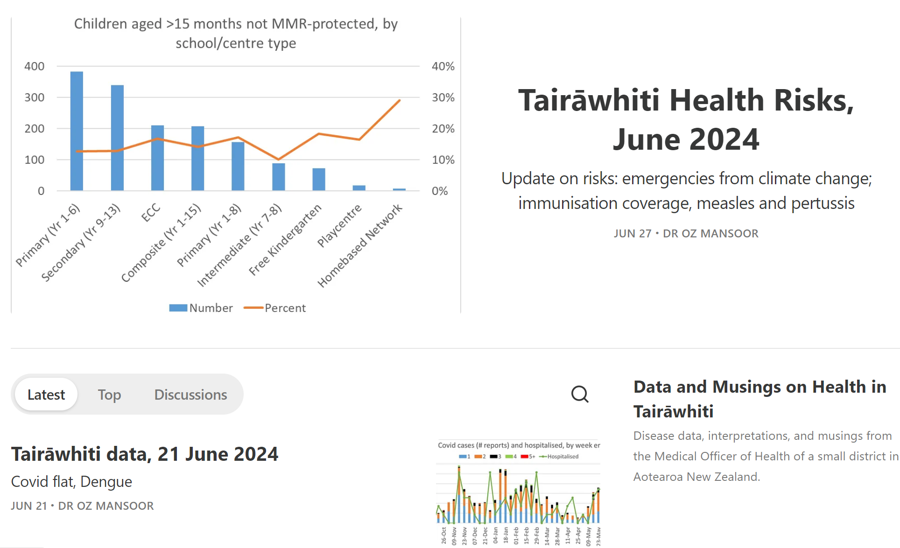
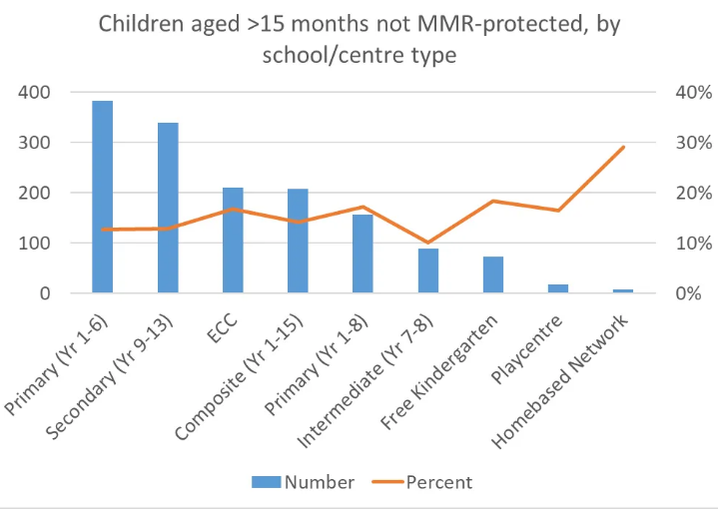

Slide 14
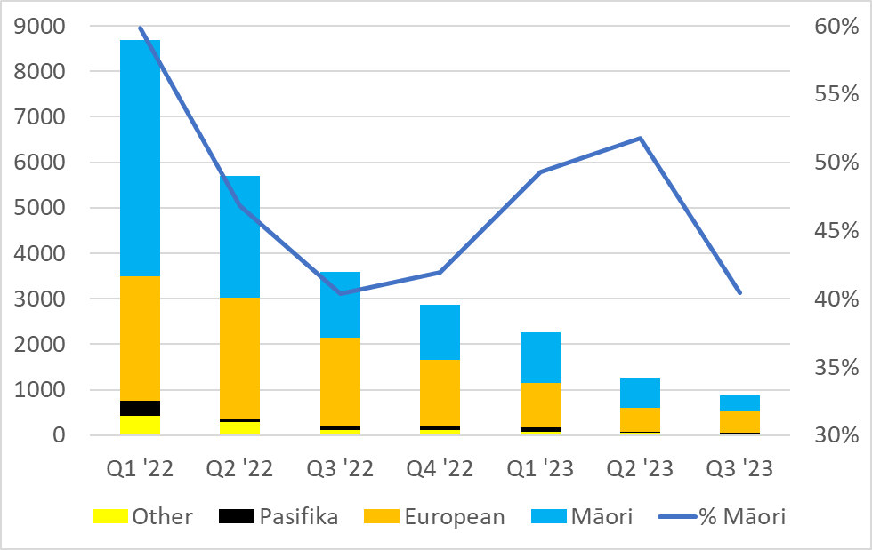
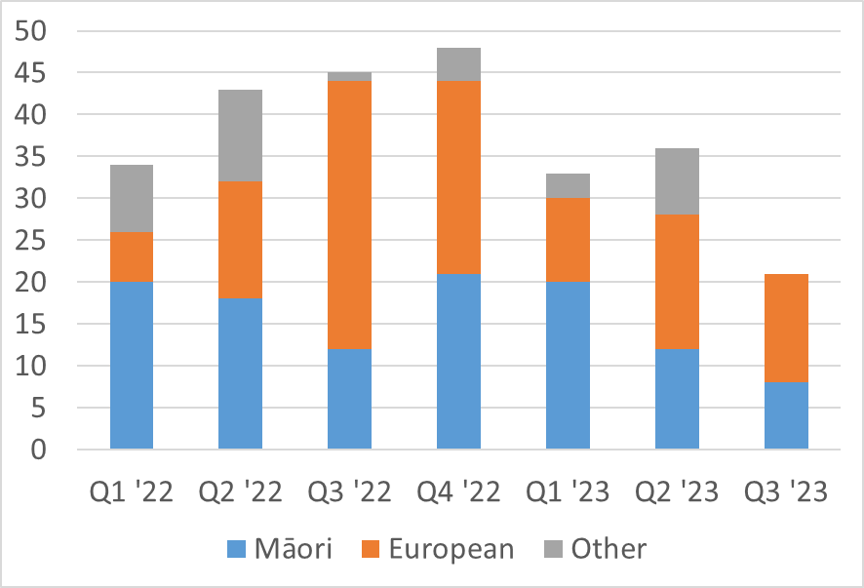
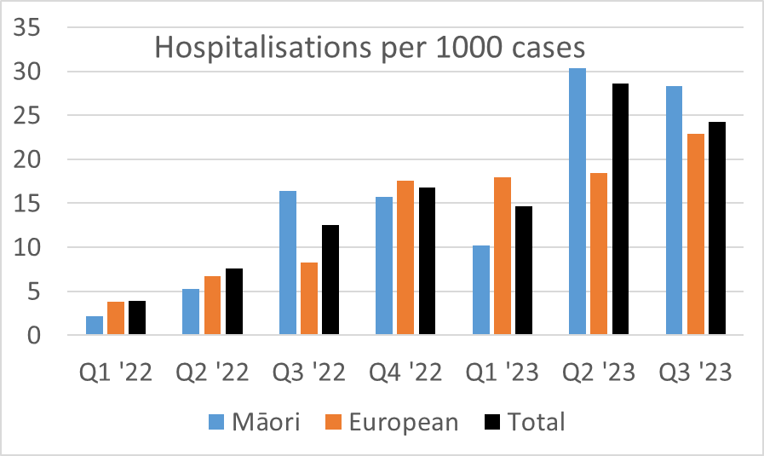
Covid-19 Hospitalisations
Cases

Slide 15
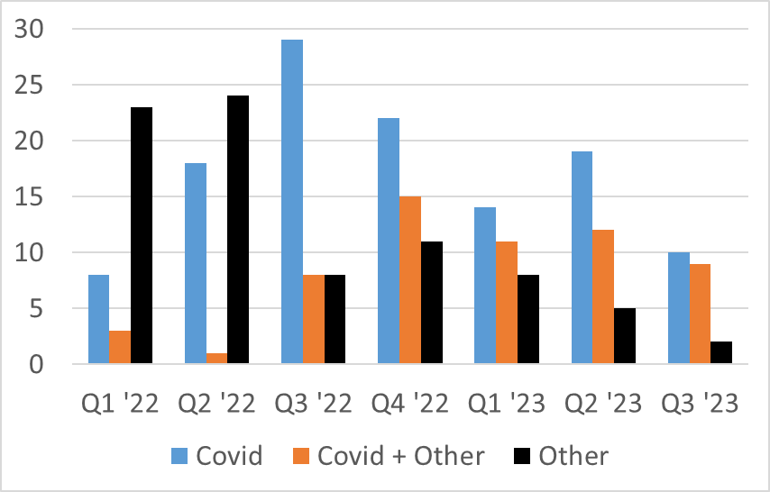
Covid hospital cases: cause

Slide 16
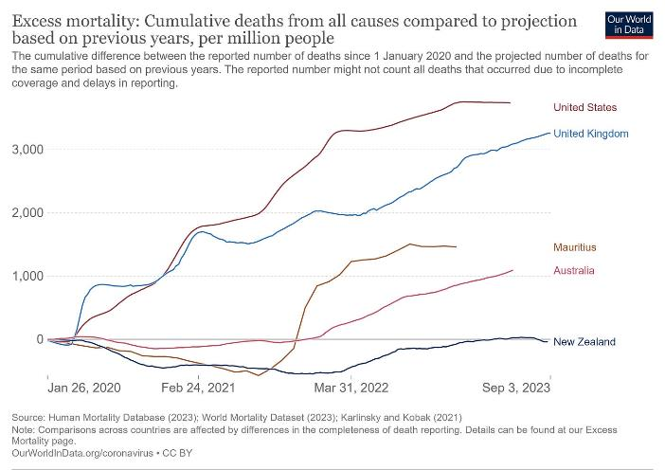
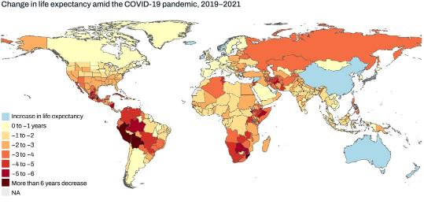
Global pandemic impacts
https://www.thelancet.com/journals/lancet/article/PIIS0140-6736(24)00476-8/fulltext
“Between 1950 and 2021, global life expectancy at birth increased by 22·7 years (20·8–24·8), from 49·0 years (46·7–51·3) to 71·7 years (70·9–72·5). Global life expectancy at birth declined by 1·6 years (1·0–2·2) between 2019 and 2021, reversing historical trends. An increase in life expectancy was only observed in 32 (15·7%) of 204 countries and territories between 2019 and 2021.”

Slide 17
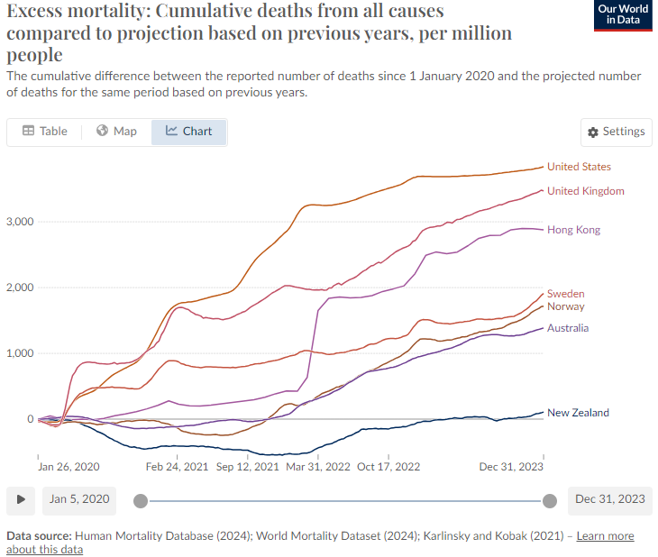

Slide 18
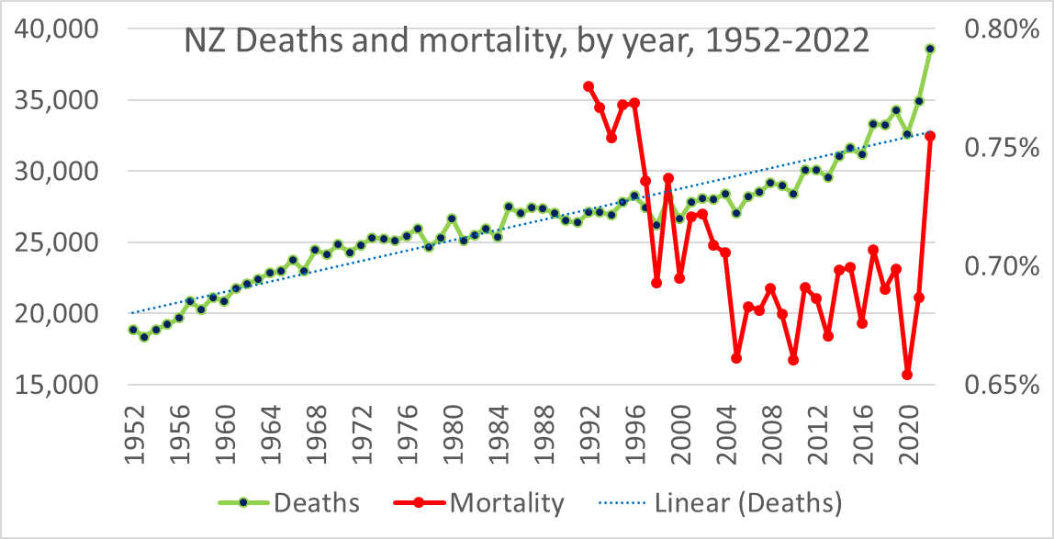
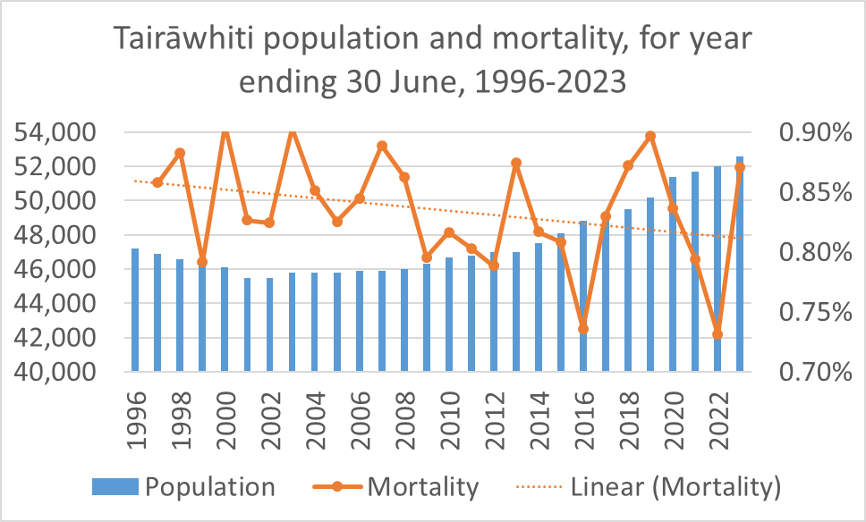
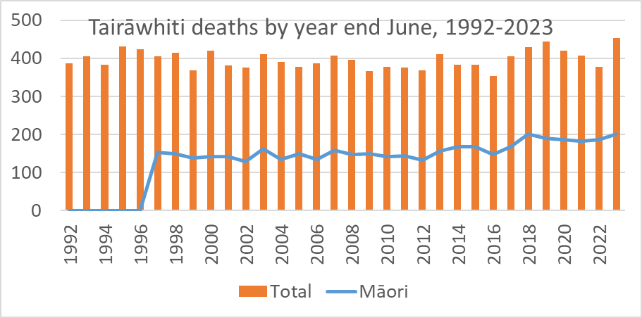
National and local mortality

Slide 19
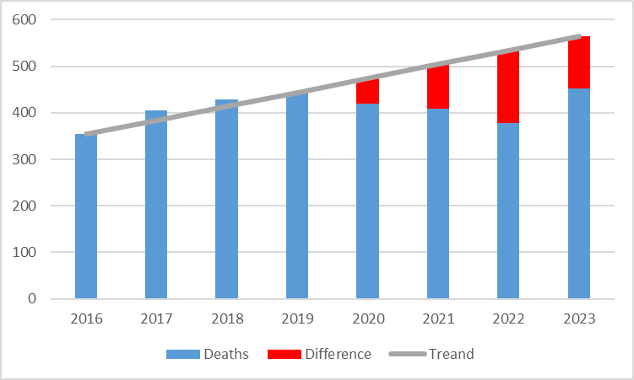
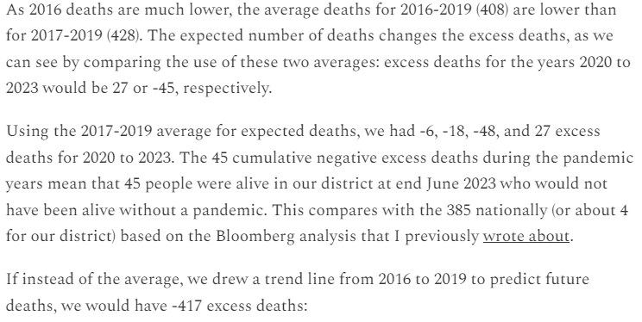
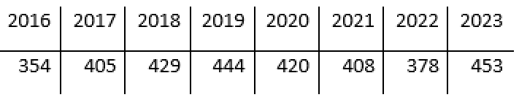
Tairāwhiti deaths avoided
Excess district deaths to June 2023: -4, 27 or -45, -417

Slide 20
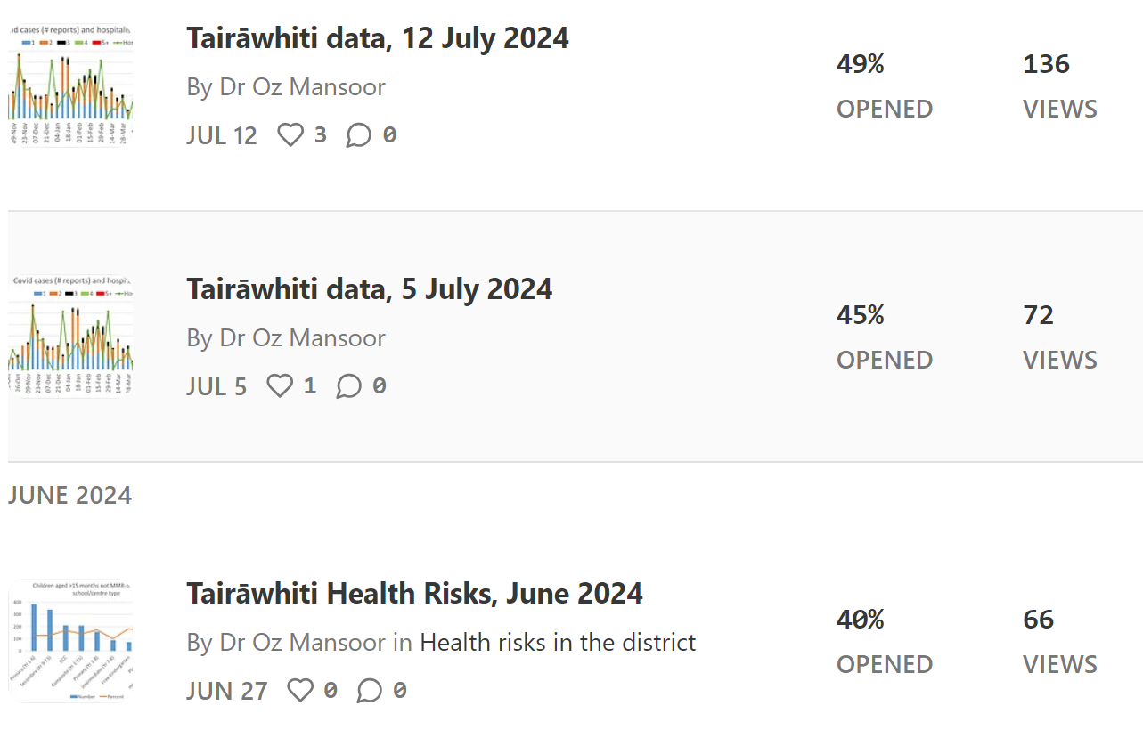
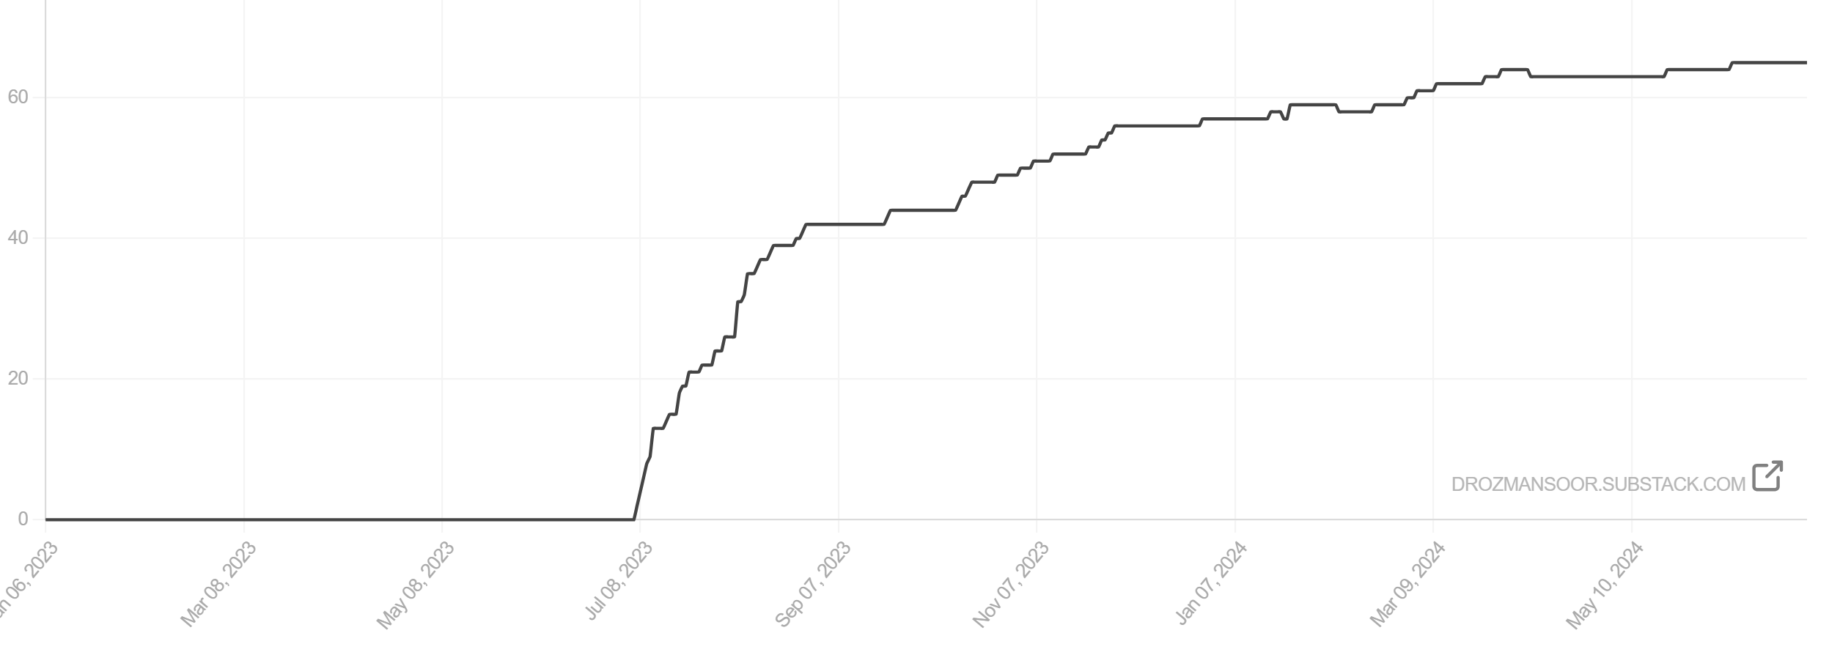
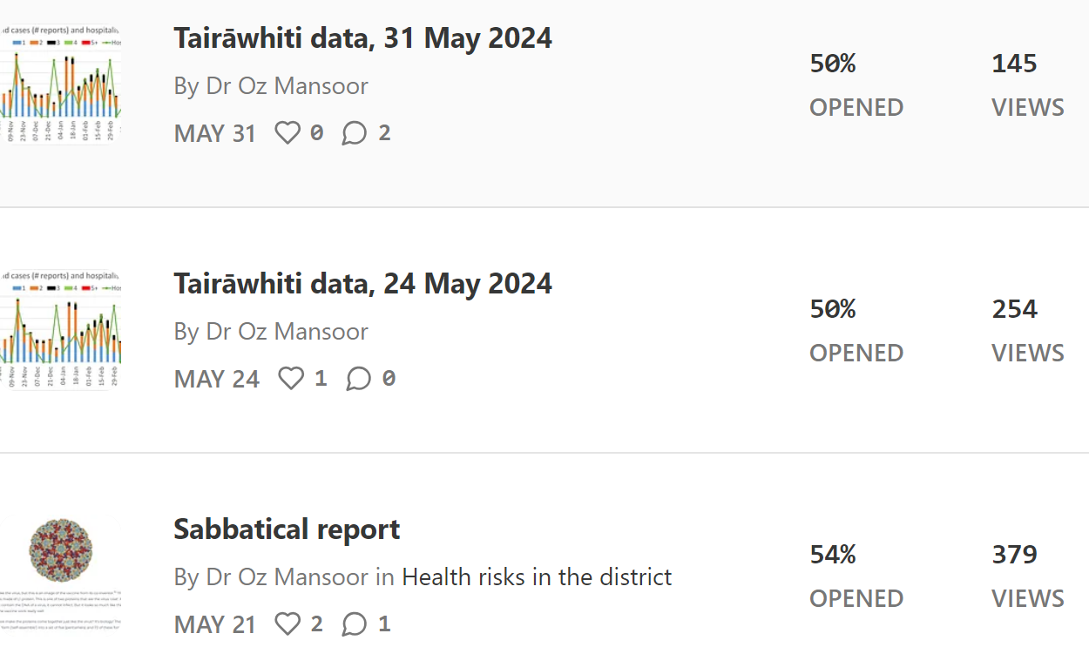
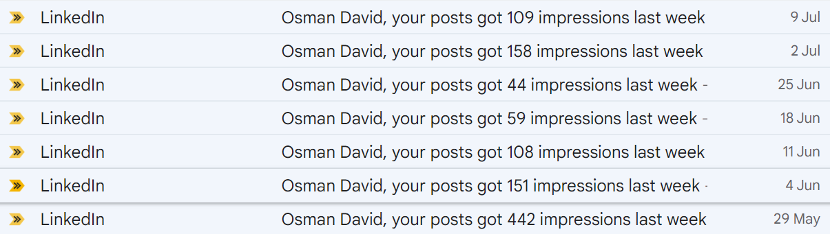
Subscribers & views

Slide 21
Why a weekly update on Substack
Substack as source of good (and bad) science stories
  Free
Local disease risks
Role in buidling trust??
Thanks and feedback to notifiers and others involved in system
  Most are self-notified now (Covid)
Your thoughts?

